Slide 1
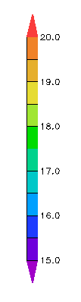
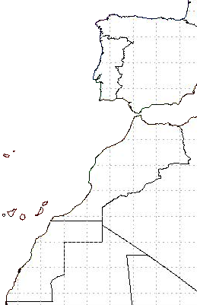
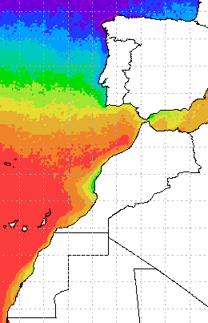
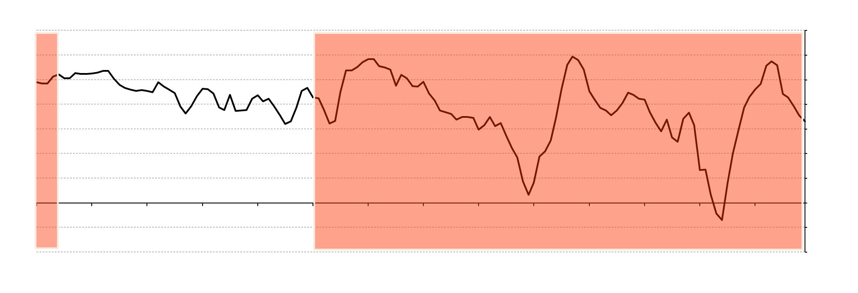

a)
b)
c)
North
20˚C
19˚C
18˚C
17˚C
16˚C
15˚C
44N
42N
40N
38N
36N
34N
Latitude
32N
30N
28N
26N
24N
300 km
22N
South
-0.1
0
0.1
0.2
0.3
16W
14W
12W
10W
8W
6W
4W
2W
16W
14W
12W
10W
8W
6W
4W
2W
Rate of warming (˚C/decade)

