Slide 1
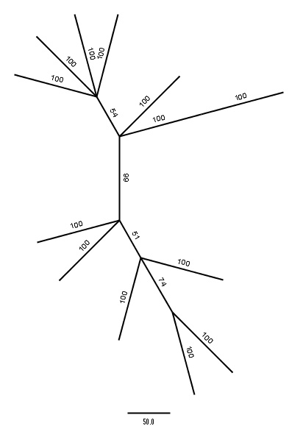
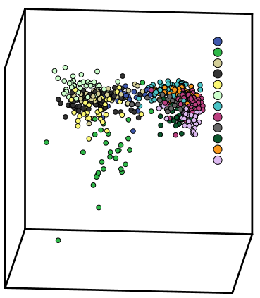
a)
b)
LG
VN
ML
OV
RL
RE
RE
OV
LG
VN
RL
ML
MG
Axis 2 (13.48%)
TJ
RM
RF
TV
LX
MG
TV
RM
Axis 1 (34.86%)
RF
Axis 3 (11.77%)
LX
TJ

