Slide 1
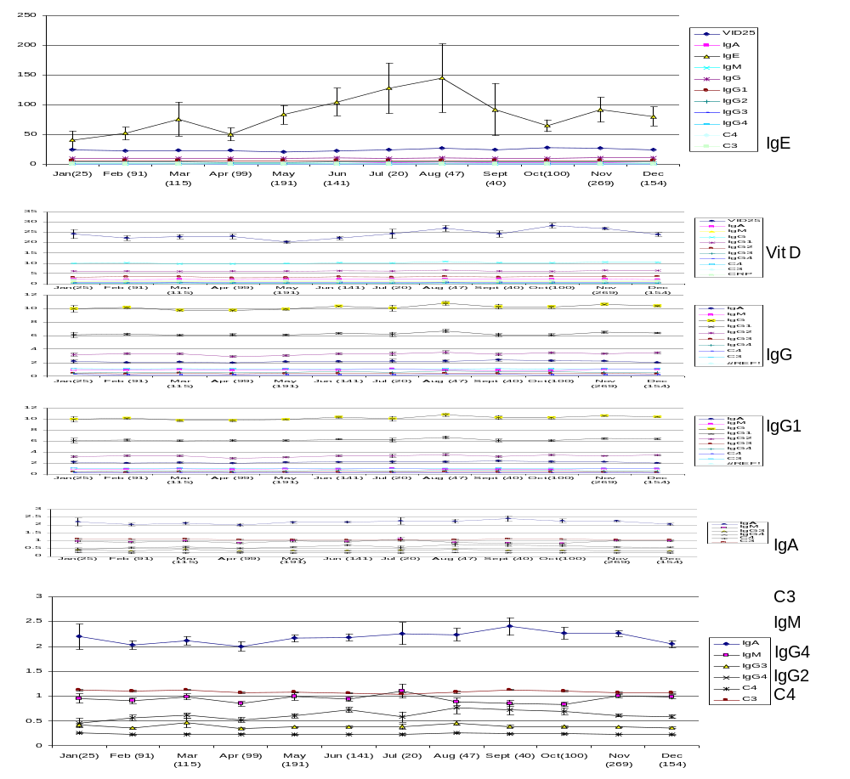
kU/L
ng/ml
mg/ml
mg/ml
mg/ml
mg/ml

