Slide 1

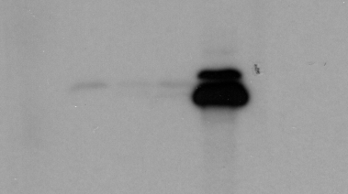

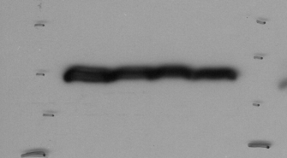
E
F
55 kDa
55 kDa
Myc
Relative band
Intensity
Actin
PRMT6
Relative band
Intensity
Actin
40 kDa
40 kDa
0 0.8 1
1 0.06 0.03 0.04
40 kDa
40 kDa
NT WT R35A
Lane 1 2 3 4

