Slide 1




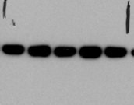

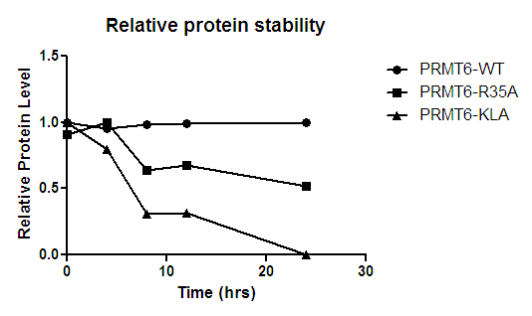
Figure 5
A
55 kDa
Myc
Actin
Time
(hrs)
40 kDa
40 kDa
0 4 8 12 24
0 4 8 12 24
0 4 8 12 24
PRMT6-wt
PRMT6-R35A
PRMT6-KLA
B

