Slide 1
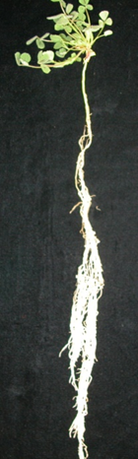
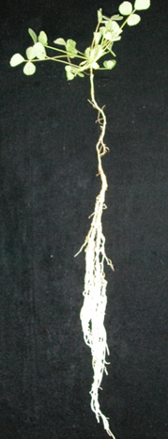
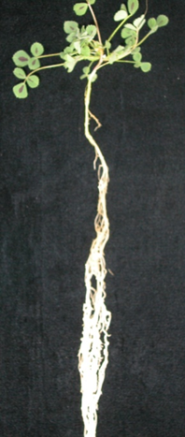
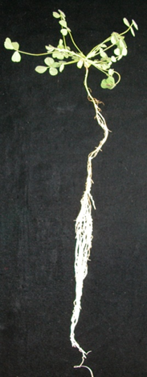
Genotype
Genotype
Genotype
Genotype
Shoot
A17
A17
rdn1-2
rdn1-2
Root
A17
rdn1-2
A17
rdn1-2

