Slide 1
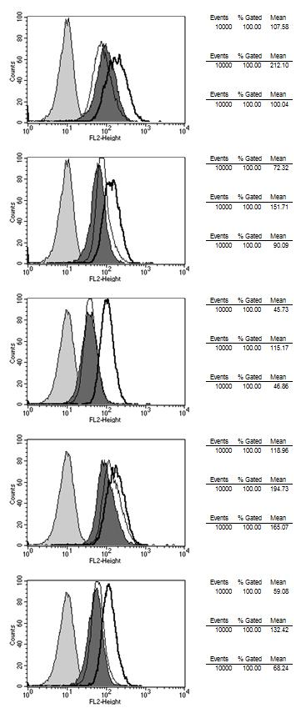
Supplement 2
RT+CHX
RT
MICA
MICB
ULBP1
ULBP2
ULBP3

