Slide 1
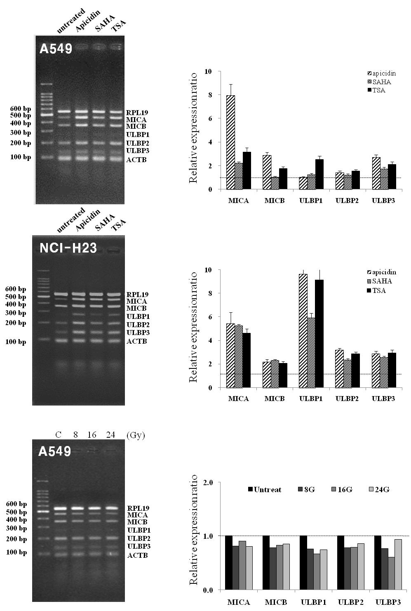
Figure 1
A
B
C

