Slide 1
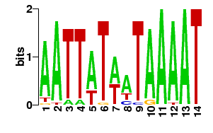
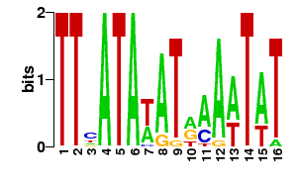
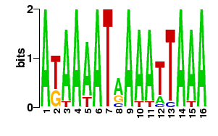
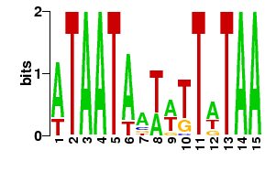
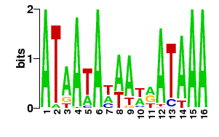
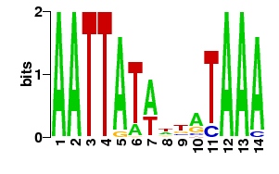
Motif Cluster ID | Sequence of logo of predicted DNA Binding Site | Regulator Name | Optimal offset | p-value | E-value | q-value | Overlap | Query consensus | Target consensus
29 |  | IscR_Rickettsiales | 5 | 0.009 | 1.22 | 1.00 | 14 | TTCATATATAAAATAT | ATTGTTTTATATCTACAAT
 |  | NadR_Enterobacteriales | 3 | 0.011 | 1.59 | 1.00 | 15 | TTCATATATAAAATAT | TGTTTAATATACTAAACA
 |  | NagC Ecol | 6 | 0.005 | 0.93 | 1.00 | 16 | TTCATATATAAAATAT | TATTTTTCGATAGATAAAAAAAG
 |  | torR | 3 | 0.005 | 0.32 | 0.64 | 7 | TTCATATATAAAATAT | CTGTTCATAT
41 |  | arcA | 3 | 0.001 | 0.08 | 0.15 | 12 | AATTATATTATAAA | GTTAATTAAATGTTA
 |  | PhoP Bsub | 12 | 0.020 | 3.79 | 1.00 | 14 | AATTATATTATAAA | TGATTAAAAAAGAAATTTAAAATATAATACA
 |  | rpoD16 | -1 | 0.005 | 0.34 | 0.33 | 13 | AATTATATTATAAA | ATTATACAGAAAAAATAAAAAATGTCAA
 |  | rpoD17 | -1 | 0.011 | 0.71 | 0.38 | 13 | AATTATATTATAAA | ATTATAACAAAAACTAAAGAATTTGTCAA
 |  | rpoD19 | -1 | 0.011 | 0.76 | 0.38 | 13 | AATTATATTATAAA | ATTATACCTCAAAACAGATAAAAAATGTCAA
 |  | XylR_Gammaproteobacteria | 12 | 0.025 | 3.48 | 1.00 | 14 | AATTATATTATAAA | ACGAAAAATCGTAATAGAAGTGTAAAATAACATAATTG
46 |  | Hpr Bsub | 0 | 0.001 | 0.12 | 0.25 | 16 | ATAATATAATAATAAA | AAAATAGCATAATATAAAA
 |  | ihf | 5 | 0.010 | 0.69 | 0.69 | 16 | ATAATATAATAATAAA | CTAAGATAATAAAATGTTAAAAAATCAATAAGTTATATTTAATAAGTA
 |  | lrp | 7 | 0.001 | 0.08 | 0.16 | 16 | ATAATATAATAATAAA | AAAATGAATAATAAAAAAATCAAAT
 |  | MngR Ecol | -1 | 0.002 | 0.38 | 0.38 | 14 | ATAATATAATAATAAA | TAATACAAATACAA
 |  | XylR_Gammaproteobacteria | 10 | 0.004 | 0.55 | 1.00 | 16 | ATAATATAATAATAAA | ACGAAAAATCGTAATAGAAGTGTAAAATAACATAATTG
51 |  | arcA | 1 | 0.003 | 0.20 | 0.40 | 14 | ATAATAATATTATAA | GTTAATTAAATGTTA
 |  | ArcA_Gammaproteobacteria | -1 | 0.012 | 1.62 | 1.00 | 14 | ATAATAATATTATAA | TAACATTTAGTTAAC
 |  | DeoR_Enterobacteriales | -1 | 0.021 | 2.96 | 1.00 | 14 | ATAATAATATTATAA | TGTTAGTATTCTAACA
 |  | Fur Hpyl | 1 | 0.008 | 1.51 | 0.49 | 15 | ATAATAATATTATAA | TATTATTTTGTTTTAATGAAAAT
 |  | MngR Ecol | -1 | 0.004 | 0.81 | 0.49 | 14 | ATAATAATATTATAA | TAATACAAATACAA
 |  | RcsA-RcsB Ecol | -1 | 0.008 | 1.45 | 0.49 | 14 | ATAATAATATTATAA | TAAGAATATTCCTA
 |  | XylR_Gammaproteobacteria | 10 | 0.014 | 2.00 | 1.00 | 15 | ATAATAATATTATAA | ACGAAAAATCGTAATAGAAGTGTAAAATAACATAATTG
 |  | YhiX Ecol | 5 | 0.005 | 0.90 | 0.49 | 13 | ATAATAATATTATAA | TTAGGATATTTTTTTTAT
52 |  | arcA | -1 | 0.009 | 0.61 | 0.68 | 15 | ATAAAATAAAATTAAA | TAACATTTAATTAAC
 |  | ArcA_Gammaproteobacteria | -1 | 0.013 | 1.90 | 1.00 | 15 | ATAAAATAAAATTAAA | TAACATTTAGTTAAC
 |  | CovR Spyo | -6 | 0.007 | 1.26 | 1.00 | 10 | ATAAAATAAAATTAAA | TTAAATTAAAA
 |  | lrp | 0 | 0.010 | 0.68 | 0.68 | 16 | ATAAAATAAAATTAAA | AAAATGAATAATAAAAAAATCAAAT
 |  | MtaR_Streptococcaceae | 1 | 0.014 | 2.00 | 1.00 | 16 | ATAAAATAAAATTAAA | TATAGTTTAAAACTATA
53 |  | CodY Bsub | 33 | 0.004 | 0.78 | 0.78 | 14 | AATTATAATAAAAT | ATCTGTTCATGTAAAACGAAAGGTAGAAAGAAAAAAAAAAATAAAAACAACGAATAAAGAGACAA
 |  | CovR Spyo | -2 | 0.002 | 0.36 | 0.72 | 11 | AATTATAATAAAAT | TTAAATTAAAA
 |  | lrp | 3 | 0.022 | 1.51 | 1.00 | 14 | AATTATAATAAAAT | AAAATGAATAATAAAAAAATCAAAT
Supplementary Table 5

