Slide 1
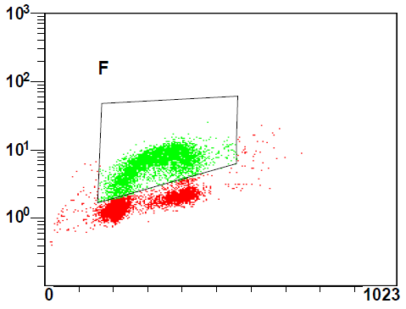
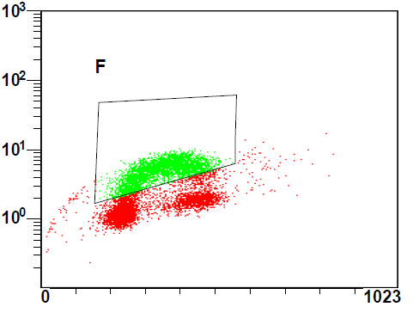
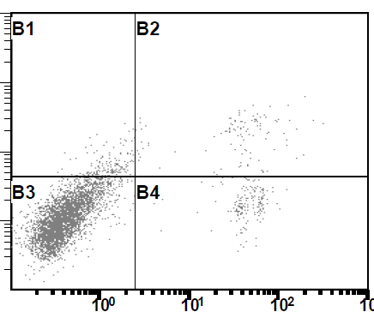
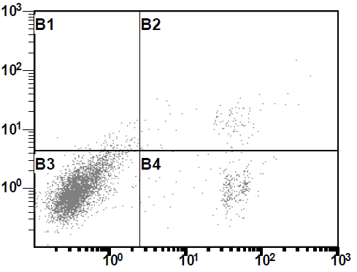
Supplemental Figure 2
A
B
Contrl siRNA + -
PIK3R3 siRNA - +
PIK3R3
actin
C
Control siRNA PIK3R3 siRNA
D
Brdu-FITC
Control siRNA
PIK3R3 siRNA
Annexin-V
2.9%
2.58%
7-ADD
 | ctrl siRNA | PIK3R3 siRNA
Brdu incorporation (%) | 46.2 ± 2.0 | 37.0 ± 3.8 *
PI

