Slide 1
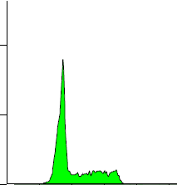
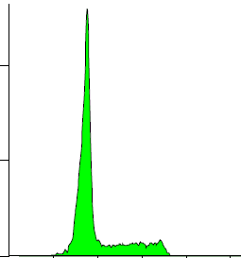
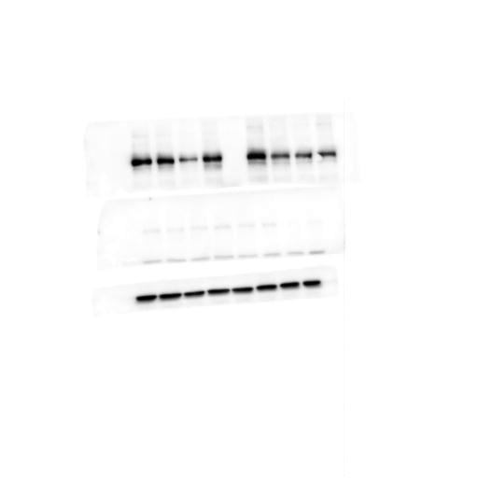
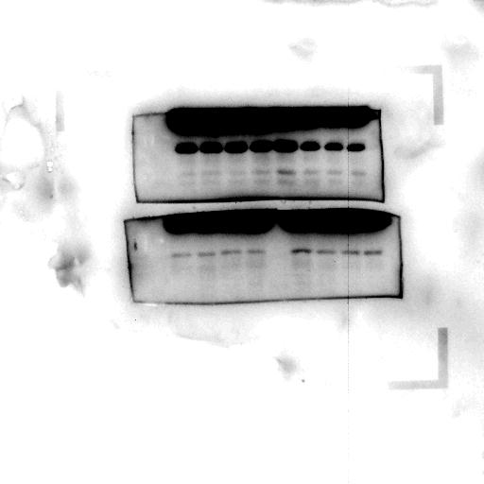
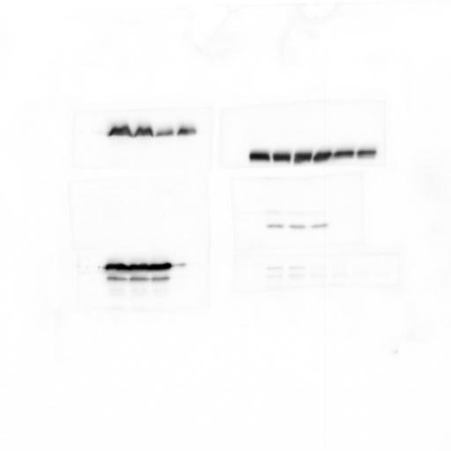
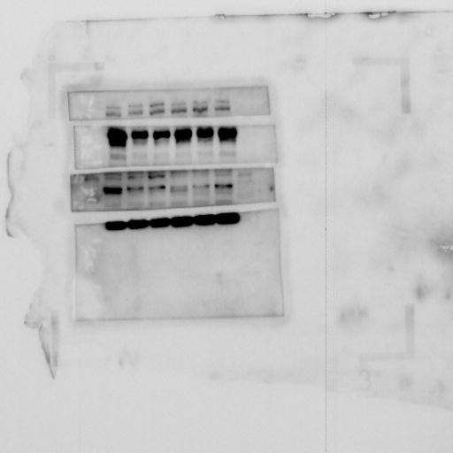
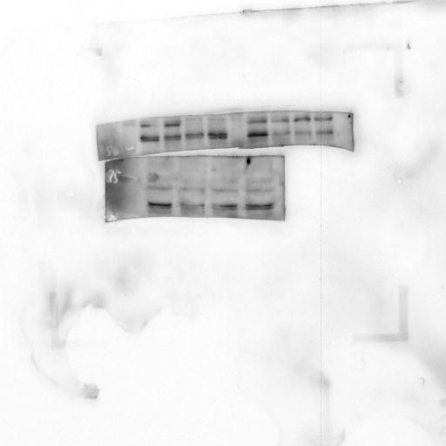
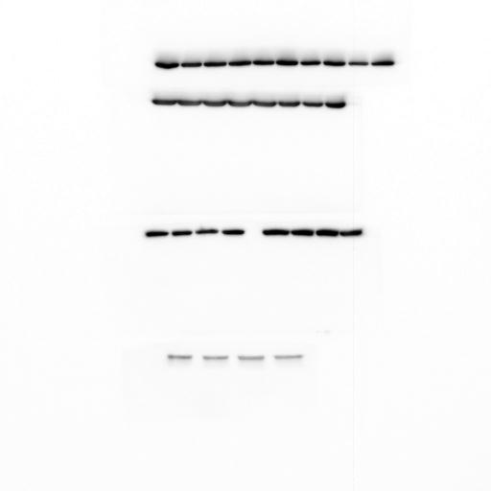
Supplemental Figure 3
A
B
Ctrl siRNA
PIK3R3 siRNA
Ctrl siRNA + -
PIK3R3 siRNA - +
p-RB (ser 780)
Cyclin D1
p-AKT (ser 473)
p-mTOR (ser 2448)
 |  | Ctrl siRNA | PIK3R3 siRNA
10% FBS | G0/G1 | 61.6±1.2 | 71.1±1.4**
 | S | 16.1±3.1 | 11.6±2.5*
 | G2/M | 16.6±2.4 | 12.8±1.2*
PIK3R3
actin

