Slide 1
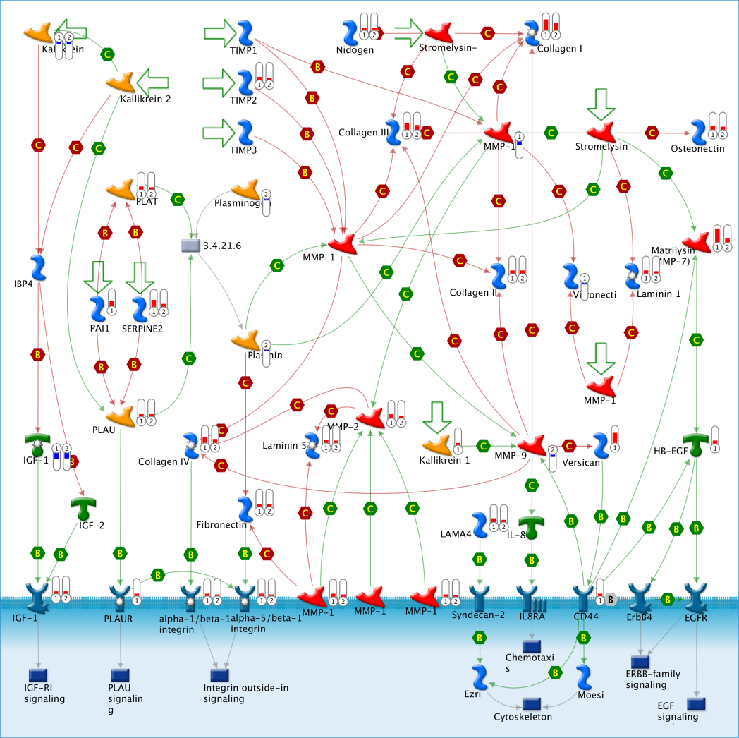
A
Supplementary Figure 7

