Slide 1
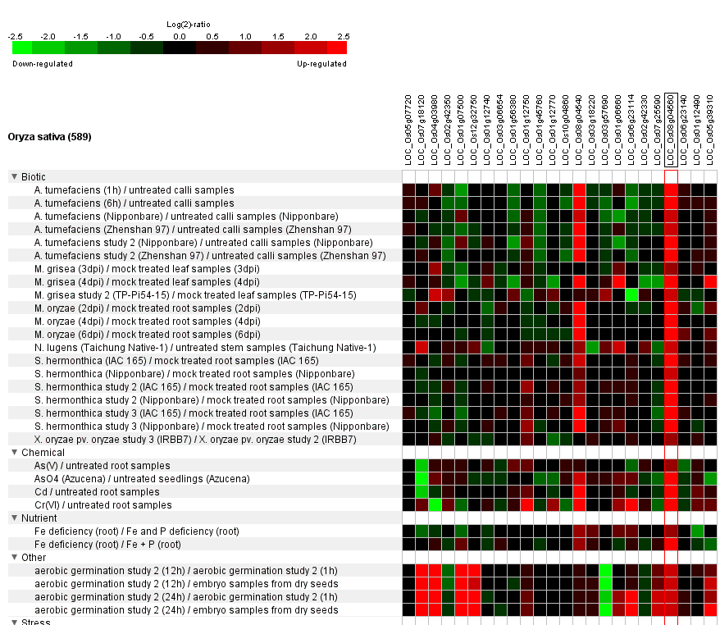
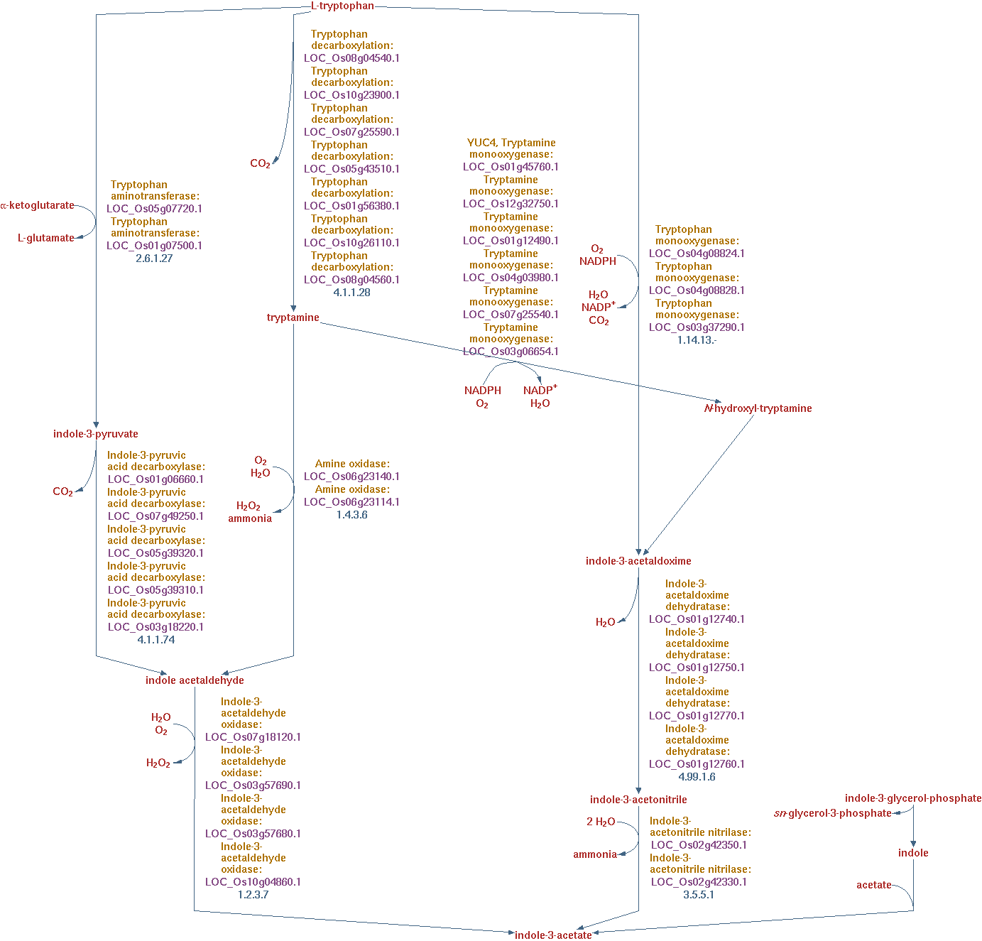

(A)
(C)
1
7
4
6
2
5
(B)
0 4 8 12 16 20 24 28 32 36 40 44 48
8
3
9
-100 0 100
Notes:
4

