Slide 1
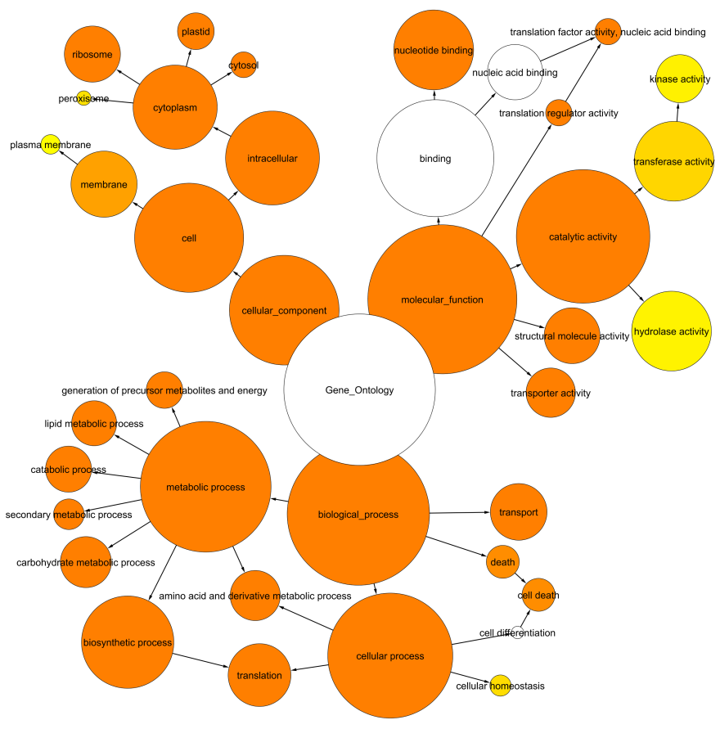
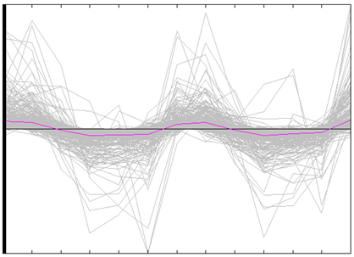
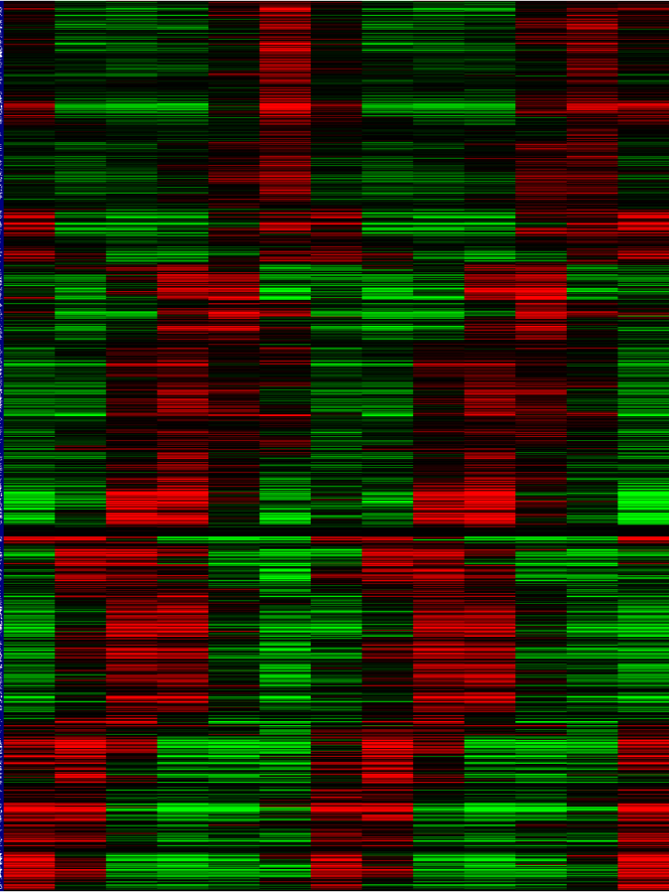
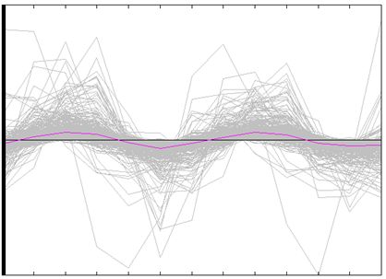
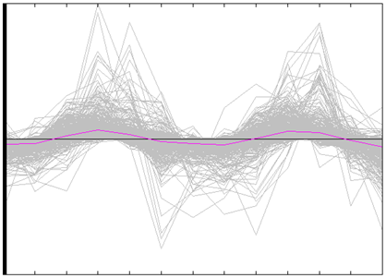
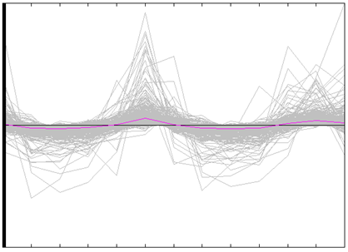
Supplementary Figure-1
(A)
0 4 8 12 16 20 24 28 32 36 40 44 48
(B)
0 4 8 12 16 20 24 28 32 36 40 44 48
-500 0 500
Notes:
S2

