Slide 1
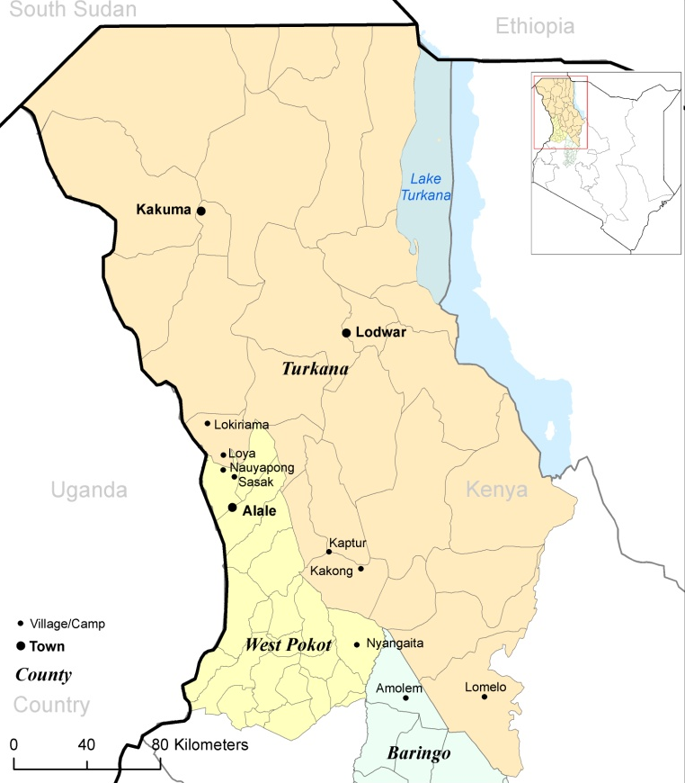
Study area
Conflict Corridor

