Slide 1
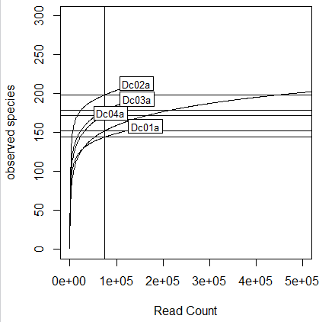
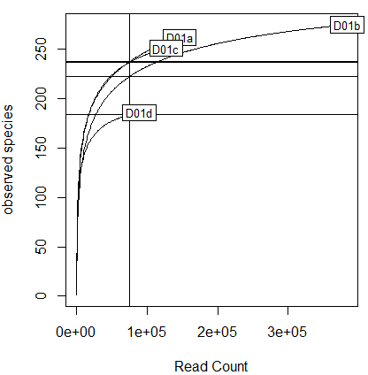
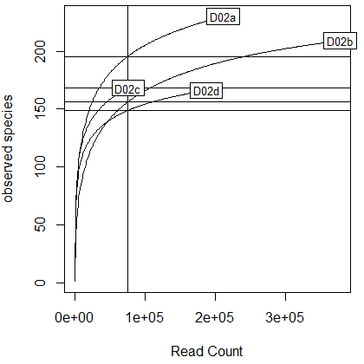
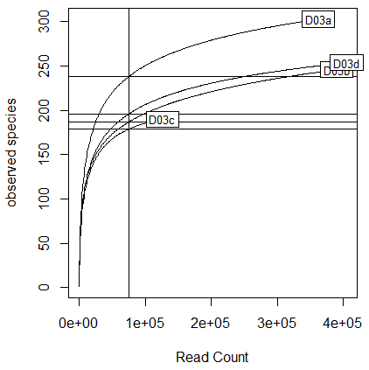
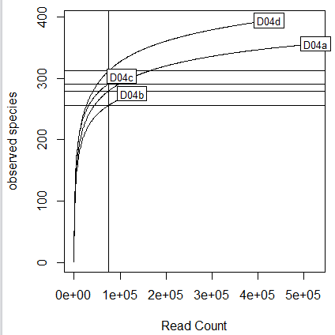
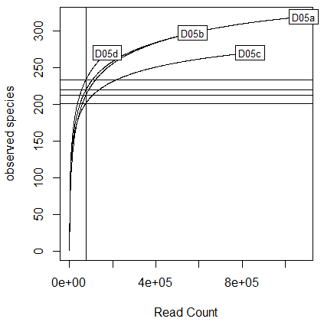
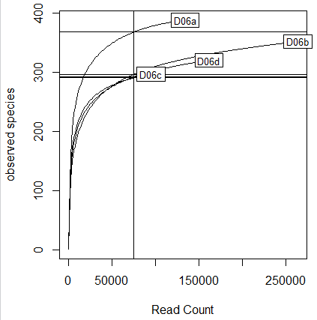
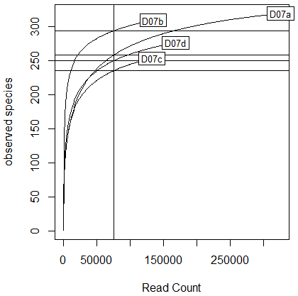
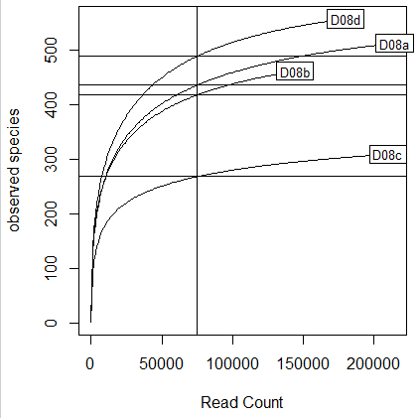
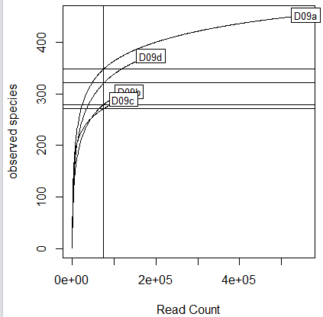
A
B
C
D
Dc05a
E
F
G
H
I
J

Slide 2
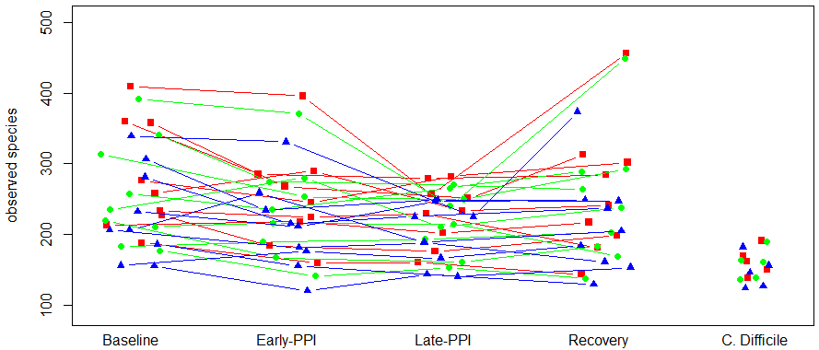

Slide 3
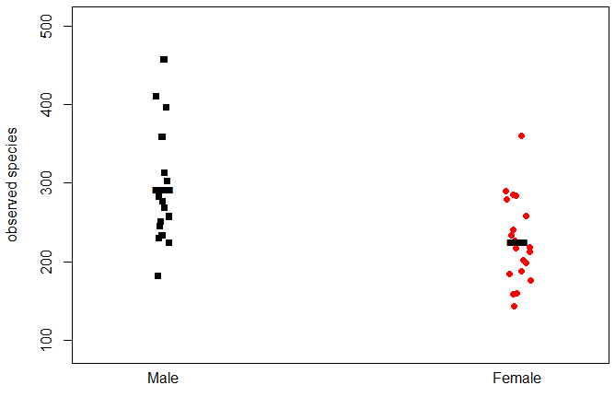
*
Notes:
By Gender. Male=black squares, female=red circles. Horizontal Line=row mean.

Slide 4
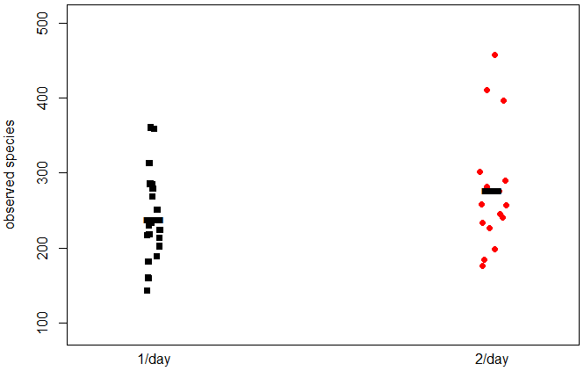
Notes:
By Dosage. Black Squares=once/day, red circles=twice/day

Slide 5
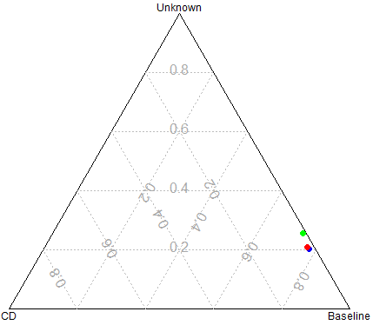

Slide 6
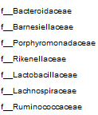

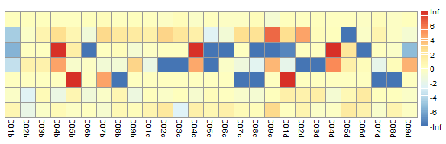
A
B
Log₁₀T7/T0
Log₁₀T28/T0
Log₁₀T56/T0
Means

Slide 7
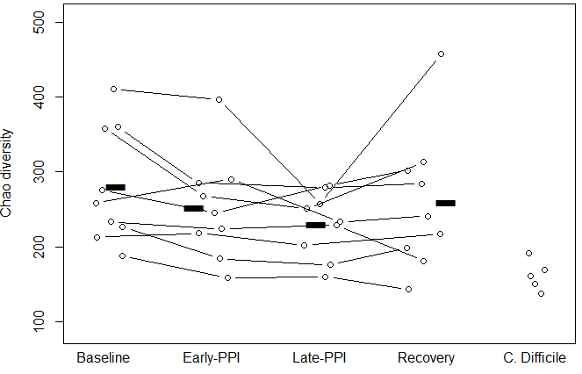
§§
§
§
**
§
*
Notes:
Supplemental Figure 7. Chao Diversity shows differences between PPI and Baseline.
Significant differences were measured between baseline and on-PPI timepoints (p≈0.037, p≈0.006), and baseline and C. difficile (p≈0.001). C. difficile Chao diversity was significantly different from all baseline and one-week on PPI (p≈0.004, p≈0.004) (Supplemental Table 6). All statistical tests using matched-pair healthy volunteers used Wilcoxon signed rank; statistical tests between healthy volunteer groups (*p < 0.05, **p < 0.005) and C. Difficile group used Wilcoxon Rank Sum (§p<0.01, §§p<0.005).

Slide 8
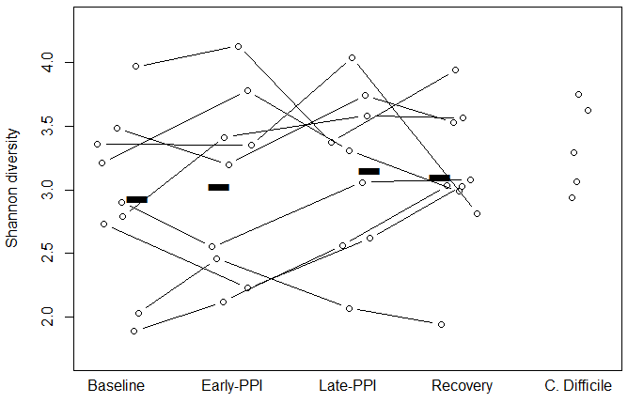
Notes:
Supplemental Figure 8. Shannon Diversity not significantly affected by PPI.
Shannon diversity does not fluctuate significantly while on PPI, and CD is not significantly different, with p>0.05. (Supplemental Table 6)

Slide 9
Supplemental Table 1: Sensitivity of Statistical Findings to Rarefaction
75,000 |  | 50,000 |  | 25,000
Time | T0 | Time | T0 | Time | T0
T7 | 0.038 | T7 | 0.064 | T7 | 0.064
T28 | 0.006 | T28 | 0.027 | T28 | 0.014
T56 | 0.096 | T56 | 0.213 | T56 | 0.125
CD | 0.001 | CD | 0.002 | CD | 0.007
Notes:
Supplemental Table. Analysis of Sensitivity of Statistical Testing to Rarefaction. Samples were rarefied to 75,000 reads/sample, 50,000 reads/sample, 25,000 reads/sample. A subset of the full series of paired Wilcoxon tests were performed at each rarefaction, showing that the significant observed species changes detected between baseline (T0) and one month of PPI treatment (T28) remained significant at all three rarefaction depths.

Slide 10
Supplemental Table 2: Percent OTU content binned by longitudinal behavior, per subject
Subjects | 0001 | 0010 | 0011 | 0100 | 0101 | 0110 | 0111 | 1000 | 1001 | 1010 | 1011 | 1100 | 1101 | 1110 | 1111
1 | 8.43% | 7.58% | 1.40% | 10.11% | 0.56% | 4.21% | 2.25% | 10.11% | 1.12% | 3.37% | 5.06% | 3.93% | 1.40% | 9.83% | 30.62%
2 | 8.54% | 18.29% | 1.83% | 5.79% | 4.88% | 1.22% | 2.13% | 14.33% | 3.05% | 3.35% | 2.13% | 7.93% | 6.71% | 5.49% | 14.33%
3 | 7.42% | 15.38% | 2.47% | 4.67% | 3.57% | 1.65% | 2.47% | 16.48% | 3.02% | 3.30% | 1.37% | 2.47% | 14.01% | 1.65% | 20.05%
4 | 8.98% | 6.55% | 4.37% | 3.16% | 1.46% | 0.73% | 7.77% | 8.98% | 3.88% | 2.18% | 5.58% | 1.21% | 3.88% | 3.88% | 37.38%
5 | 6.62% | 7.57% | 3.47% | 5.68% | 2.52% | 1.58% | 5.36% | 6.31% | 3.79% | 1.58% | 1.89% | 3.79% | 7.57% | 5.05% | 37.22%
6 | 4.08% | 6.22% | 1.93% | 4.94% | 1.29% | 2.36% | 1.93% | 15.67% | 3.00% | 3.43% | 4.51% | 2.36% | 8.80% | 4.08% | 35.41%
7 | 7.73% | 5.96% | 2.87% | 19.87% | 1.55% | 3.09% | 1.99% | 7.51% | 3.09% | 2.65% | 6.18% | 4.42% | 4.42% | 3.31% | 25.39%
8 | 14.13% | 7.61% | 1.55% | 6.21% | 3.26% | 1.71% | 1.86% | 5.59% | 4.97% | 1.71% | 2.95% | 4.04% | 21.89% | 2.17% | 20.34%
9 | 6.00% | 18.01% | 1.88% | 3.19% | 1.31% | 1.88% | 0.56% | 10.51% | 9.19% | 1.69% | 2.44% | 4.32% | 18.39% | 1.69% | 18.95%
Notes:
Supplemental Table 1. Binning of OTU’s by behavior during treatment (columns) sorted by subject (rows). Columns represent possible per-OTU behaviors with presence greater than ten reads or absence at zero reads at all of the four given timepoints, corresponding to baseline, short- and long-term PPI usage or the recovery phase. Rows represent individual subjects. The predominant trend is survival of OTU’s throughout PPI treatment (rightmost column, in bold).

Slide 11
Supplemental Table 3: Statistical Testing between Healthy subjects (by Gender) and CDI
Male |  |  |  |  | Female
Time | T0 | T7 | T28 | T56 | Time | T0 | T7 | T28 | T56
T7 | 0.063 |  |  |  | T7 | 0.219
T28 | 0.188 | 0.438 |  |  | T28 | 0.031 | 0.0625
T56 | 0.438 | 0.938 | 0.875 |  | T56 | 0.063 | 0.139 | 0.843
CD* | 0.008 | 0.008 | 0.008 | 0.016 | CD* | 0.008 | 0.048 | 0.005 | 0.005

Slide 12
Supplemental Table 4: Probability of significant difference in KEGG pathway “Glycine, Serine, Threonine metabolism” between PPI groups and CDI.
Time | T0 | T7 | T28 | T56
T7 | 0.367
T28 | 0.064 | 0.1016
T56 | 0.125 | 0.064 | 0.875
CD | 0.001 | 0.006 | 0.056 | 0.003

Slide 13
Supplemental Table 5: Comparison of Longitudinal changes in relative abundance of taxa highlighted in Mazcorro et al
 | Male, versus Male Baseline |  |  | Female, versus Female Baseline
 | T7 | T28 | T56 | T7 | T28 | T56 | CDI*
Porphyromonas | 1 | 1 | 0.789 | 0.371 | 0.371 | 0.371 | 0.131
Prevotella | 0.25 | 0.625 | 0.875 | 0.181 | 0.375 | 0.181 | 0.533
Bacteroides | 0.875 | 0.625 | 0.375 | 0.25 | 0.875 | 0.25 | 0.016
Gammaproteobacteria | 0.875 | 0.875 | 0.875 | 0.625 | 0.875 | 0.875 | 0.032
Lactobacillus | 0.181 | 0.423 | 0.181 | 0.625 | 0.789 | 1 | 0.063
Faecalibacterium | 0.875 | 0.25 | 0.875 | 0.125 | 0.875 | 0.875 | 0.412
Firmicutes | 0.875 | 0.25 | 1 | 0.375 | 0.625 | 0.25 | 0.016
Ruminococcae | 0.625 | 0.25 | 0.625 | 0.125 | 0.375 | 0.625 | 0.064

Slide 14
Supplemental Table 6: Pairwise Statistical Tests for Significant Diversity Changes over Time
Shannon |  |  |  |  | Chao1
Time | T0 | T7 | T28 | T56 | Time | T0 | T7 | T28 | T56
T7 | 0.752 |  |  |  | T7 | 0.037
T28 | 0.951 | 0.787 |  |  | T28 | 0.006 | 0.082
T56 | 0.787 | 0.674 | 0.5 |  | T56 | 0.096 | 0.682 | 0.918
CD* | 0.120 | 0.303 | 0.350 | 0.219 | CD* | 0.001 | 0.006 | 0.006 | 0.009
Notes:
Supplemental Table 5.
Pairwise probability matrix for significant differences in Shannon and Chao1 diversity within matched pair groups and between healthy subjects and CDI subjects. Testing between matched-pair samples using Wilcoxon signed rank. *Non-matched pair probabilities for groups with CD were calculated using Wilcoxon Rank Sum with Continuity Correction.

