Slide 1
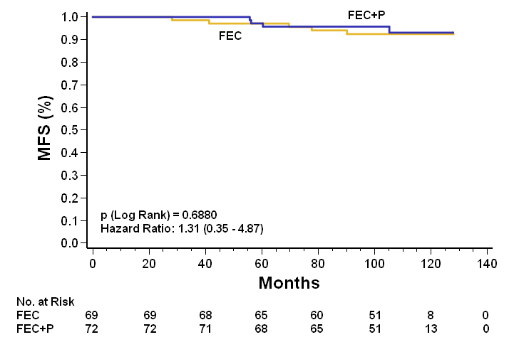
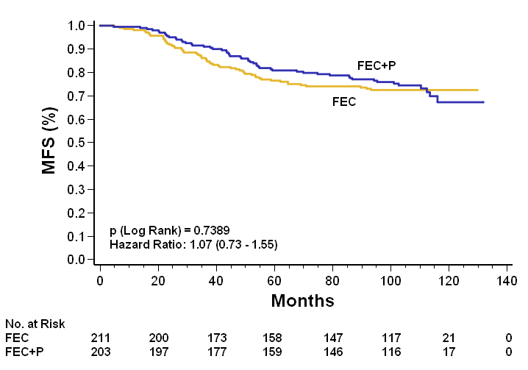
Figure 4
EP (low risk group)
EP (high risk group)

