Slide 1
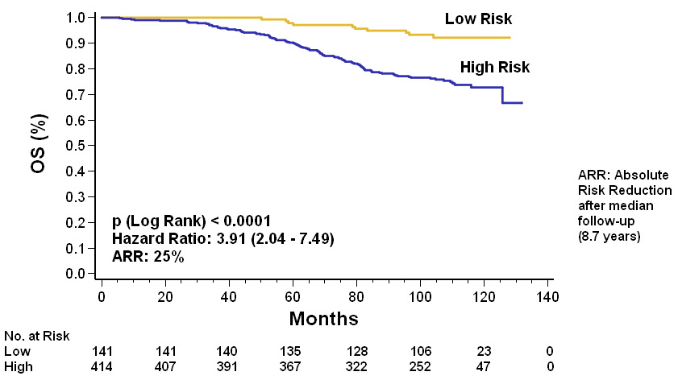
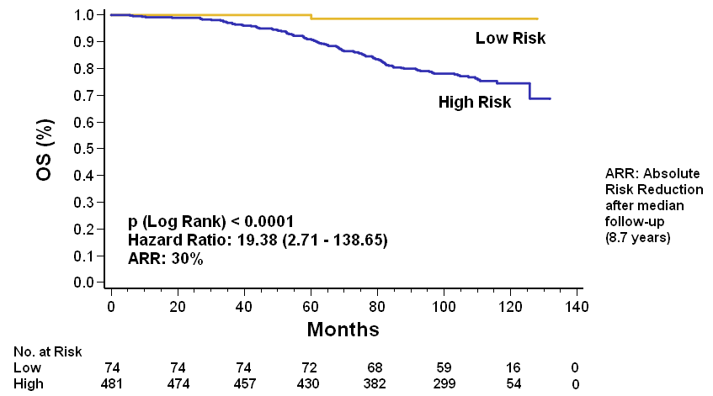
Figure S1
a) EP
b) EPclin
92% vs. 67% with absolute risk reduction of 25%
99% vs. 69% with absolute risk reduction of 30%

