Slide 1
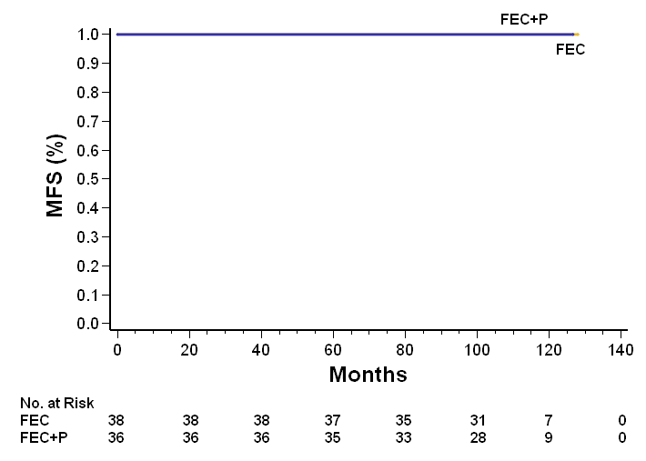
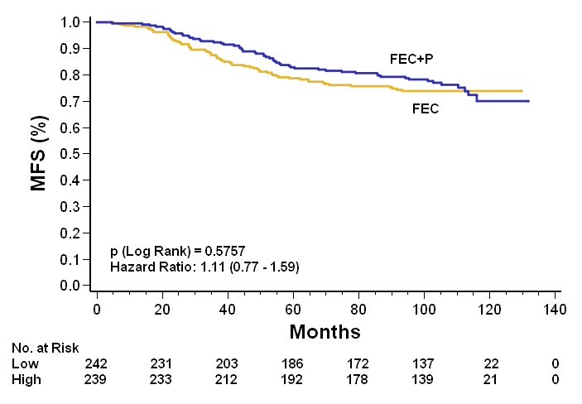
Figure S5
EPclin (low risk group)
EPclin (high risk group)
No distant metastases in the EPclin low-risk group

