Slide 1
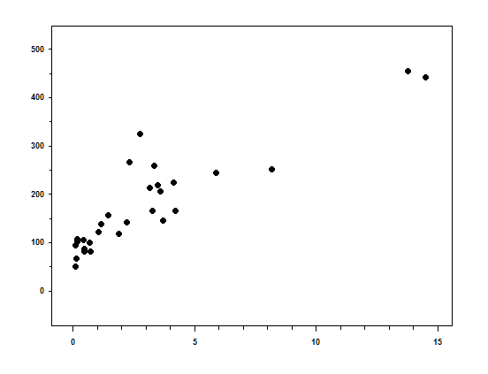
Additional file 4
500
400
AUC₂₄ (mg*h/L)
300
200
100
0
0
5
10
15
C_{min} (mg/L)

