Slide 1
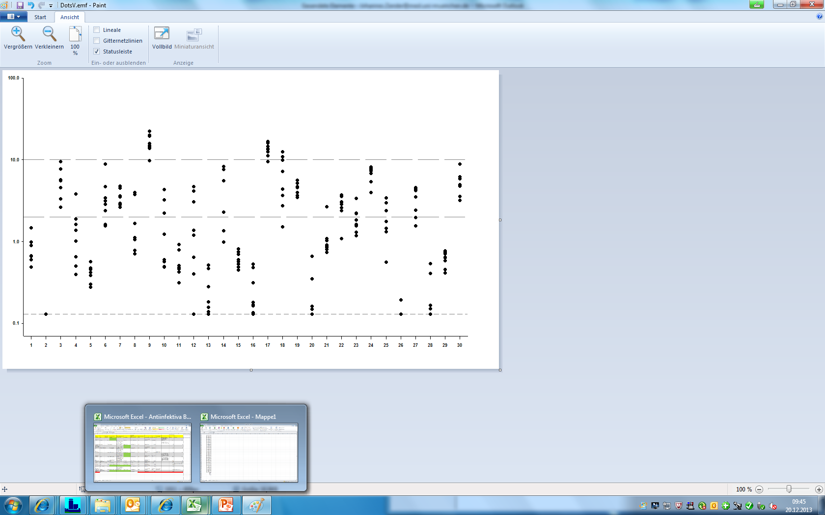
Additional file 5
100.0
Upper and lower limit of target range for C_{min}
Lower limit of quantification
10.0
Linezolid C_{min} values [mg/L]
1.0
0.1
1 2 3 4 5 6 7 8 9 10 11 12 13 14 15 16 17 18 19 20 21 22 23 24 25 26 27 28 29 30
Patient number

