Slide 1
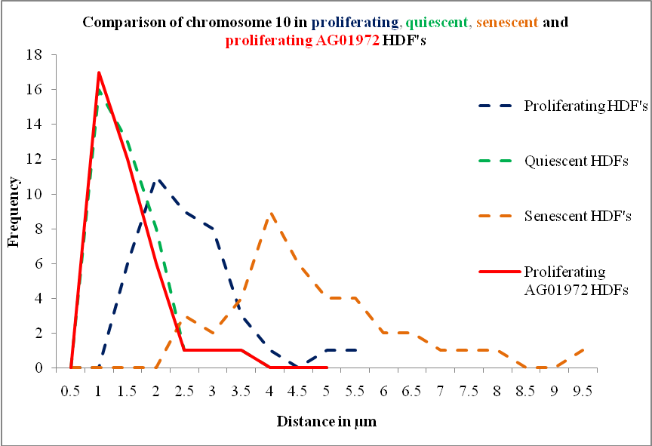
Figure S1 A

Slide 2
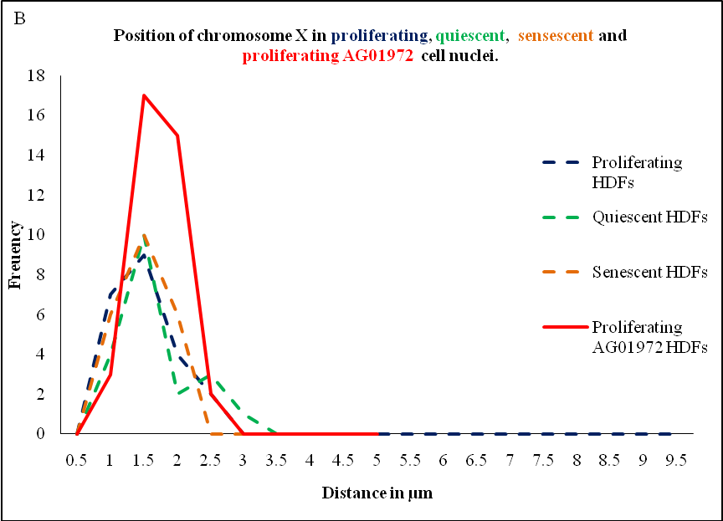
Figure S1 B

Slide 3
Figure S2
Signal intensity %/ DAPI intensity %
Shell number

