Slide 1
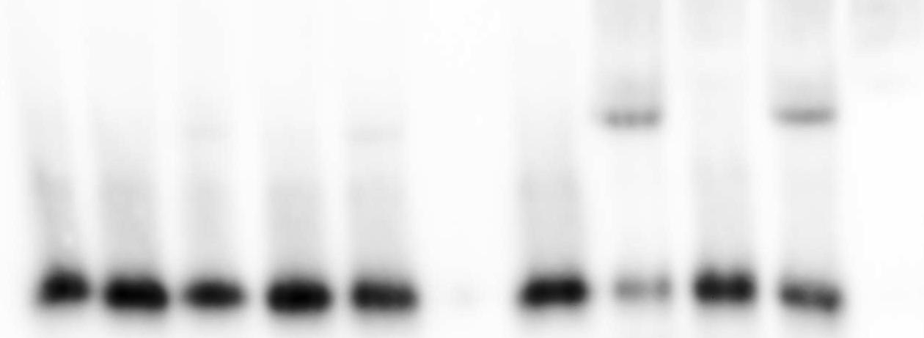
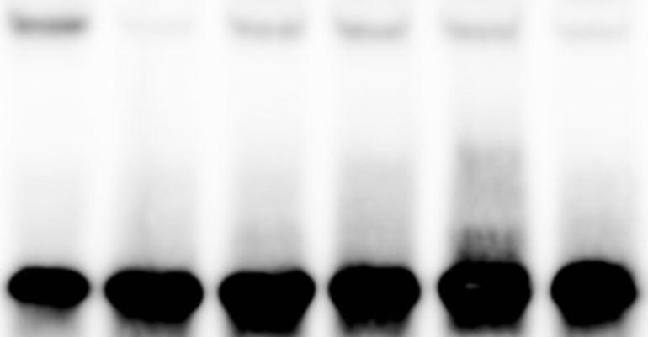

A
rs31416165
rs31415340
rs30796712
B
Pbx1*(75 bp) + + + + + - + + + + - Uninduced PRDM9^{Cst} - + - - - - - - - - -
Induced PRDM9^{Cst} - - + + + + - - - - -
Pbx1 cold - - - + - - - - + - -
Non-competitor DNA - - - - + - - - - + -
Uninduced PRDM9^{Dom2} - - - - - - + - - - -
Induced PRDM9^{Dom2} - - - - - - - + + + +
D
Fraction shifted 0.02 0.02 0.03 0.02 0.03 0.0 0.02 0.34 0.03 0.28 0.0
C
Pbx1* (75 bp) + + + + + +
Induced PRDM9^{Dom2} + + + + + +
Competitor (bp) - 75 29 31 33 34
D
Fraction shifted 0.13 0.01 0.06 0.06 0.06 0.03
Pbx1(34 bp) GAGAACTTACAAAGGTAGGACGTAAATGGAGTGT
Inferred motif
PRDM9^{Dom2} ZnF
DNE
QHQ
QDK
QDK
QVK
QVK
AVQ
ANQ
AVQ
AVQ
QNK
QDQ

