Slide 1
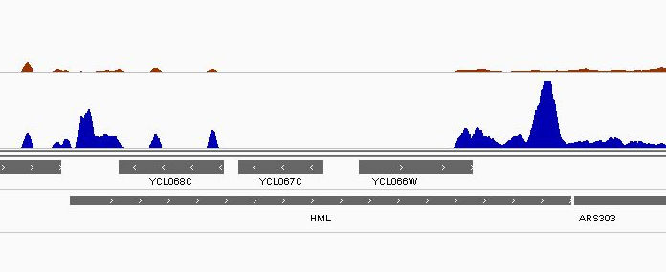
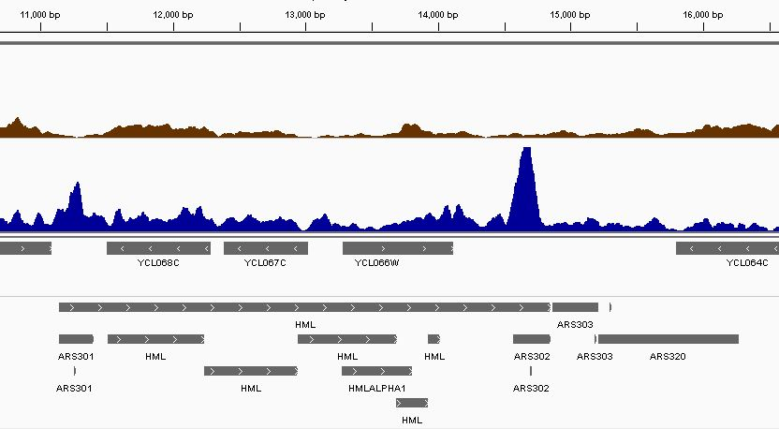
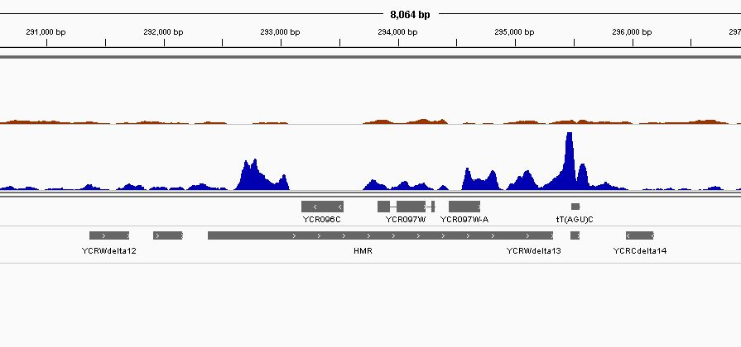
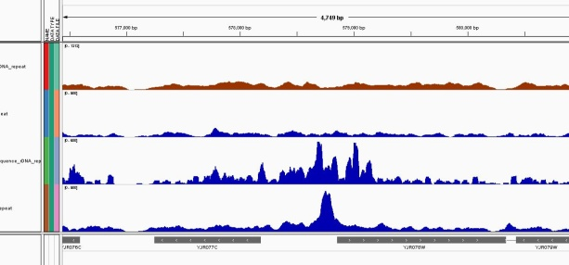
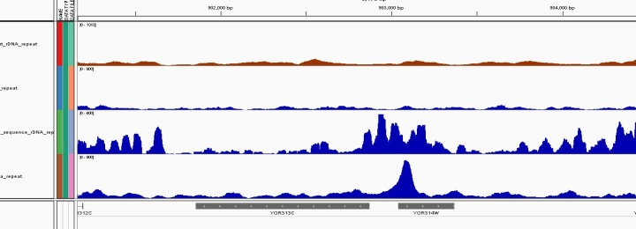
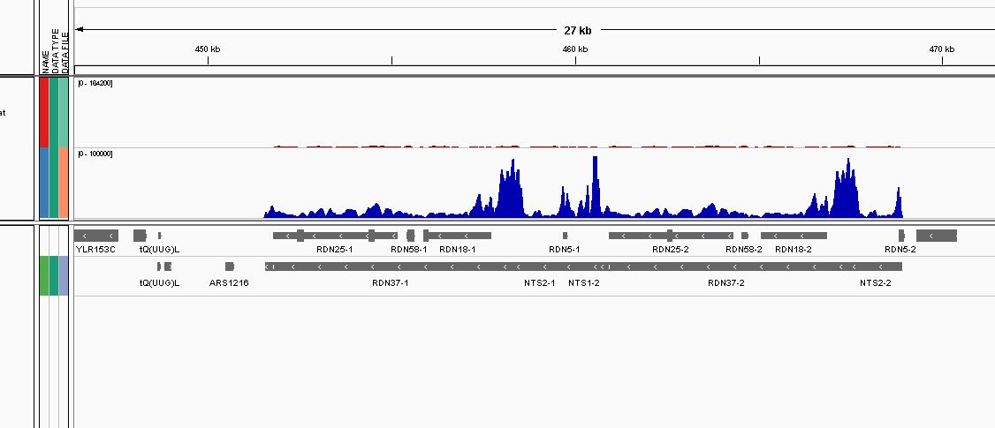
(a)
[0- 3284]
HML
500 bp
Input
[0- 2000]
Sir2
E
I
(b)
Input
[0- 3284]
HMR
500 bp
[0- 2000]
Sir2
E
I
(c)
Input
[0- 3284]
BNA2
500 bp
SPS4
500 bp
Sir2
[0- 2000]
Hst1
[0- 1500]
Sum1
[0- 1696]
YJR077C
YJR078W
YOR313C
YOR314W
(d)
[0- 164200]
rDNA
500 bp
Input
[0- 100000]
Sir2
IGS2
IGS1
IGS2
left
right

