Slide 1
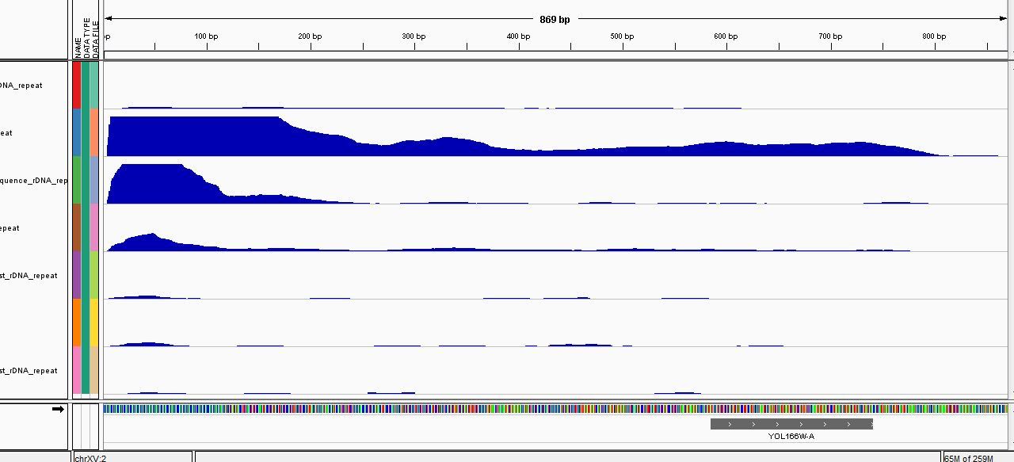
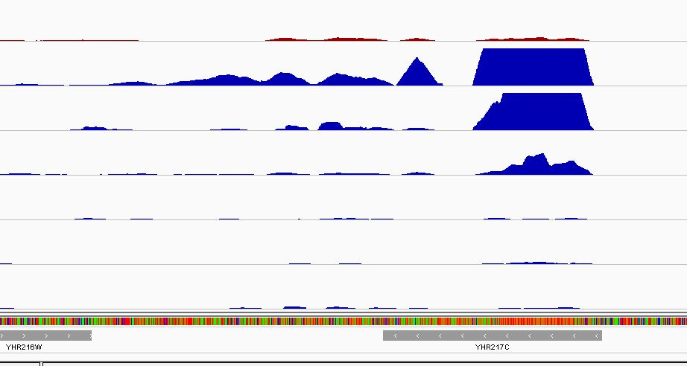
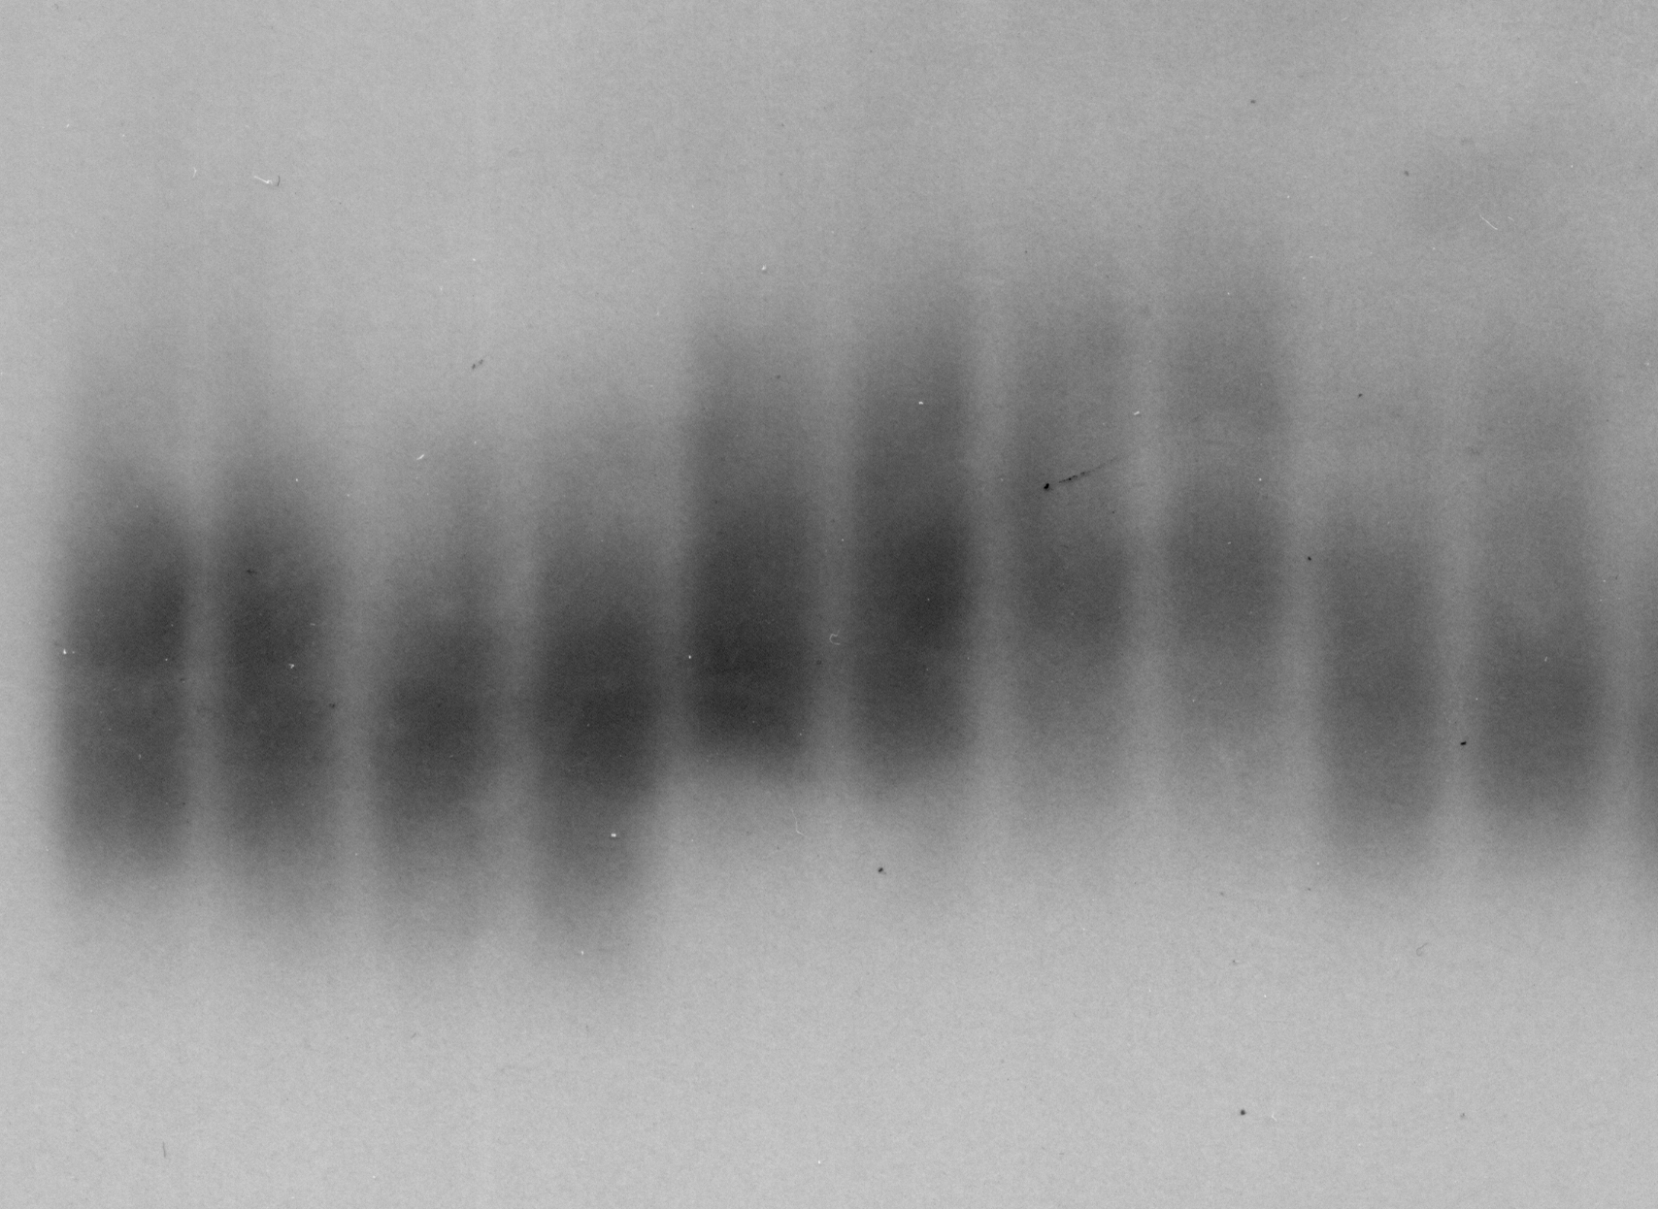
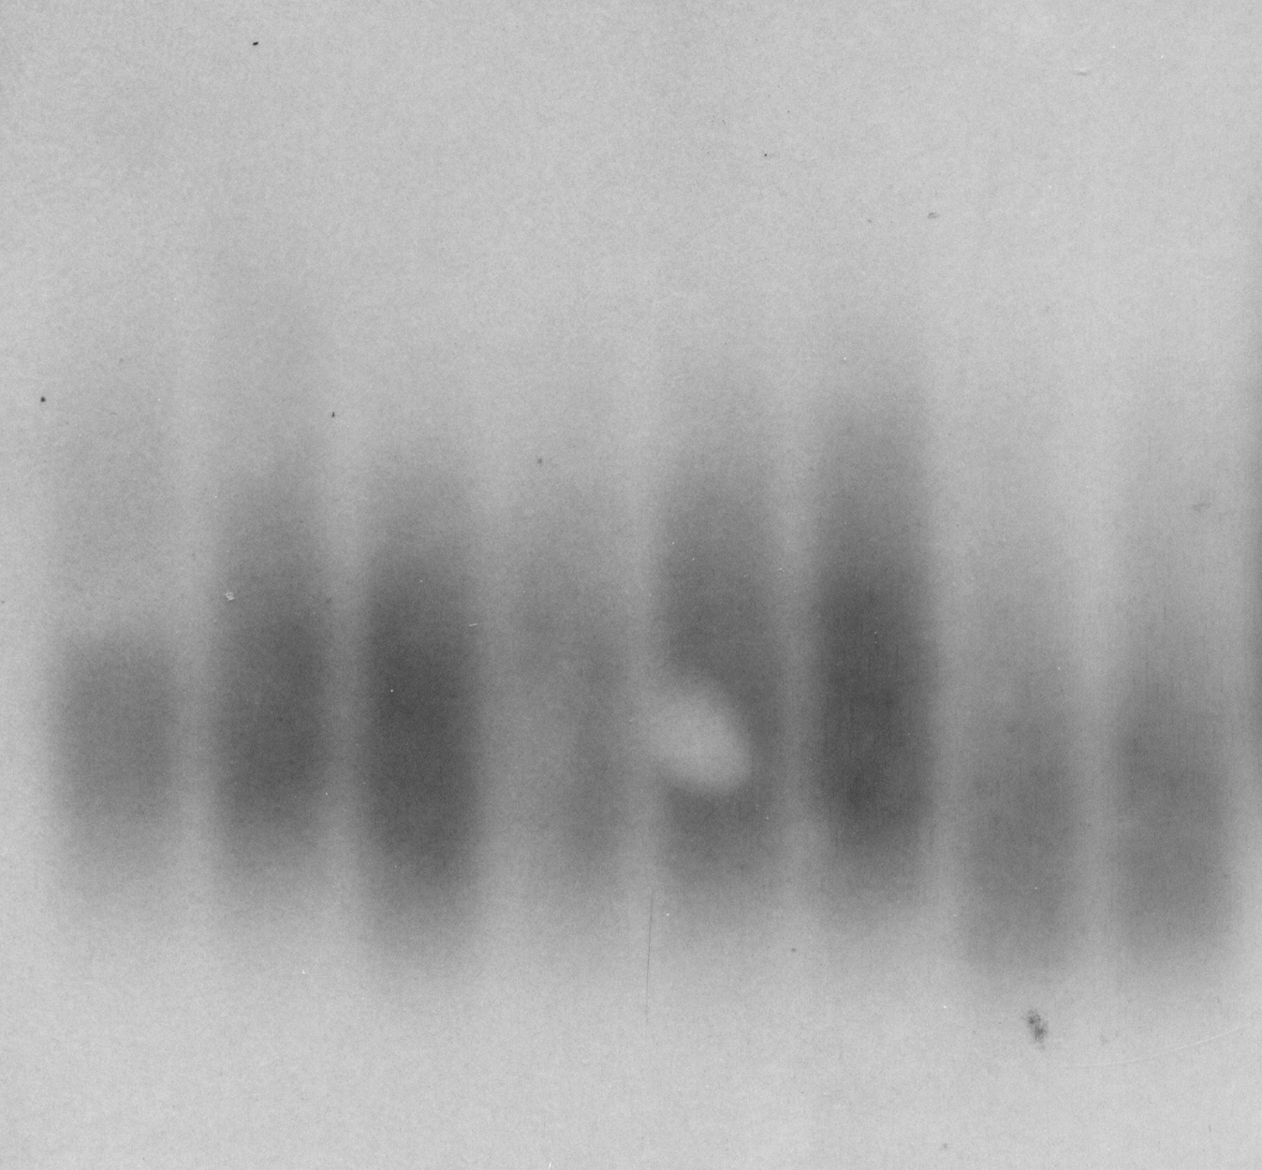

(a)
Tel_ChrXV_L
Input
100 bp
[0- 8210]
Sir2
[0- 5000]
Hst1
[0- 3741]
Sum1
[0- 4242]
Hst2
[0- 635]
Hst3
[0- 4594]
Hst4
[0- 1796]
TG₁₋₃
118 bp
(b)
Tel_ChrVIII_R
Input
100 bp
[0- 8210]
Sir2
[0- 5000]
Hst1
[0- 3741]
Sum1
[0- 4242]
Hst2
[0- 635]
Hst3
[0- 4594]
Hst4
[0- 1796]
//
TG₁₋₃
253 bp
//
(c)
5403 bp
Tel_ChrVI_R
Tel_ChrVI_R
Sir2 70 bp
Hst1 70 bp
Sir2 7000 bp
Sum1 70 bp
Hst1 7000 bp
Relative ChIP
Relative ChIP
Sum1 7000 bp
WT
WT
WT
WT
WT
WT
rap1-17
rap1-17
rap1-17
rap1-17
rap1-17
rap1-17
(d)
WT
hst1∆
hst2∆
hst3∆
hst4∆
sir2∆
hst1∆
sir2∆/hst1∆
sum1∆
WT
WT
TEL
Probe = TG₁₋₃

