Slide 1
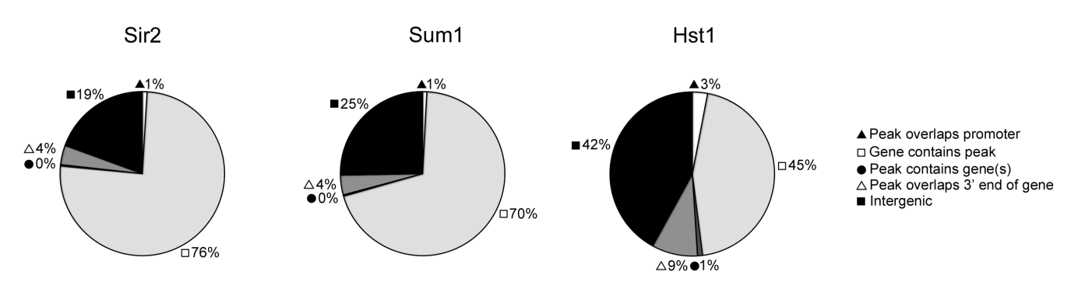
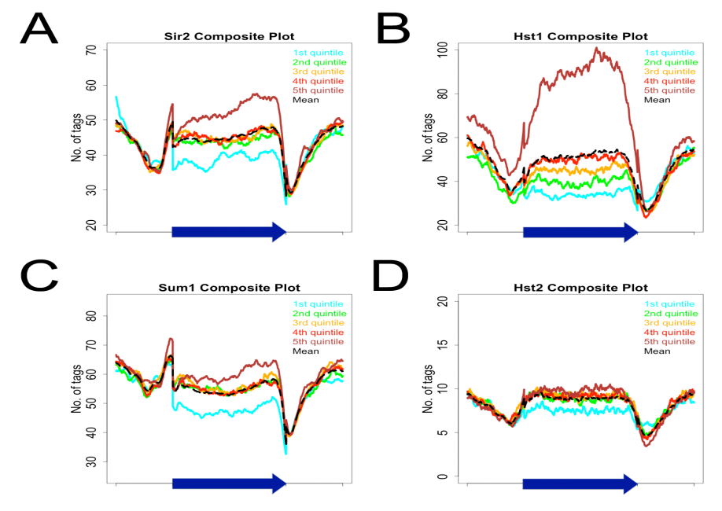
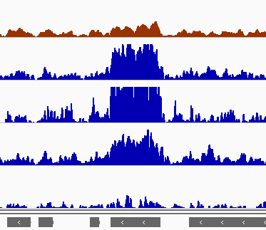
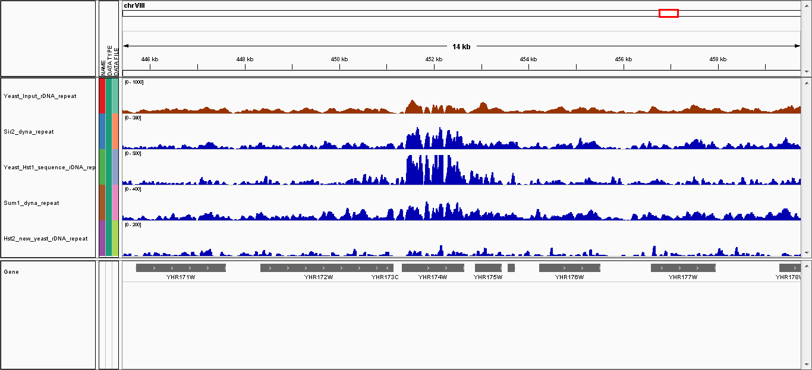
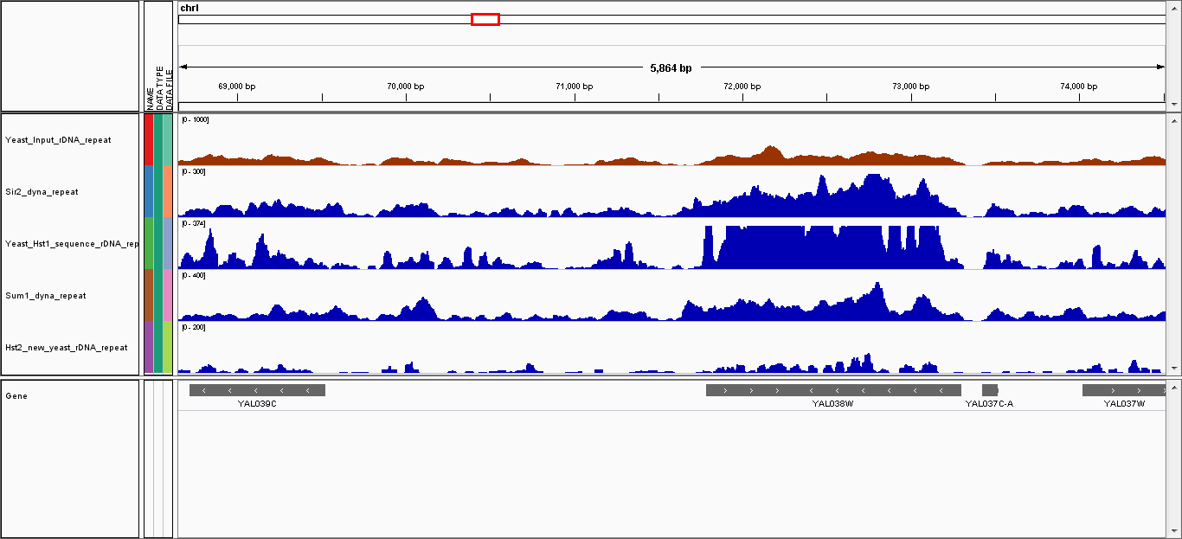
(a)
Sir2
Sum1
Hst1
Promoter
ORF
ORF inside peak
3’ end of ORF
Intergenic
(b)
(c)
70
Sir2
100
Hst1
60
80
50
60
# of Tags
∗∗
40
40
Sir2
22
Hst1
30
28
∗∗
153
20
20
∗∗
29
∗∗
80
Sum1
20
Hst2
26
4
70
15
Sum1
60
10
18
# of Tags
50
40
5
30
0
(d)
PDC1
500 bp
ENO2
500 bp
CDC19
500 bp
Input
[0- 1093]
Sir2
[0- 666]
Hst1
[0- 500]
Sum1
[0- 565]
Hst2
[0- 84]
(e)
YLR040C
YLR043C
YLR044C
YLR045C
YHR172W
YHR174W
YHR175W
YHR176W
YAL038W
YAL037C-A
YAL037W
PDC1
ENO2
Relative IP
5’ end
middle
3’ end
5’ end
middle
3’ end

