Slide 1
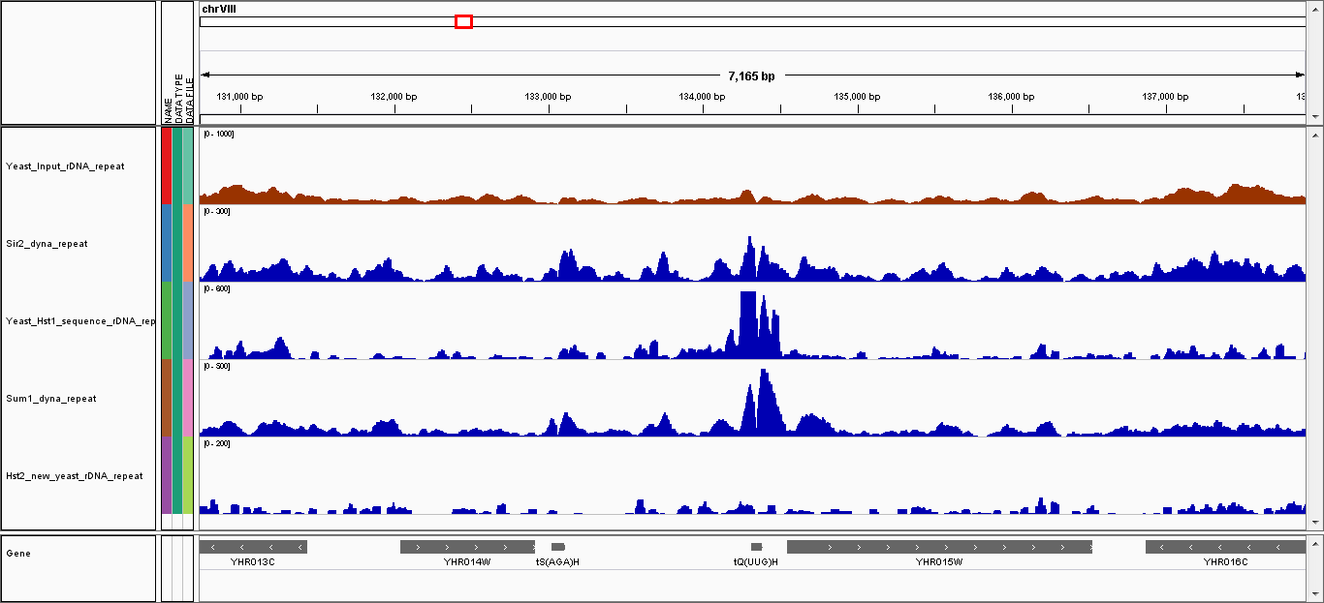
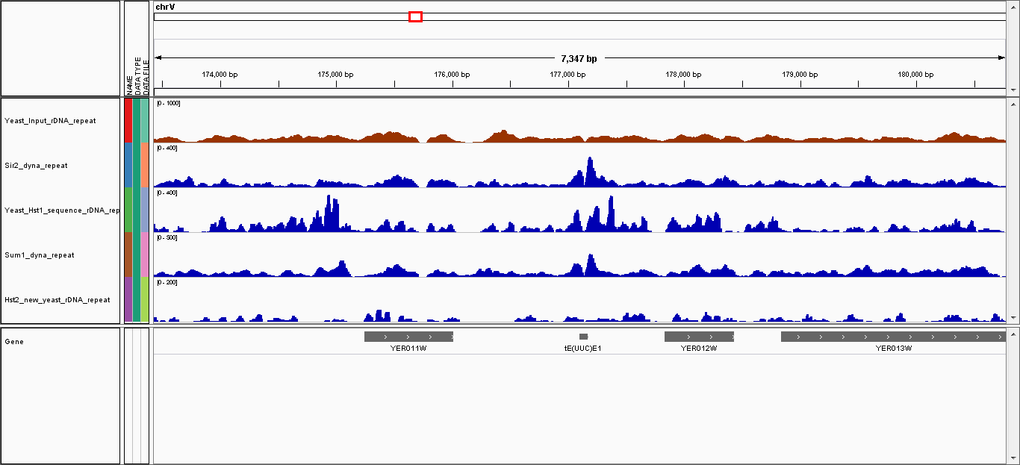
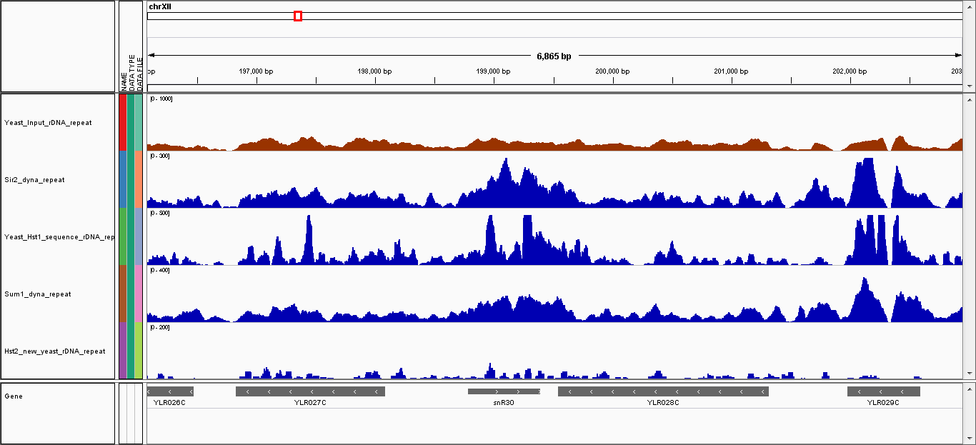
(a)
tQ(UUG)H
tE(UUC)E1
SNR30
500 bp
500 bp
500 bp
Input
[0- 1093]
Sir2
[0- 666]
Hst1
[0- 500]
Sum1
[0- 565]
Hst2
[0- 84]
tQ(UUG)H
YHR015W
tE(UUC)E1
YER012W
SNR30
YLR028C
(b)
tQ(UUG)H
SNR30
Relative IP
Relative IP
untagged
Hst2-myc
Sir2-myc
Hst1-myc
untagged
Sir2-myc
Sum1-myc
Hst2-myc
Hst1-myc
Sum1-myc
(c)
tQ(UUG)H
tE(UUC)E1
untagged
untagged
WT
WT
sir2∆
sir2∆
hst1∆
hst1∆
Relative IP
sum1∆
Relative IP
sum1∆
Mcd1-myc
Smc4-myc
Brn1-myc
Mcd1-myc
Smc4-myc
Brn1-myc

