Slide 1
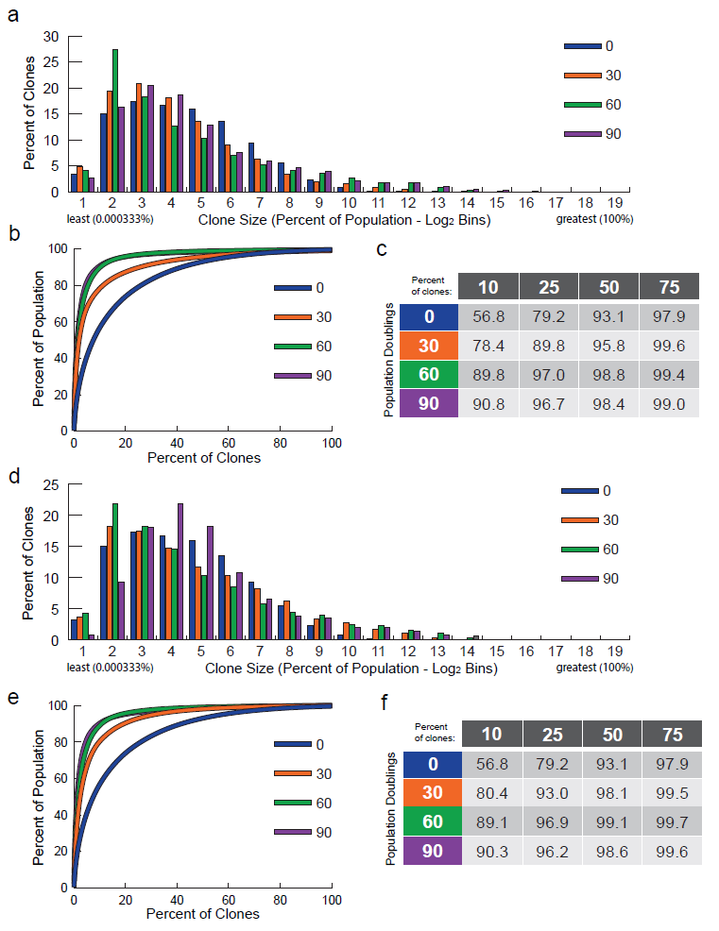
Additional File 7. Targeted K562s biological replicates B & C.
(a-c) Biological replicate B; (d-f) Biological replicate C. (a, d) Barcodes were counted and binned in Log 2 bins based on percentage (frequency) within the population, from least to greatest. The percentage of the barcodes in each bin is shown. (b, e) The percent of clones, ranked from most to least frequent plotted by what percent of the population they made up. (c, f) The percent of the population made up by the top indicated percentages of clones for each sample.

