Slide 1
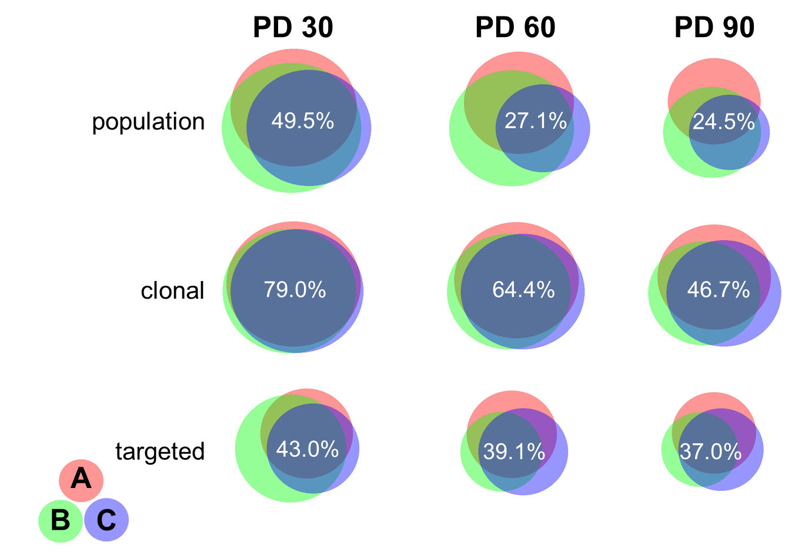
Additional File 8. Area-proportional Venn diagrams comparing clone overlap among biological replicates at given time points across K562 experiments.
The proportions of each sample that overlap with each of the other two biological replicates, indicating the relative similarity of each replicate to the others. The percent of clones in all three biological replicates is listed.
BioVenn web application available at http://www.cmbi.ru.nl/cdd/biovenn/

