Slide 1
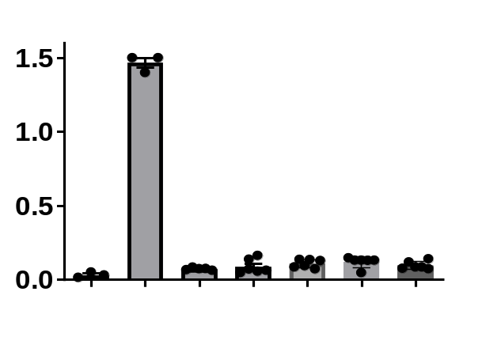
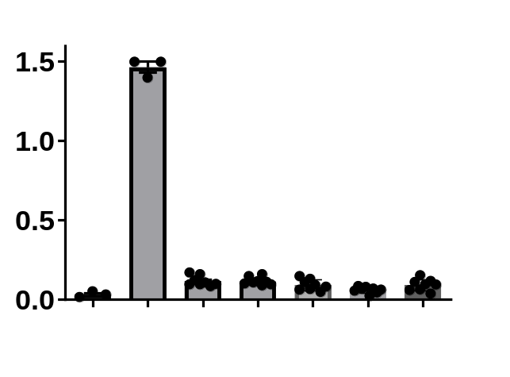
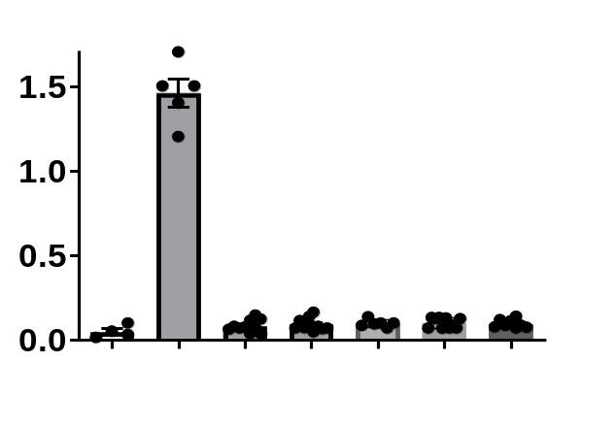
Supplement figure 2 A-C
A.
B.
C.
LDH released
(arbitrary unit)
LDH released
(arbitrary unit)
LDH released
(arbitrary unit)
Cell lysate - + - - - - -
Capsaicin (5 µM) - + + + +
ACh (µM) 0 0 0.1 1 10
Cell lysate - +
Capsaicin (5 µM) - + + + +
GTS-21 (µM) 0 0 0.1 1 10
Cell lysate - +
Stimulation (470nm) - + + + +
ACh (µM) 0 0 0.1 1 10

