Slide 1
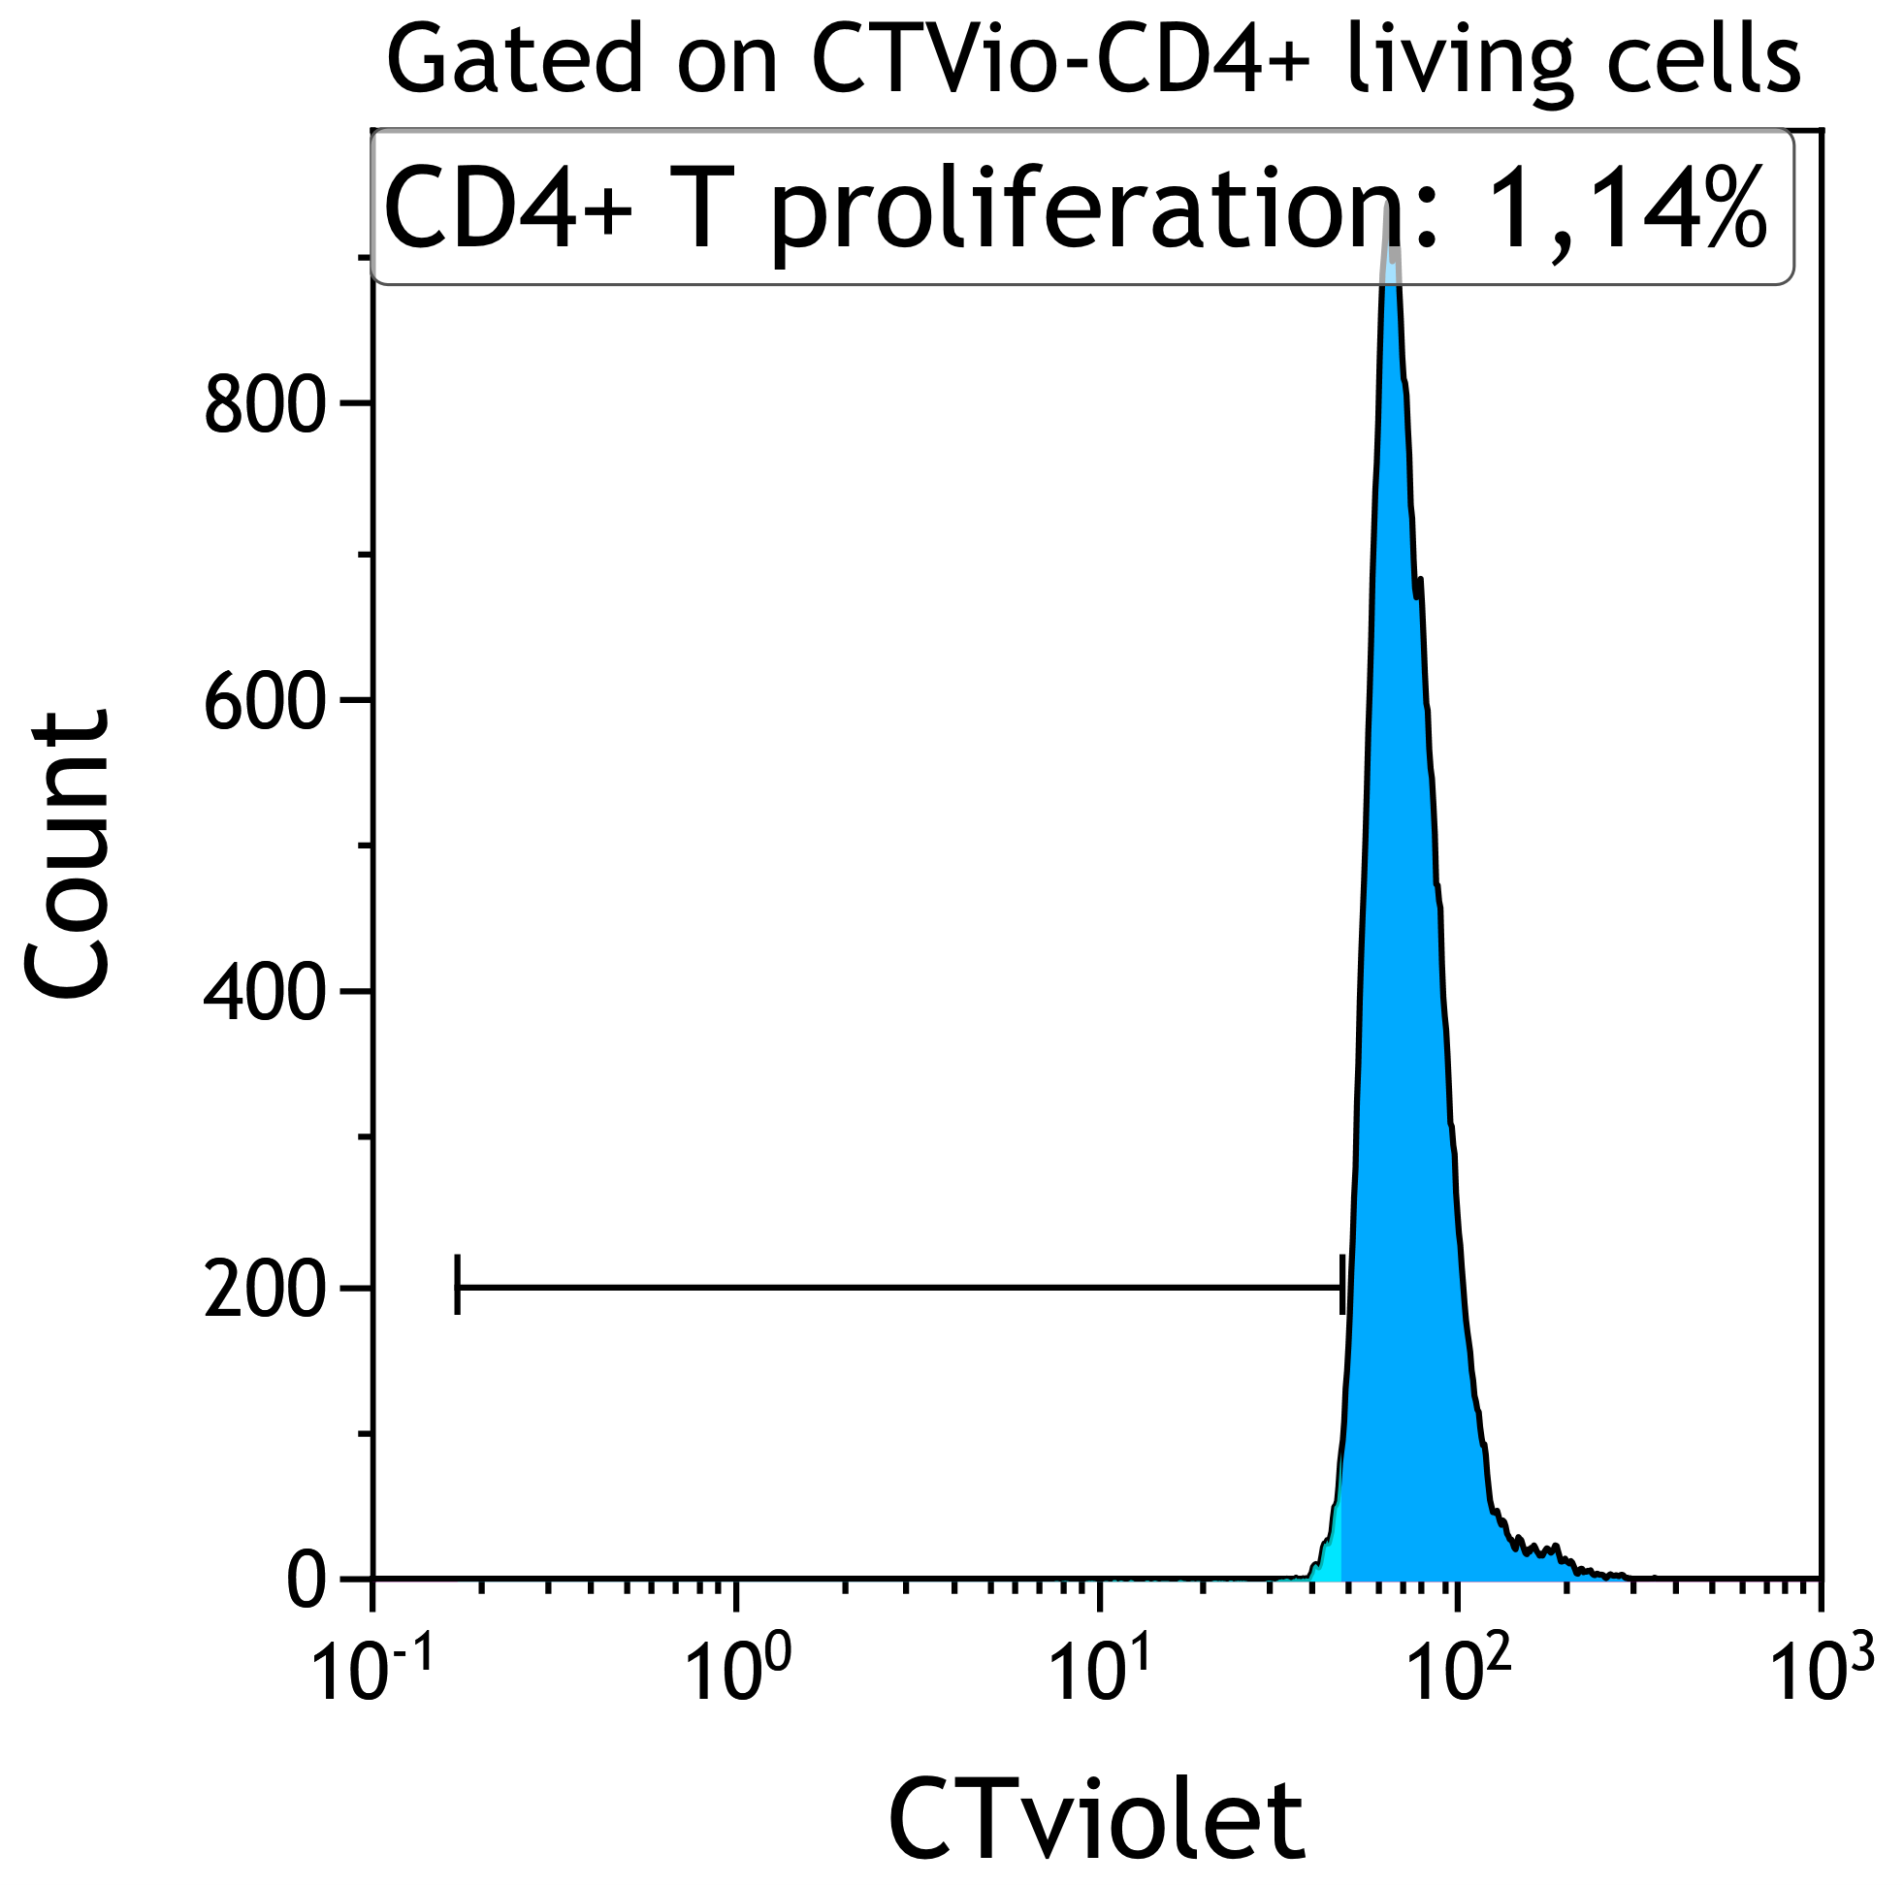
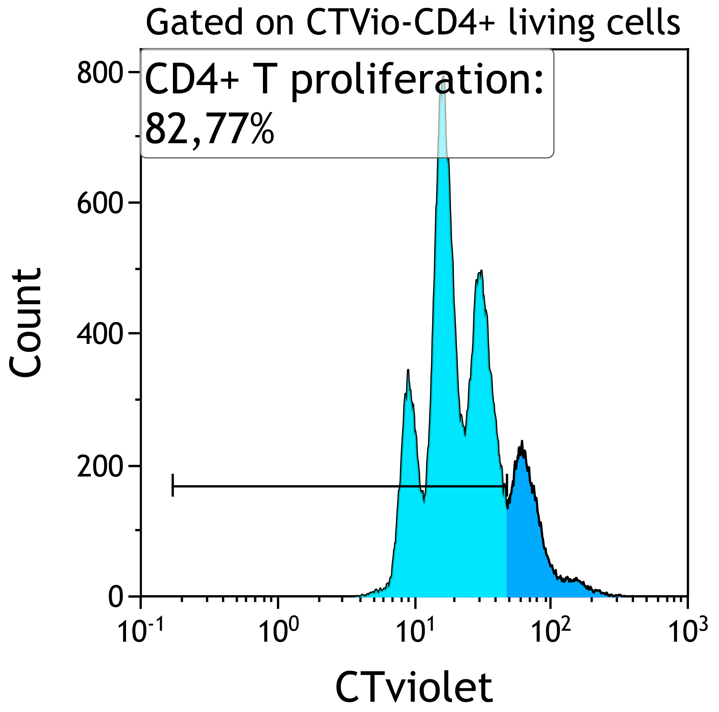
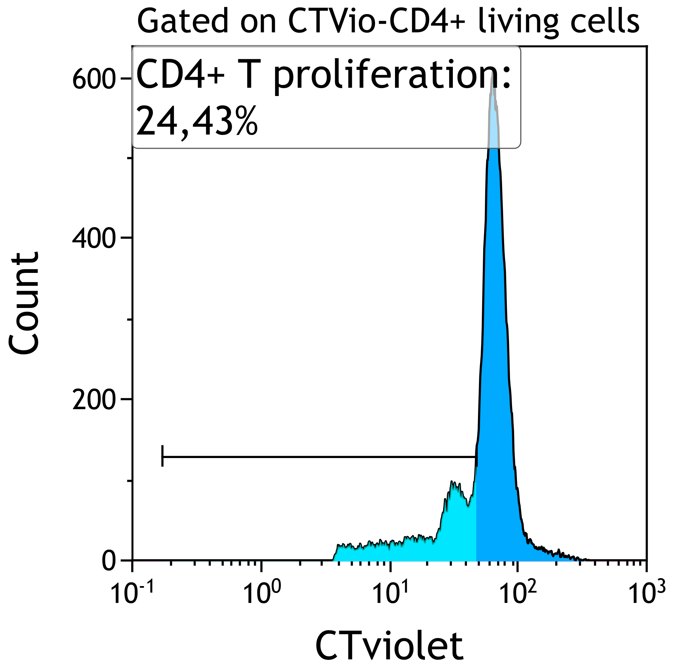
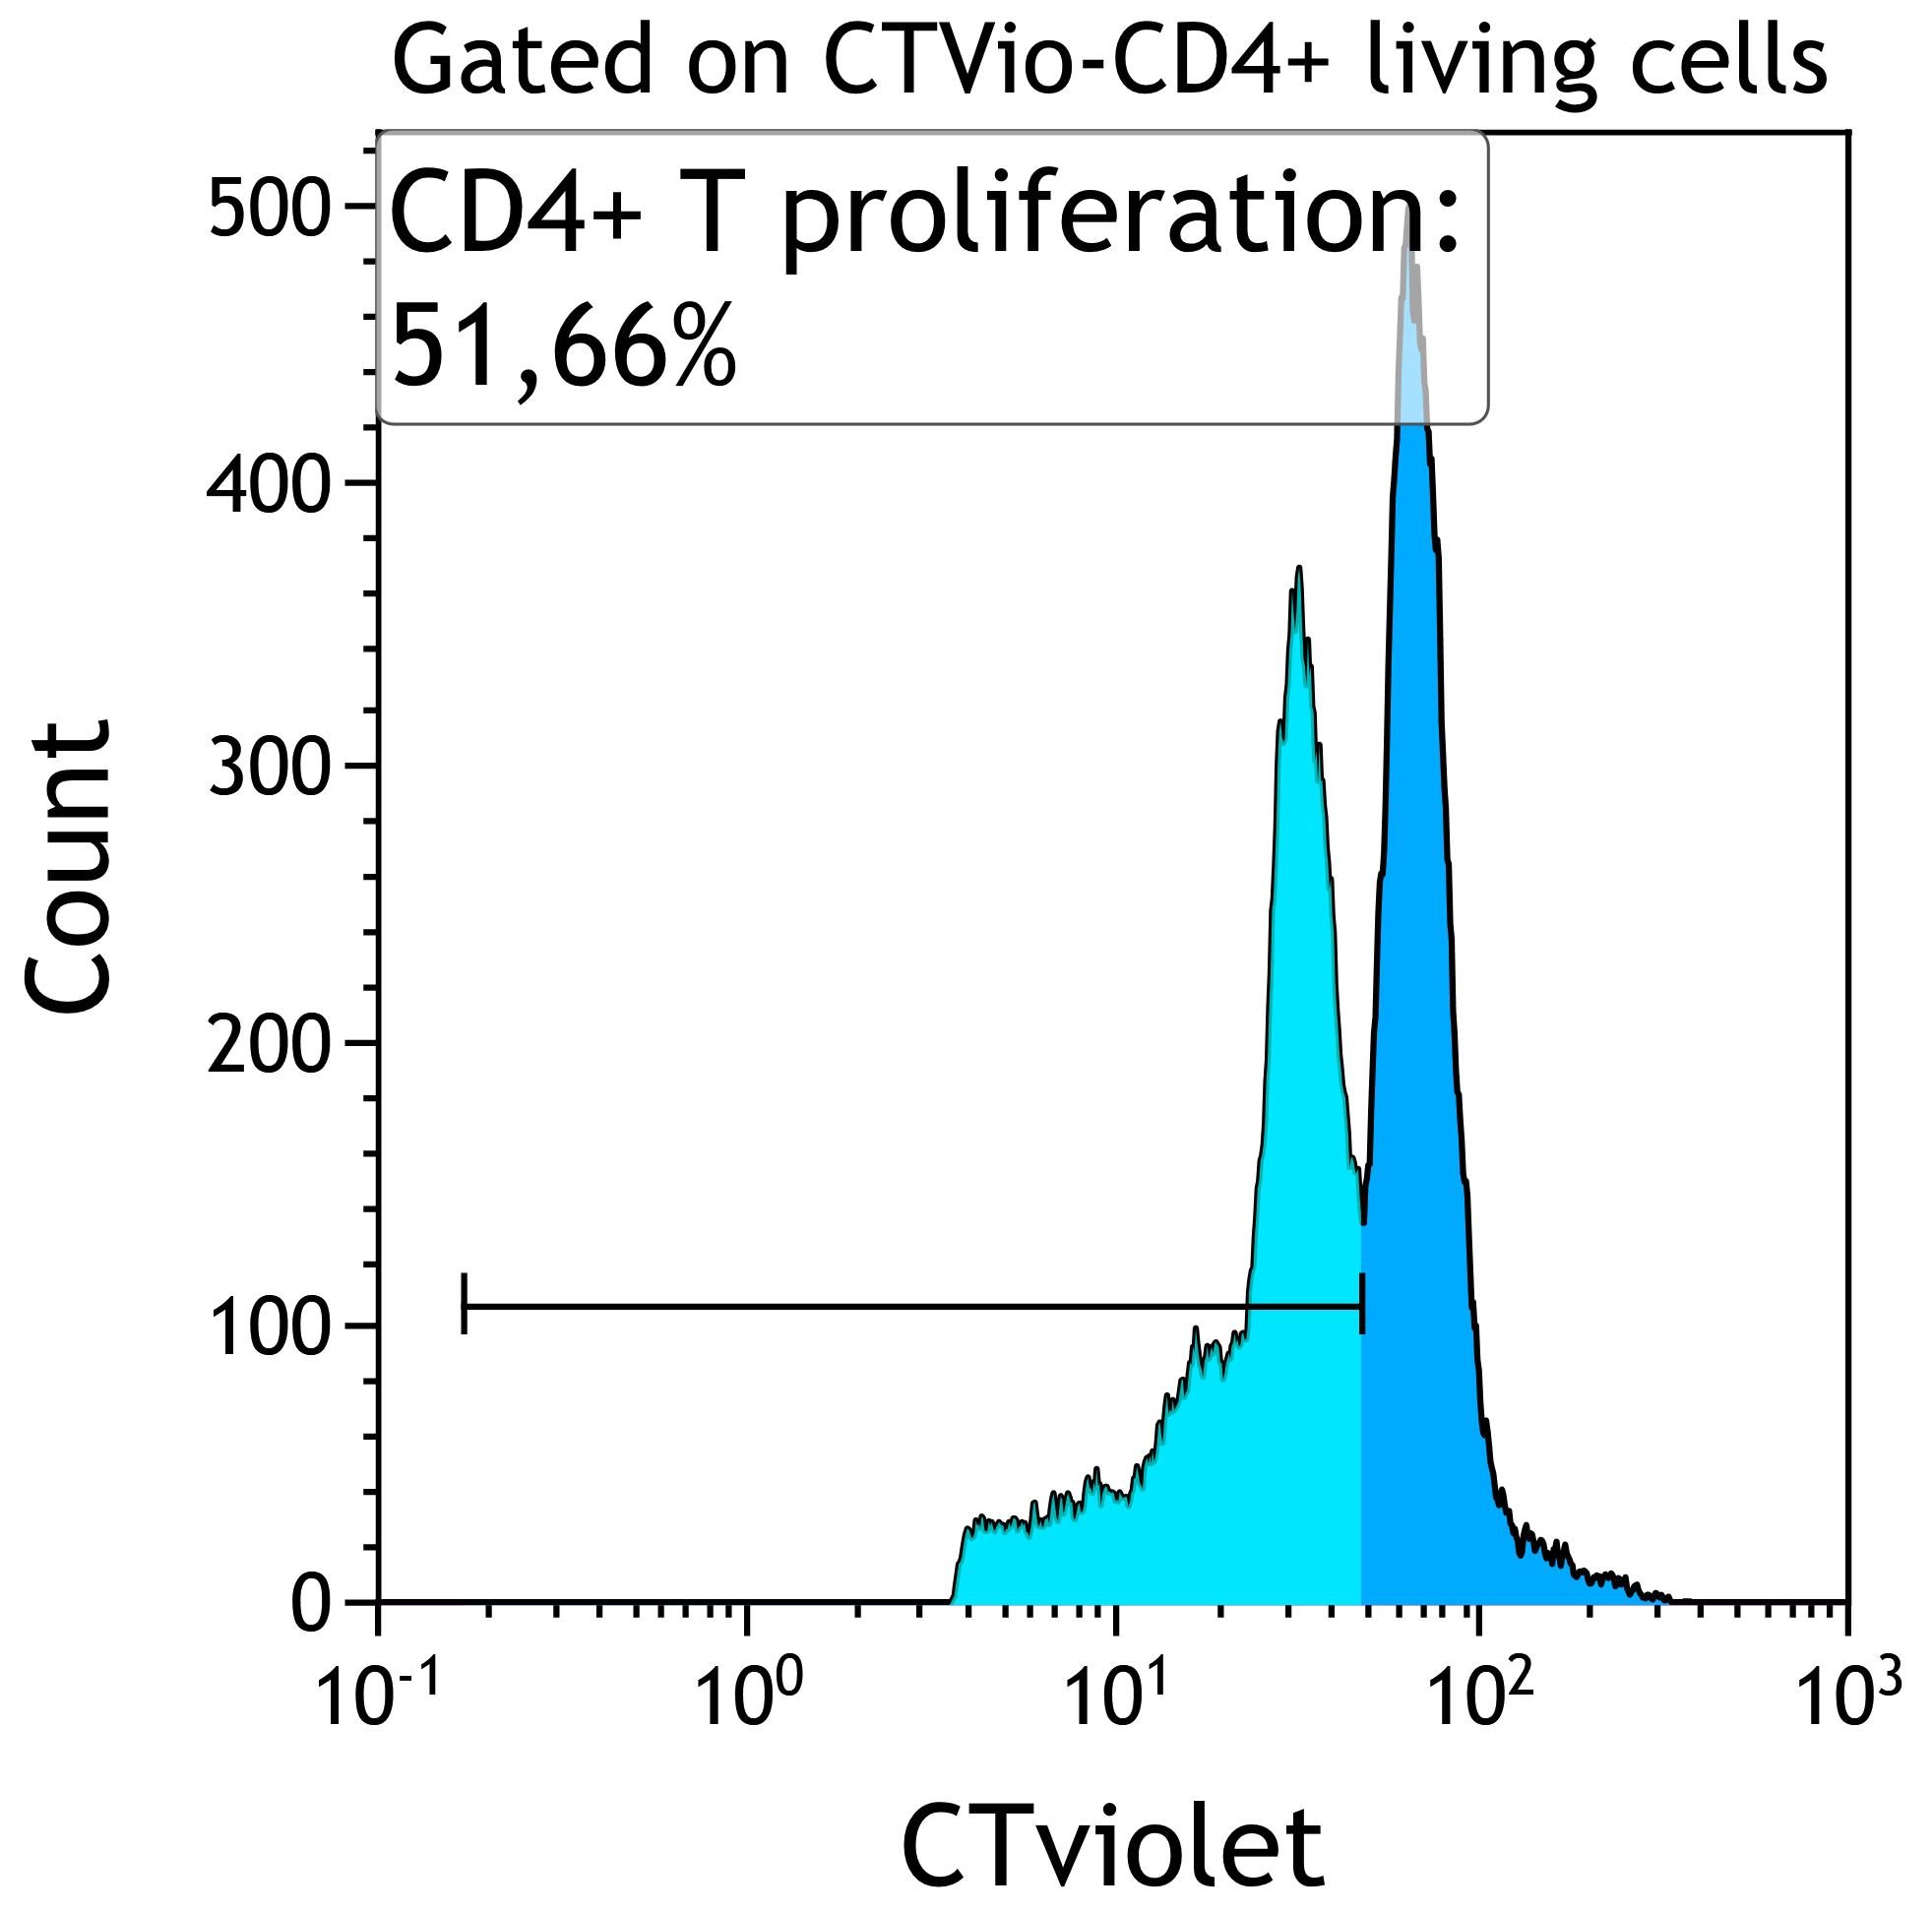
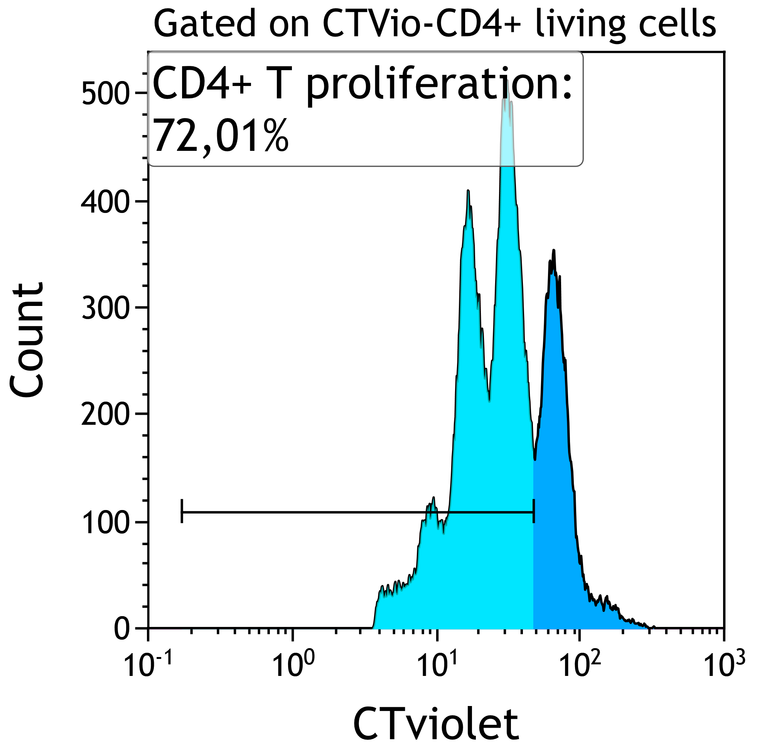
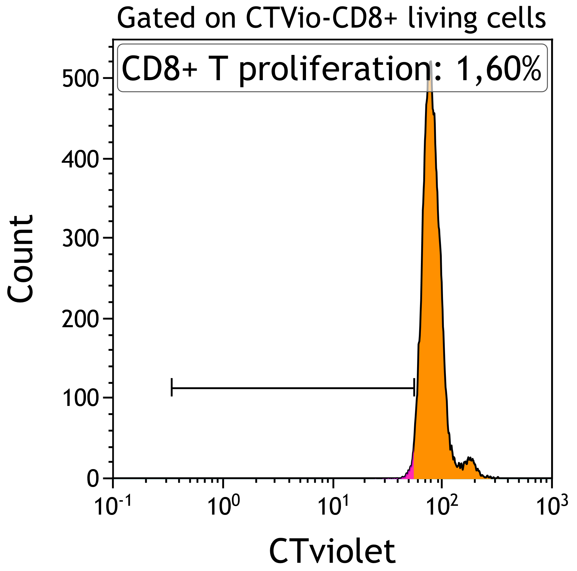
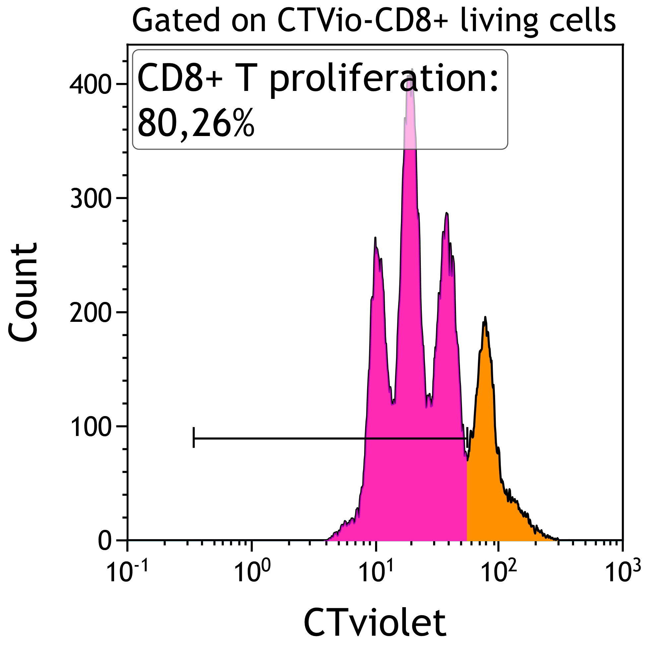
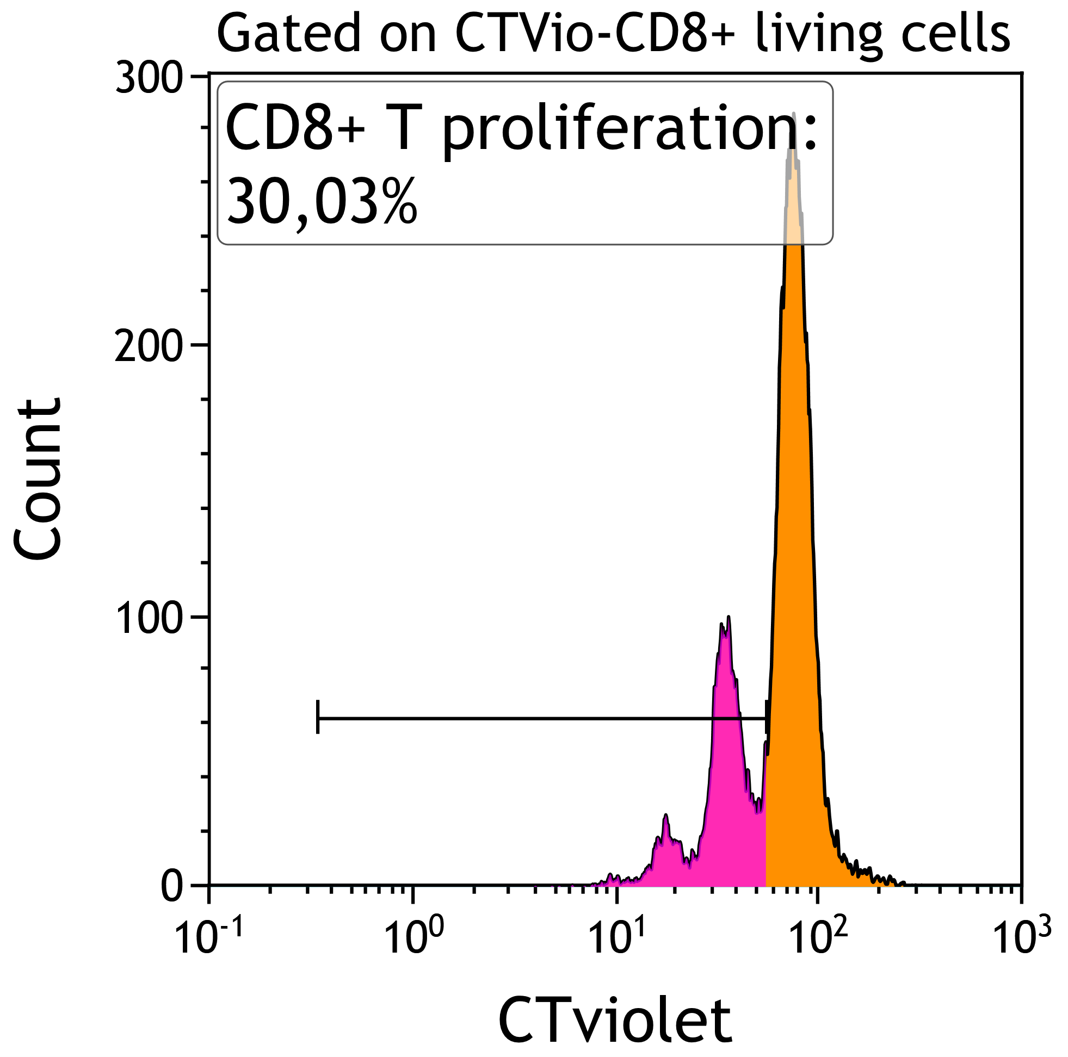
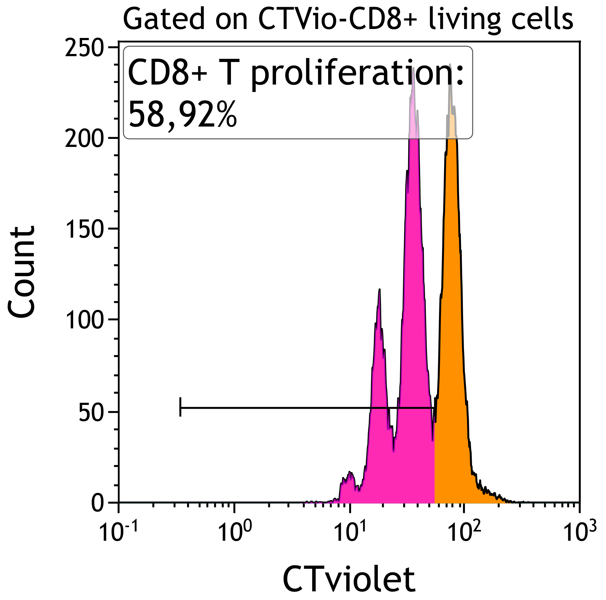
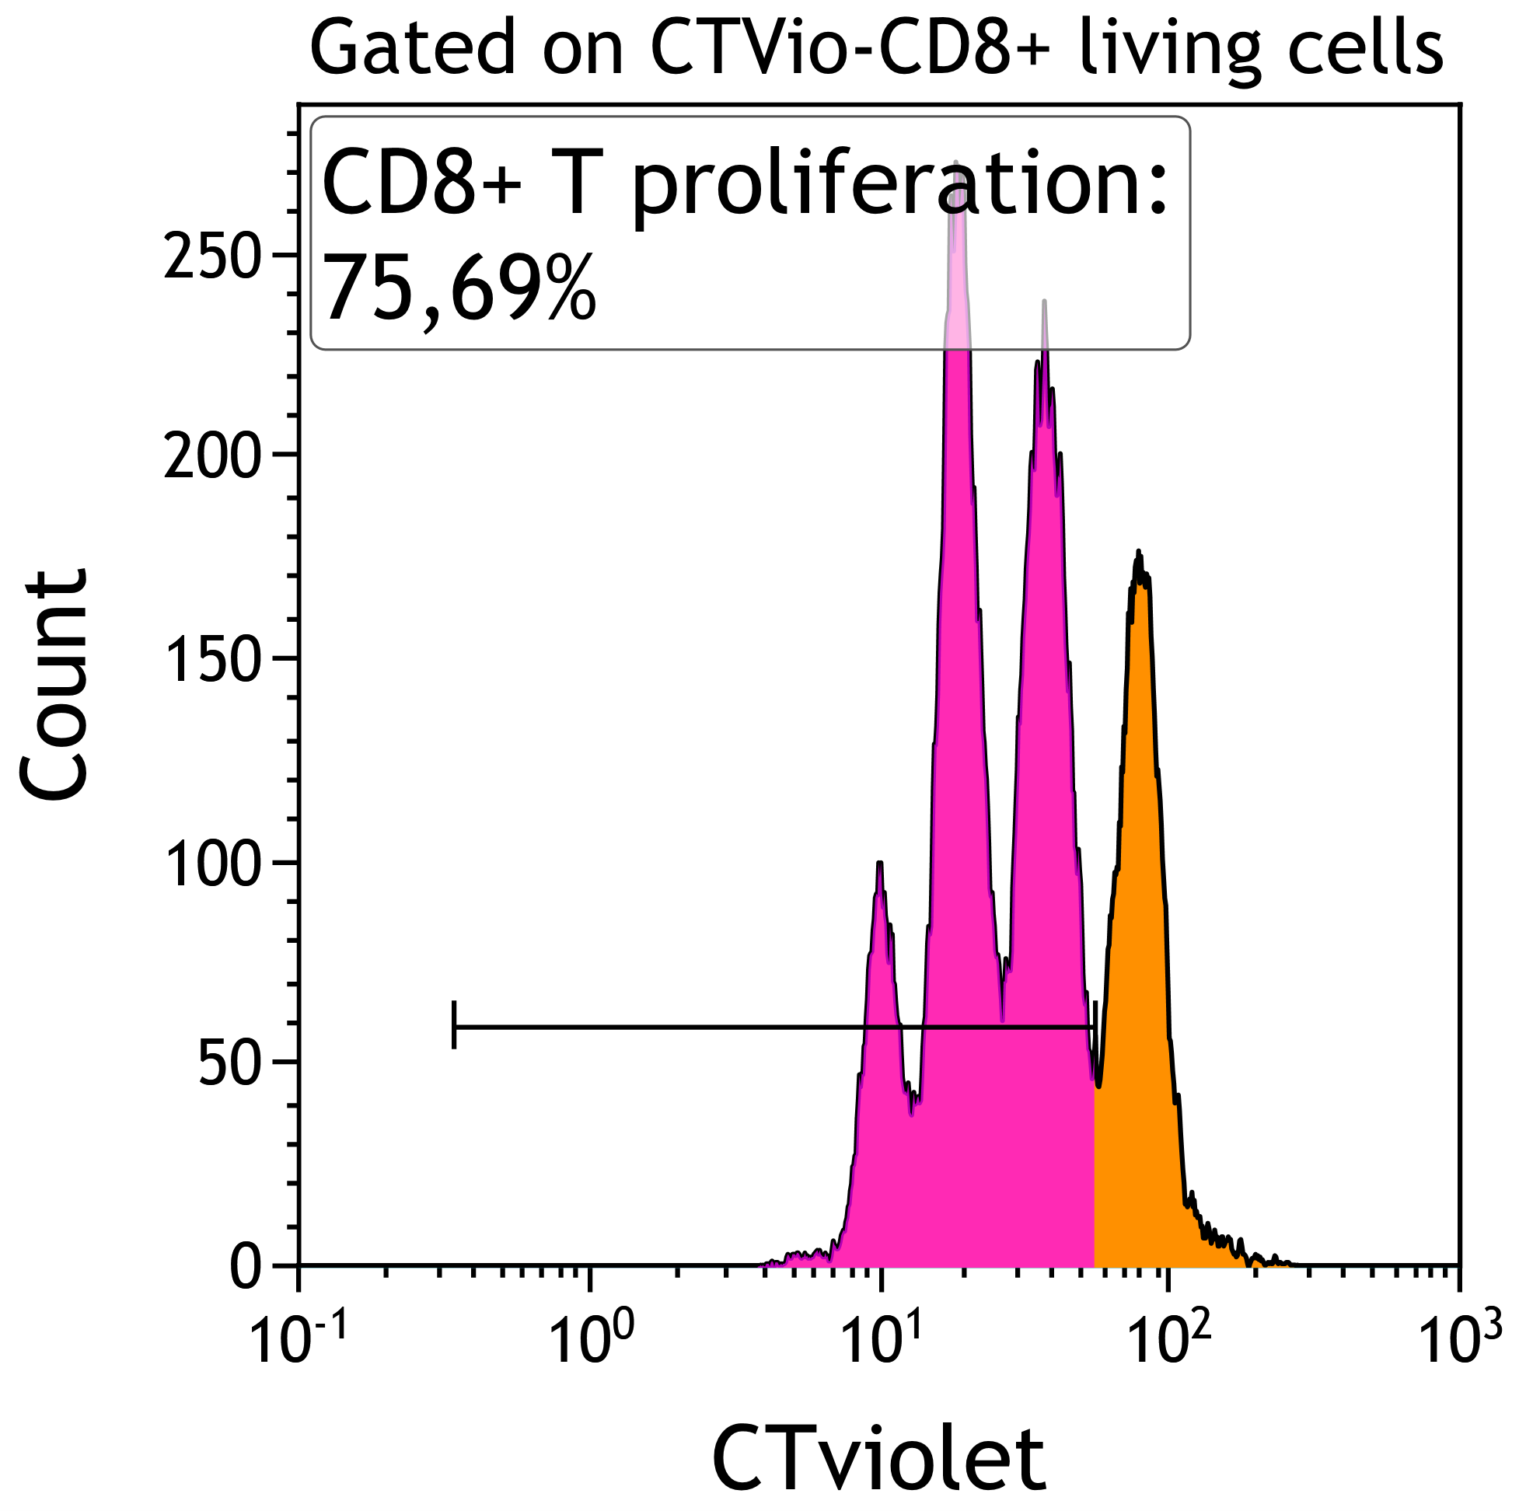
Supplemental Figure 1
PBL alone NA + PBS
Activated PBL + PBS
CD4 proliferation (gated on viable Ctvio-CD4+)
PBL/ThyTreg ratio 1:1
PBL/ThyTreg ratio 2:1
PBL/ThyTreg ratio 4:1
PBL alone NA + PBS
Activated PBL + PBS
CD8 proliferation (gated on viqble Ctvio-CD8+)
PBL/ThyTreg ratio 1:1
PBL/ThyTreg ratio 2:1
PBL/ThyTreg ratio 4:1

Slide 2
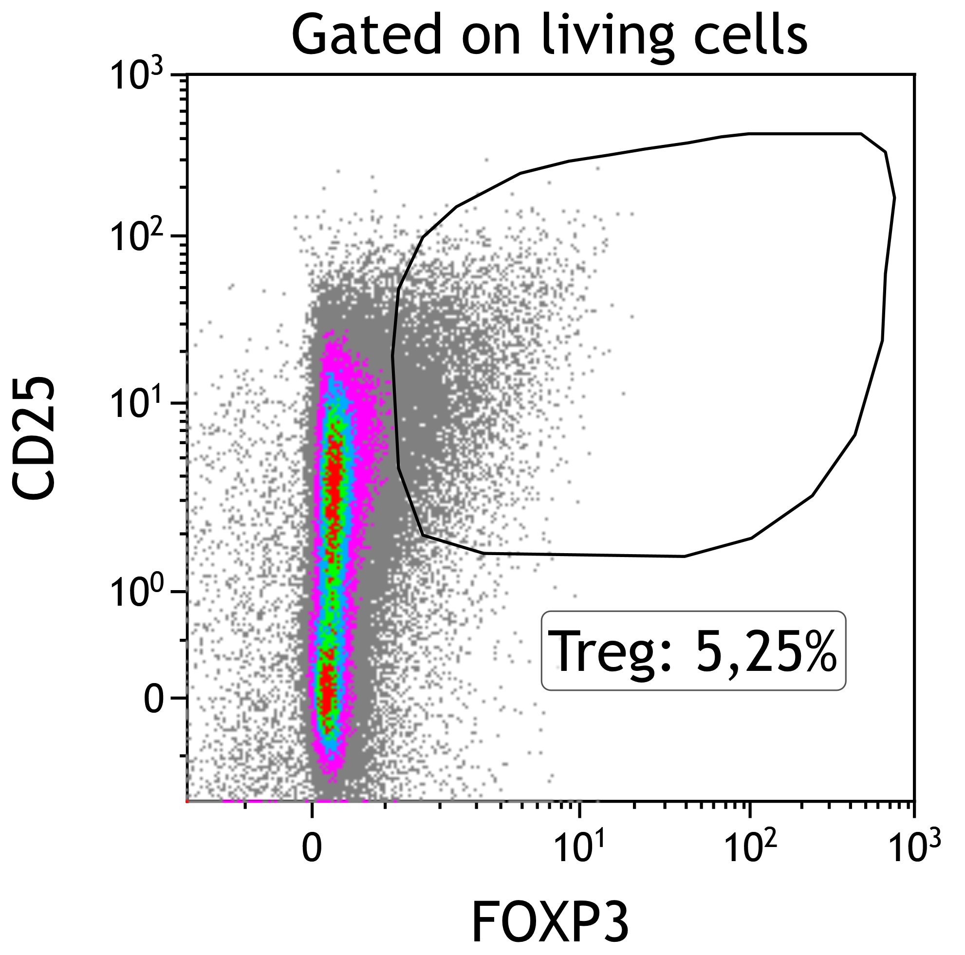
Supplemental Figure 2
A
B
C
D

Slide 3
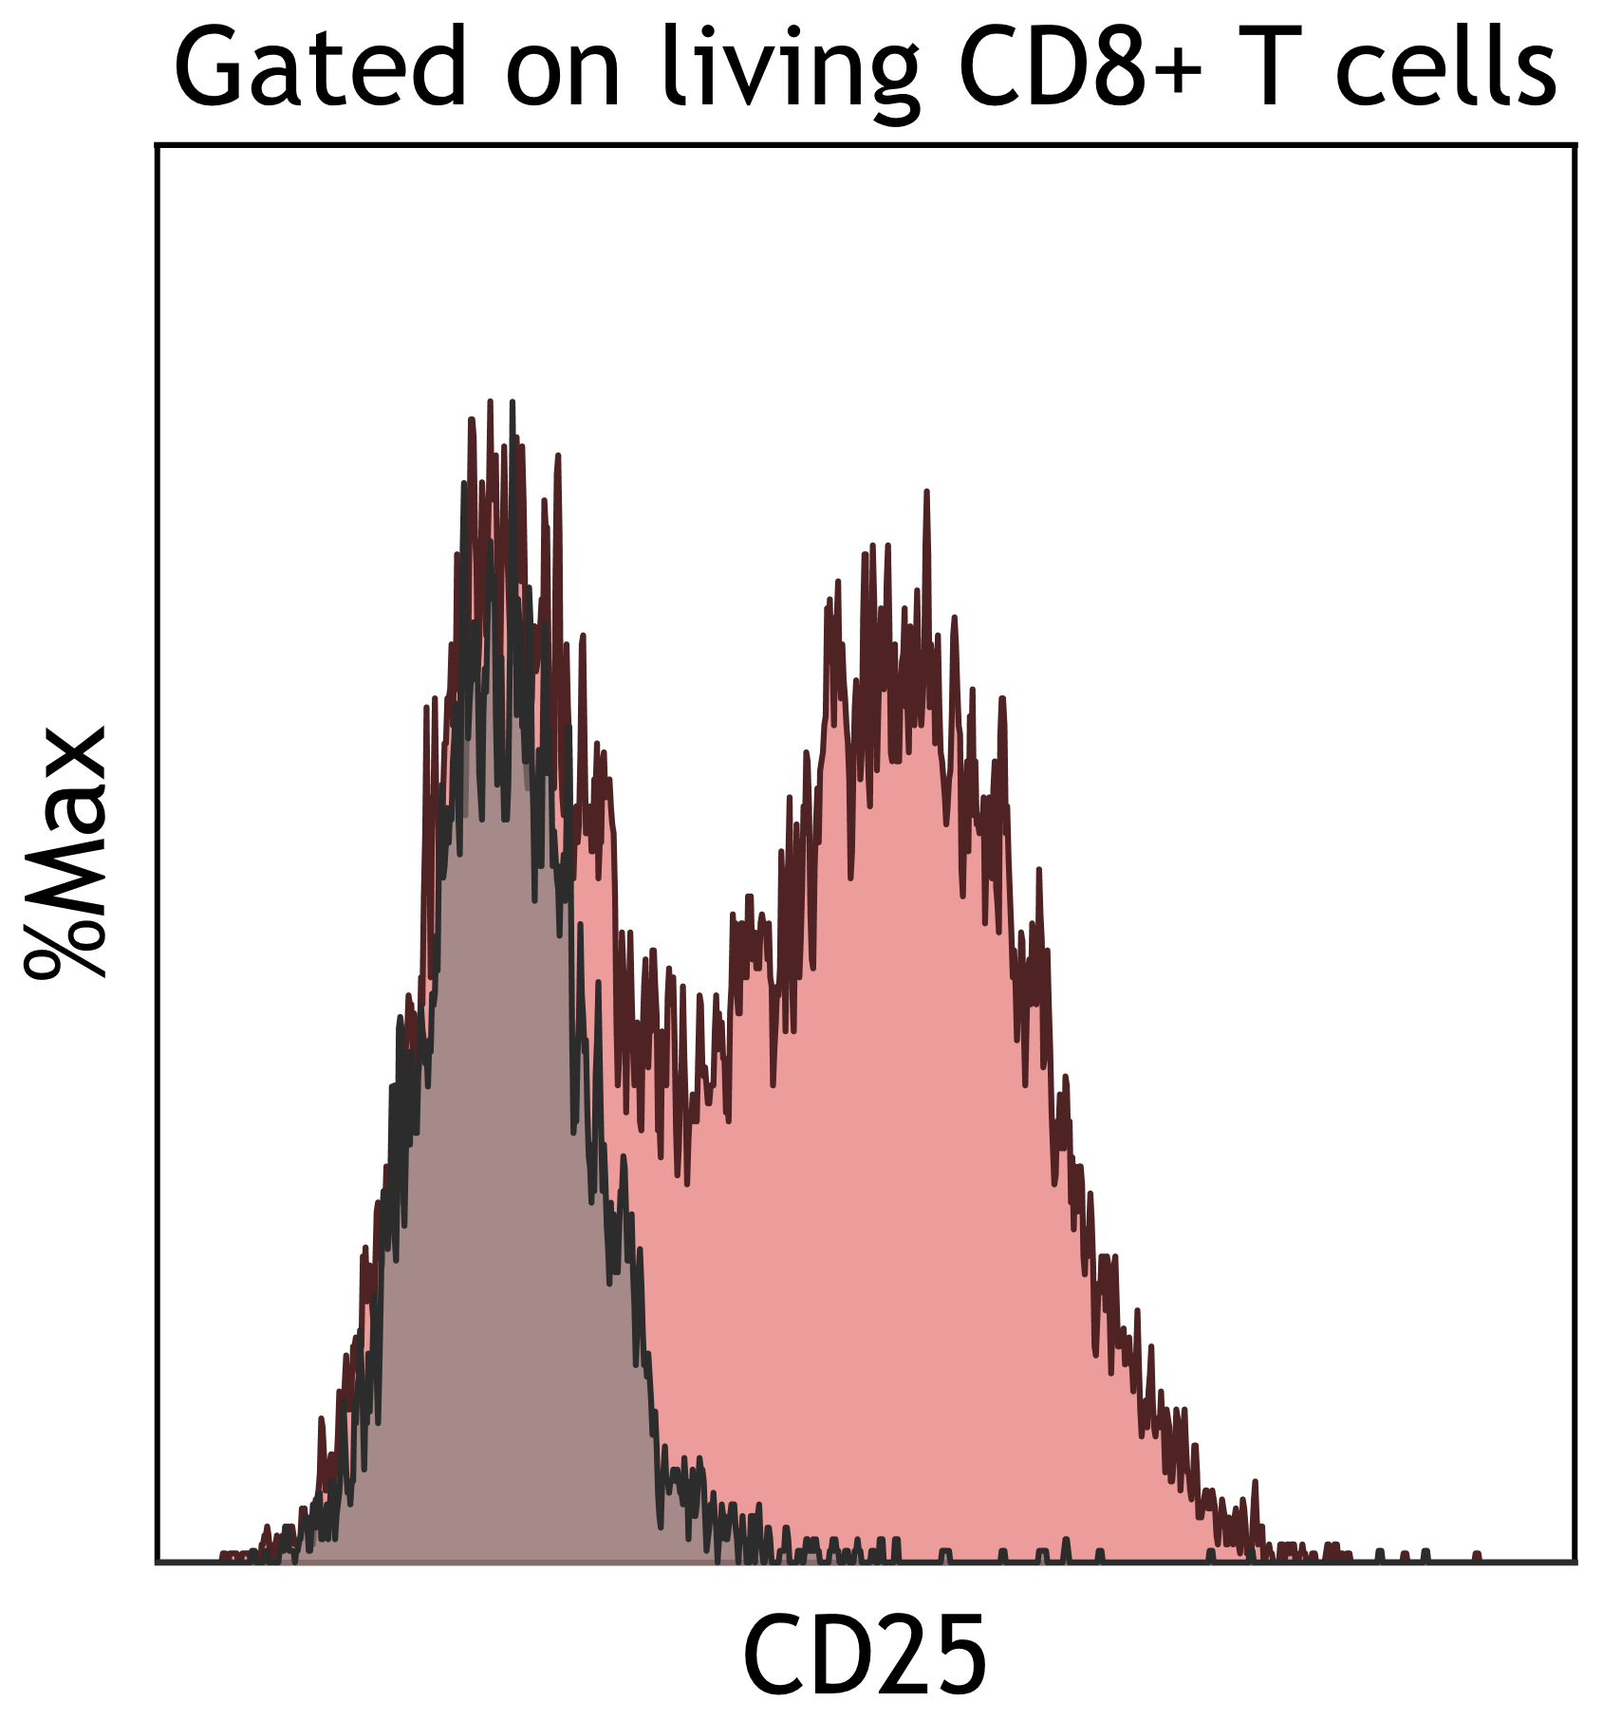
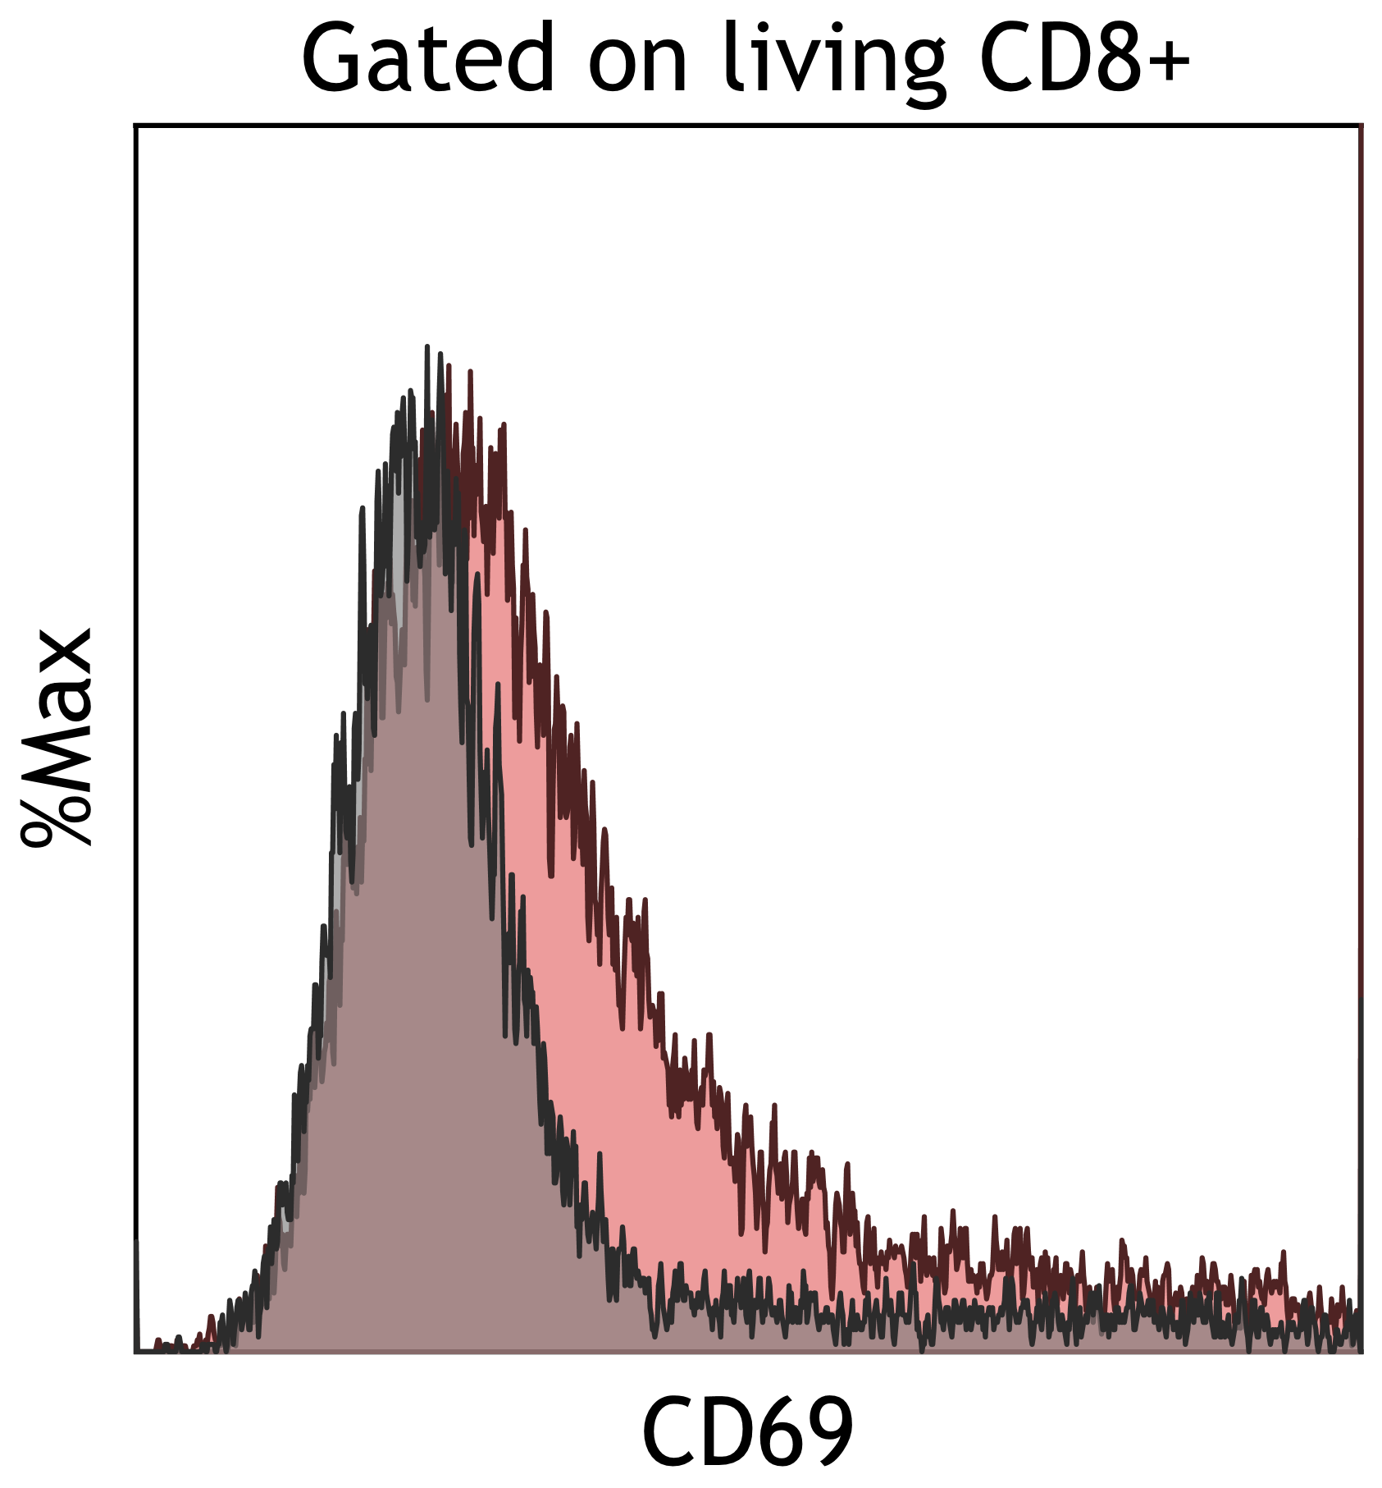

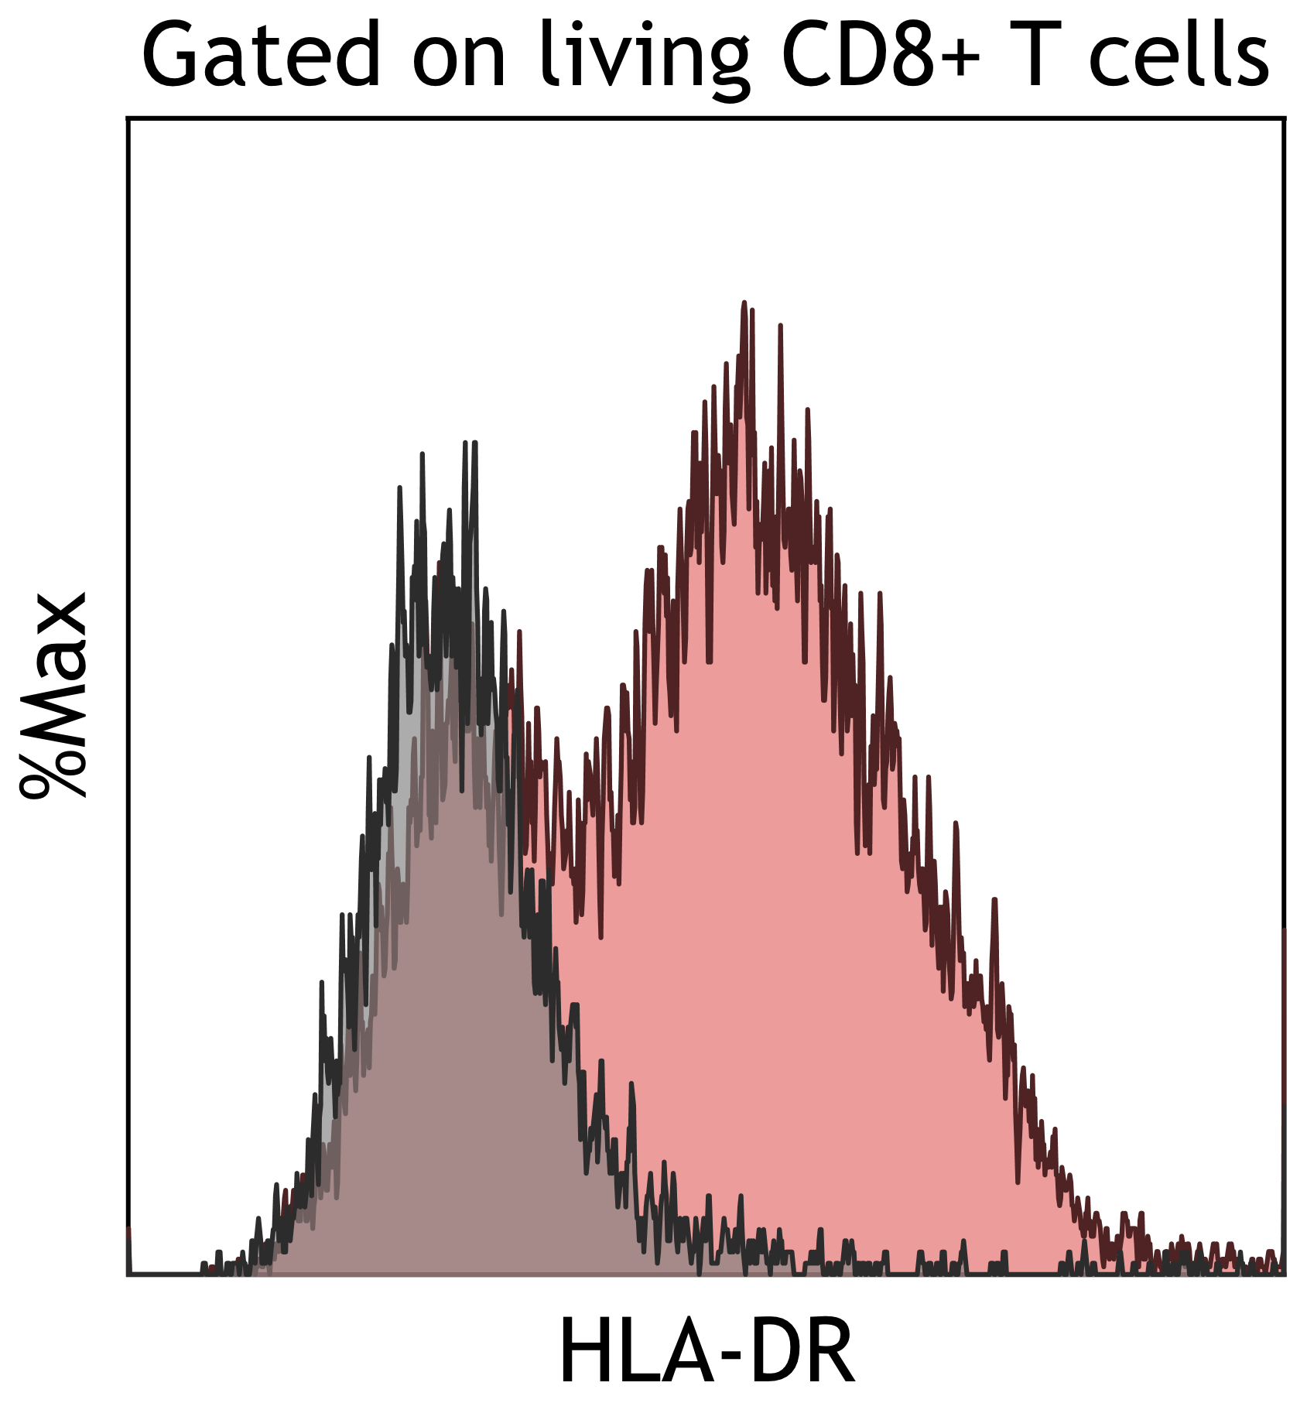
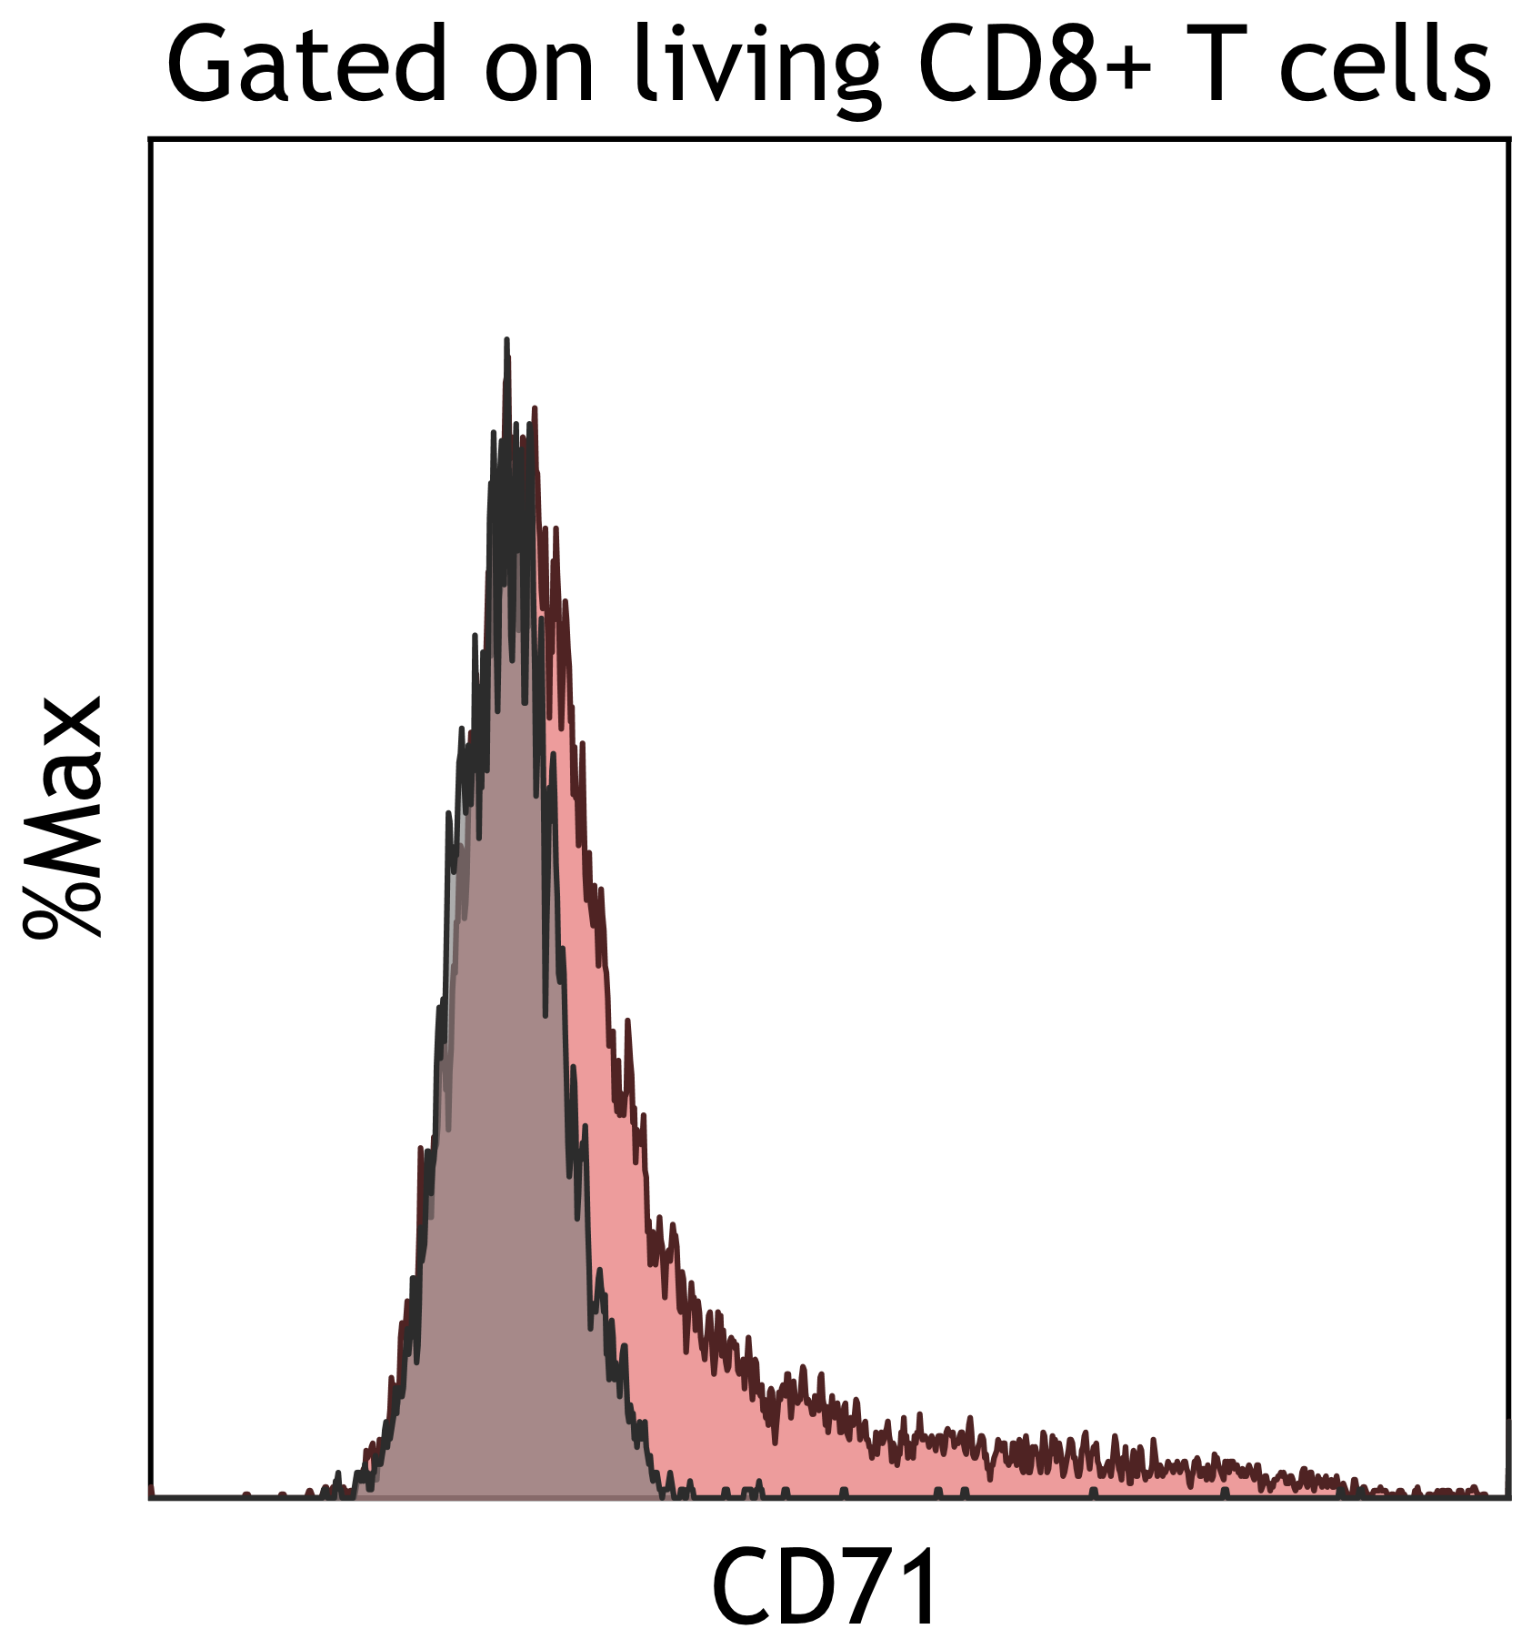
Supplemental 3

Slide 4
Supplemental 4

Slide 5
Supplemental 5

