Slide 1
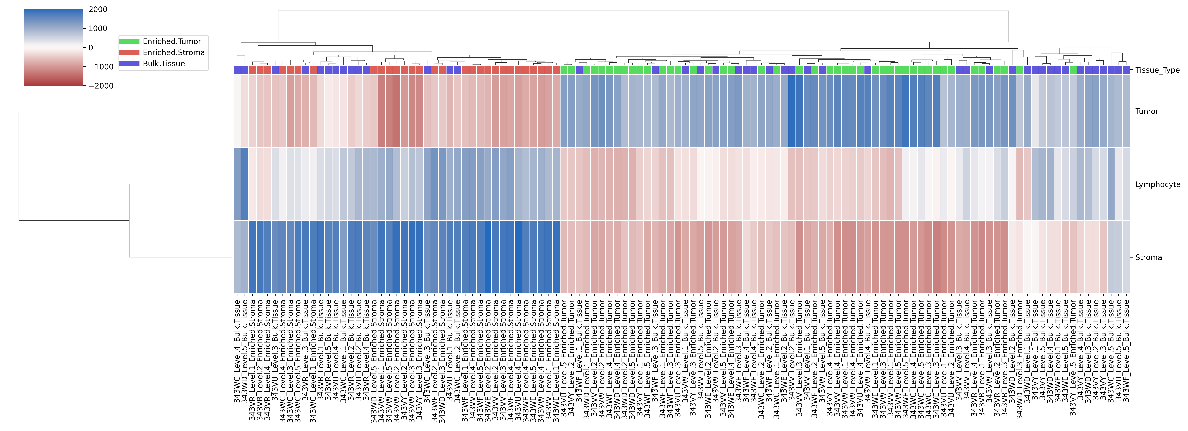
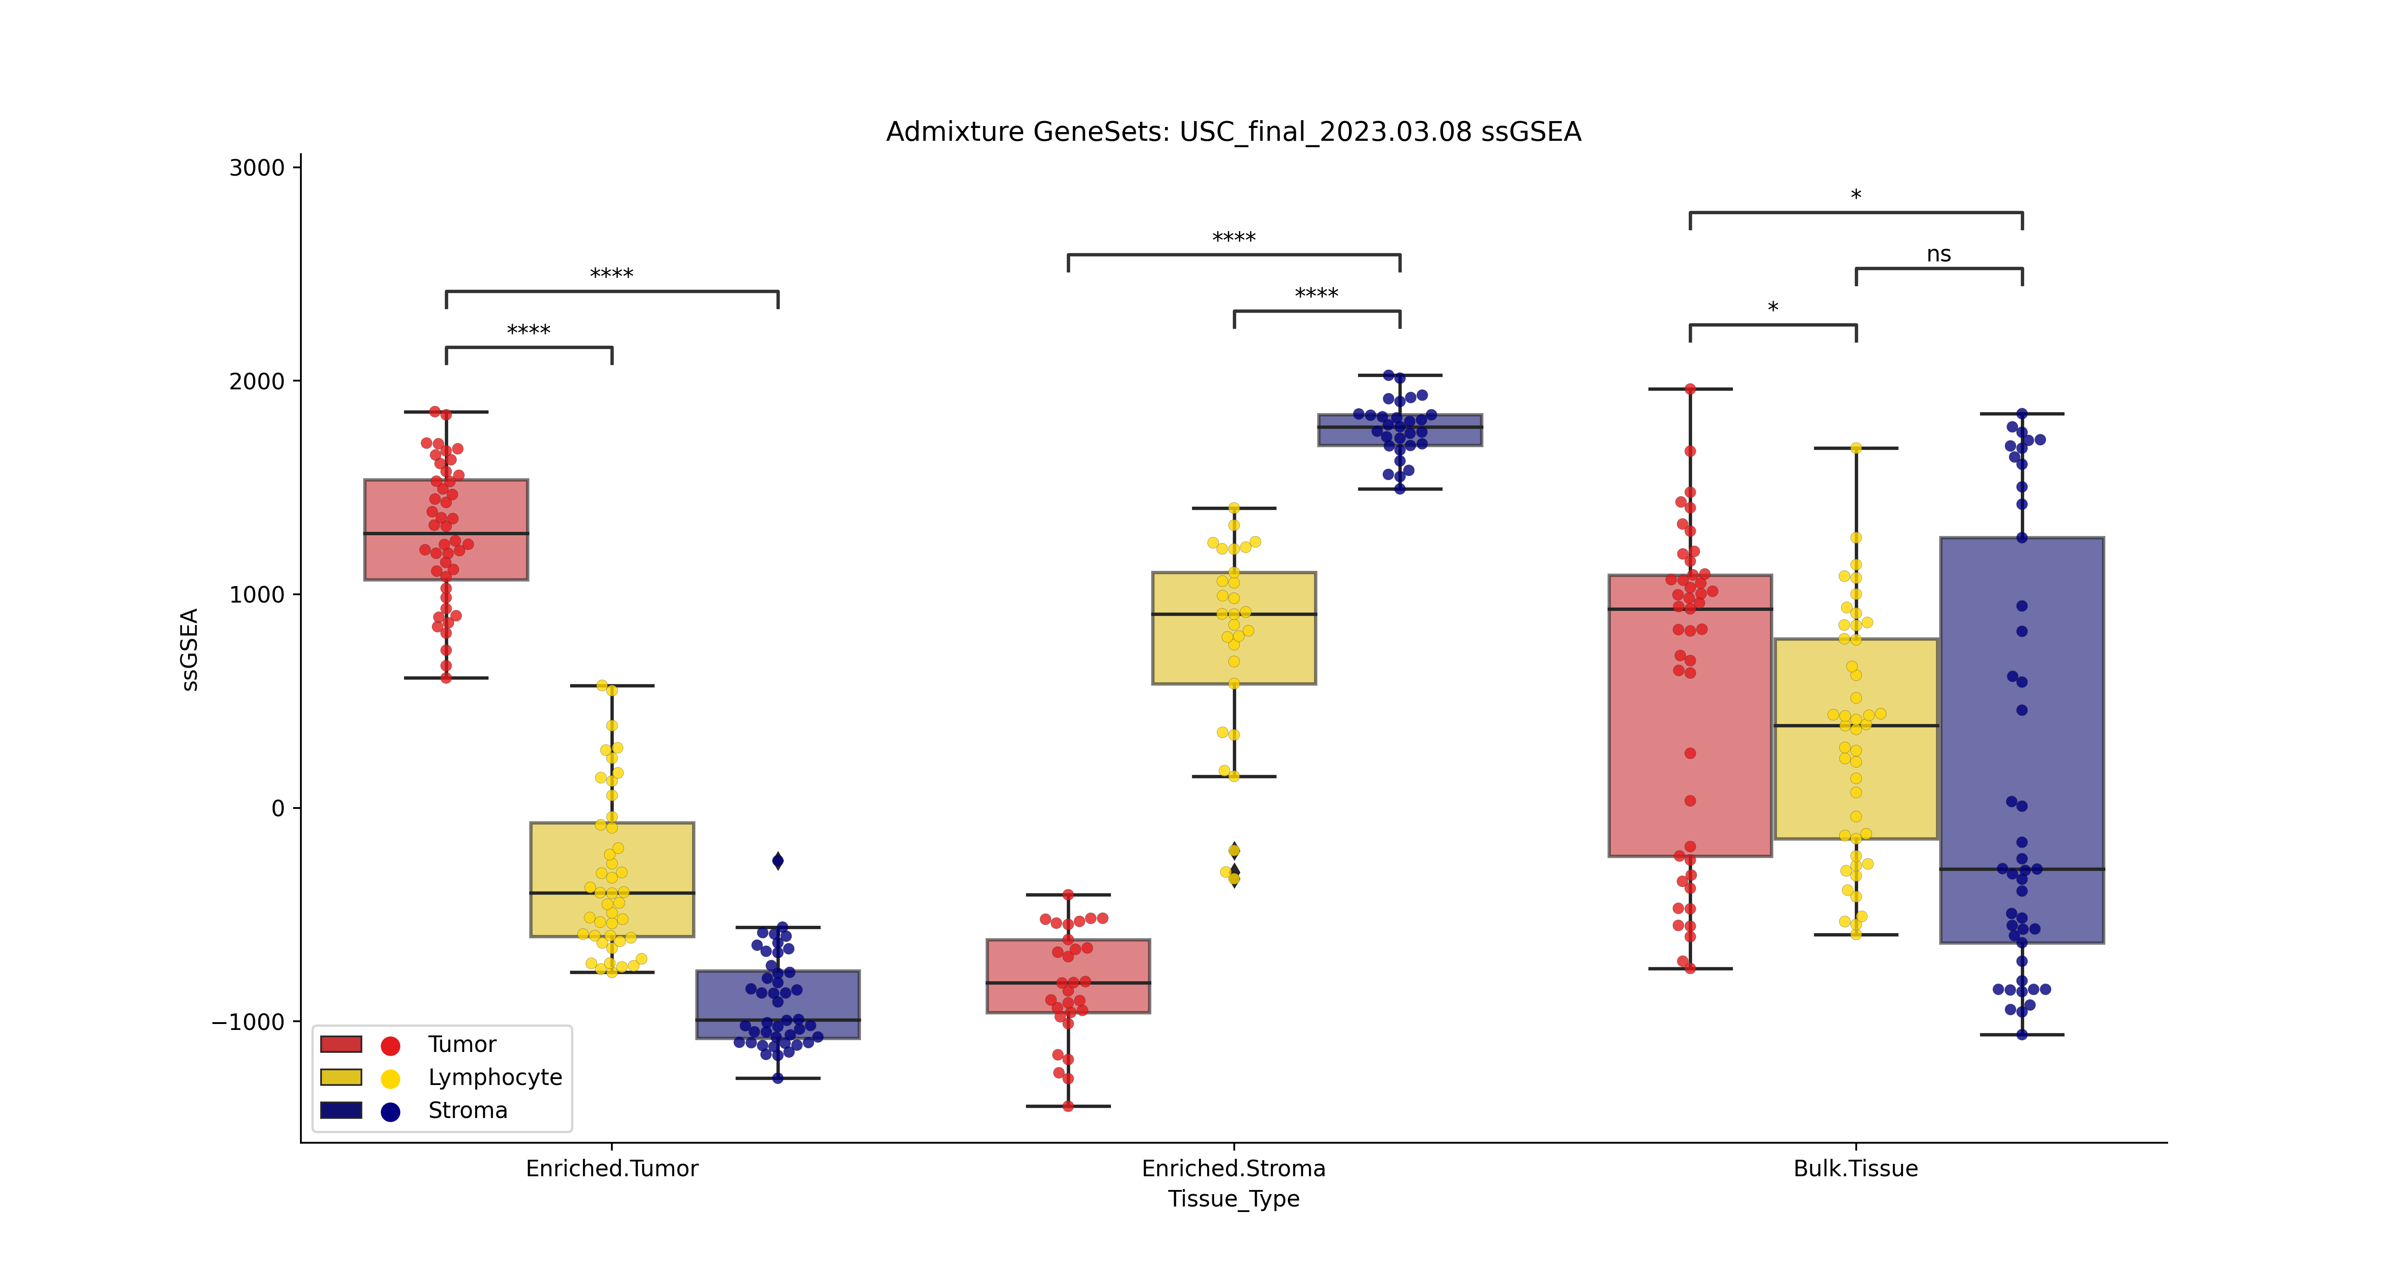
A
Tissue Type
Tumor
Immune
Stroma
B
Tumor
Immune
Stroma

