Slide 1
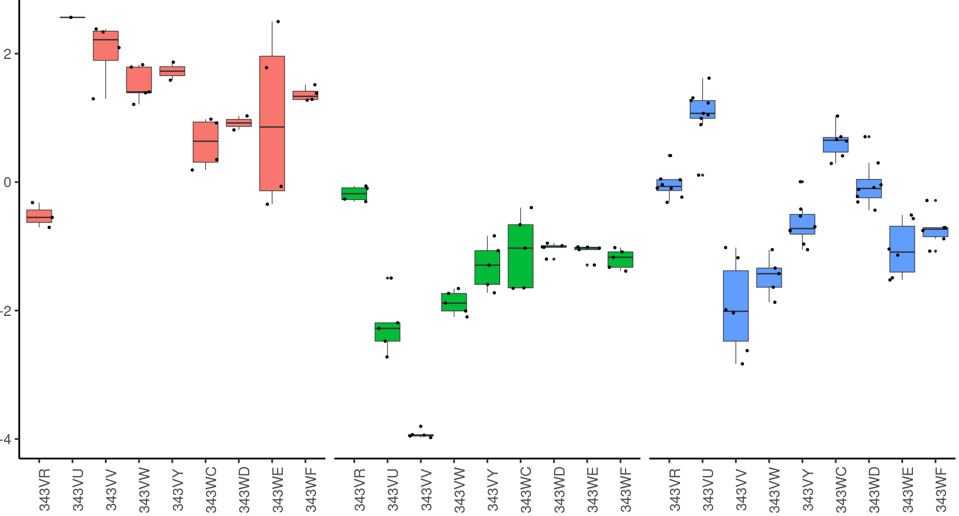
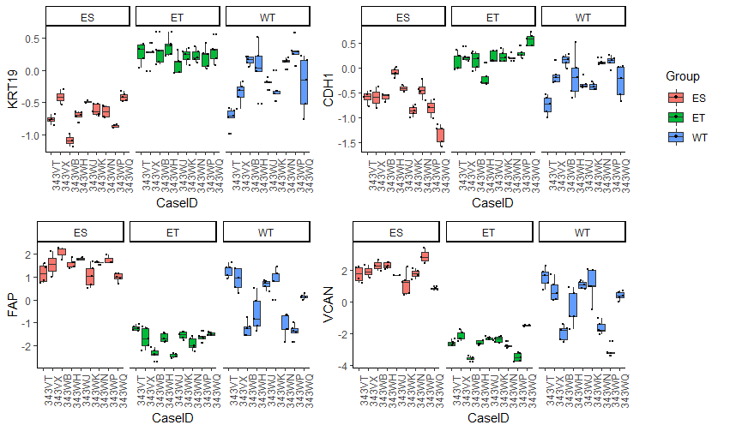
NNMT
*
Enriched Stroma
Enriched Tumor
Bulk Tissue
Collection Type
Relative Abundance
Enriched Stroma
Enriched Tumor
Bulk Tissue

