Slide 1
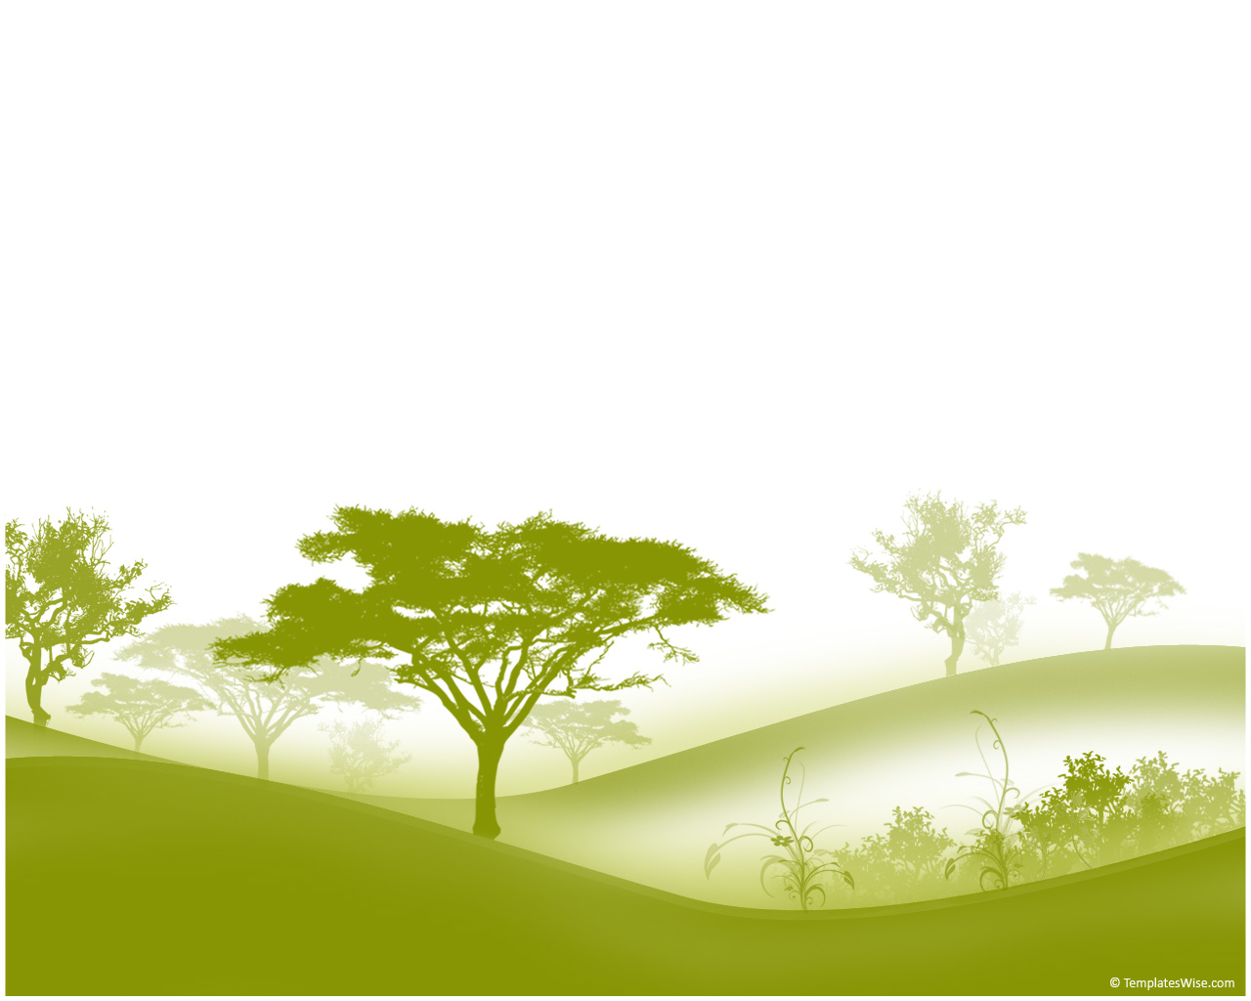
The rotifer and the yeast:
An experiment to study how multicellularity could evolve in nature
William C. Ratcliff and Jennifer Pentz
Georgia Institute of Technology
Notes:
Today we are going to hear the story of the rotifer and the yeast and how we can use these two organisms to study how multicellularity may have evolved in the deep past!

Slide 2
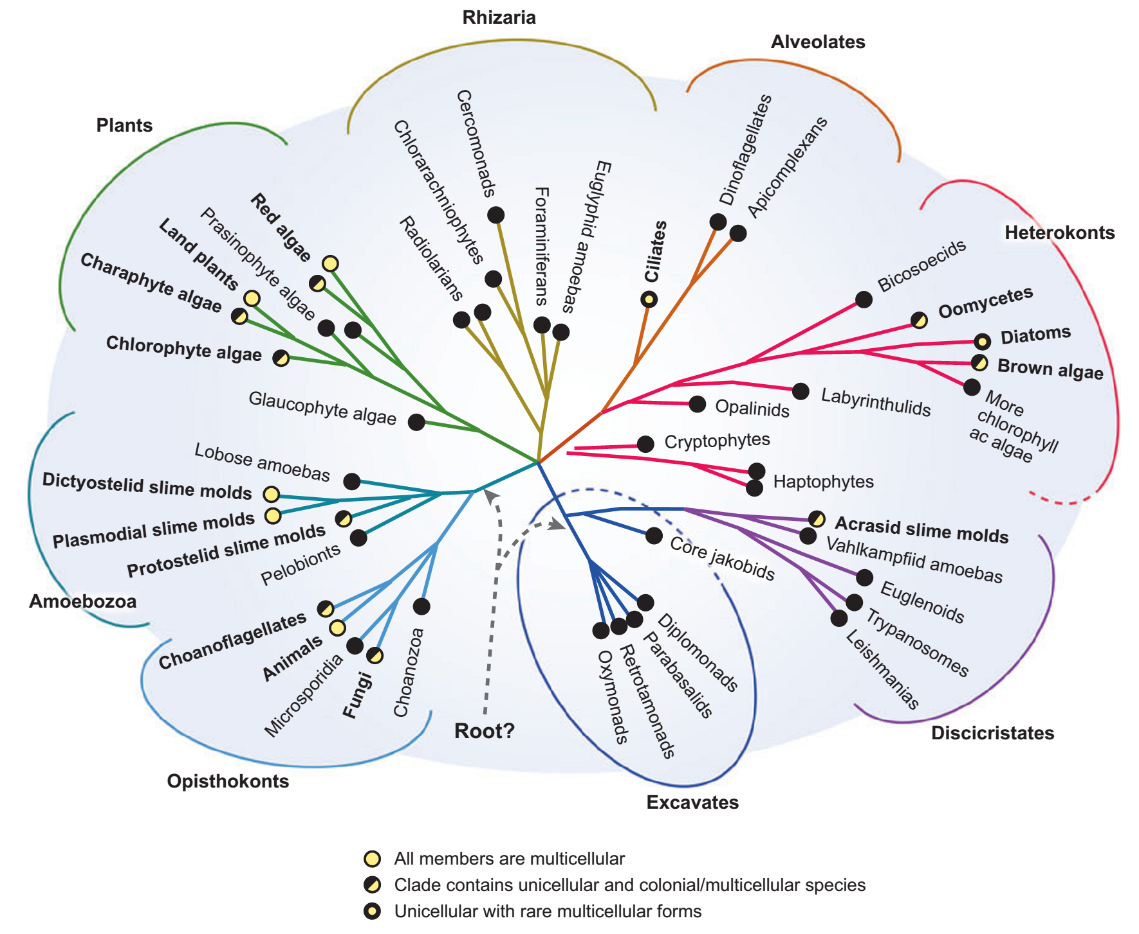
Multicellularity has evolved at least 25 times in the history of life!
Grosberg R. K., and R. R. Strathmann. 2007. Annu. Rev. Ecol. Evol. Syst. 38:621-654
Notes:
Multicellularity has evolved not once, not twice, but at least 25 times in the history of life in different lineages! Here is a phylogeny showing independent origins of multicellularity in eukaryotes. All groups represented with a yellow circle contain multicellular organisms. It is important to note that multicellularity has also evolved in the Bacteria and the Archaea, but these lineages are not included in this figure.

Slide 3
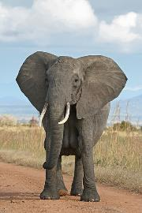
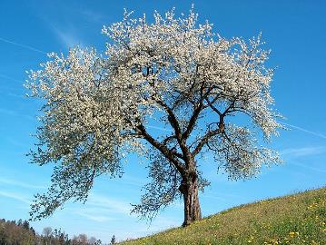
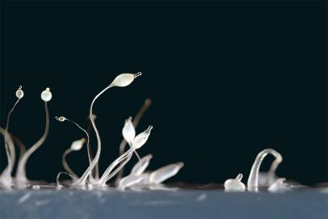
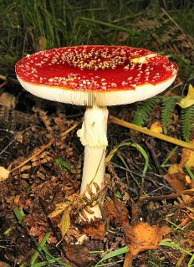
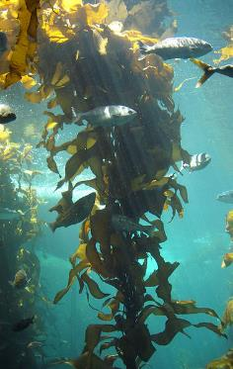
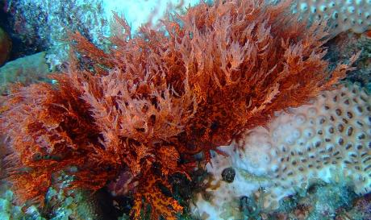
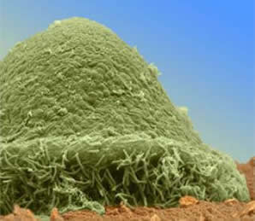
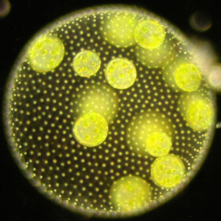
Examples of independently-evolved multicellular lineages
Notes:
Here are some examples of independently-evolved multicellular lineages. We have animals, plants, a slime mold, a fungi, a bacterium, and red, brown, and green algae. All of these lineages independently evolved multicellularity.
Copyrights
1. Elephant - © Muhammad Mahdi Karim
2. Tree (Prunus cerasus) - © Benjamin Gimmel
3. Dictyostelium - © Alex Wild
4. Fungus (Amanita muscaria) - © Tim Bekaert
5. Myxococcus xanthus - © Velicer lab
6. Brown algae - © Stef Maruch at Monteray Bay aquarium
7. Red Algae – © http://creativecommons.org/licenses/by-sa/3.0/deed.en
8. Volvox - © http://www.cam.ac.uk/research/news/stirring-tails-of-evolution

Slide 4
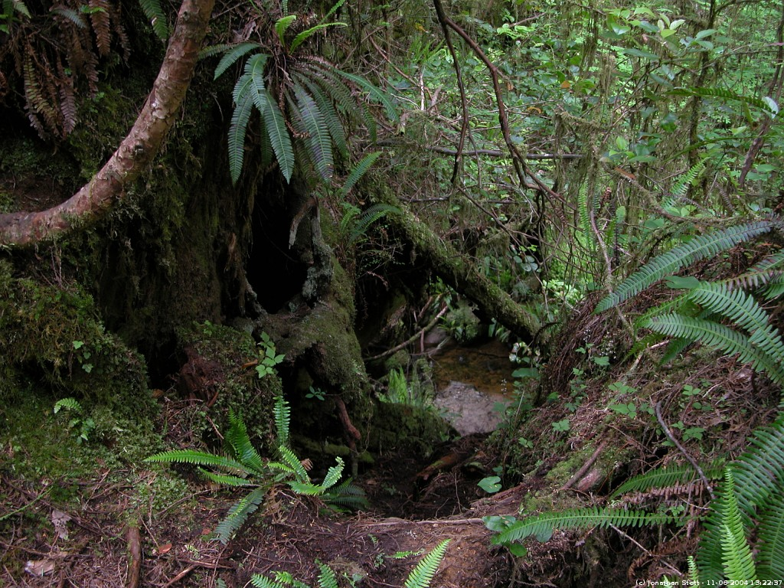
Let’s take a moment to imagine the world without multicellular organisms
Notes:
The evolution of multicellularity was revolutionary. Let’s take a moment to imagine the world without multicellular organisms…Without the trees, shrubs, herbs, animals, lichens, and fungi, this striking rainforest would be no more than a barren open landscape encrusted with a slimy layer of photosynthetic algae and bacteria….like this (next slide).
Image: $©$ Jonathan Stott Photography

Slide 5
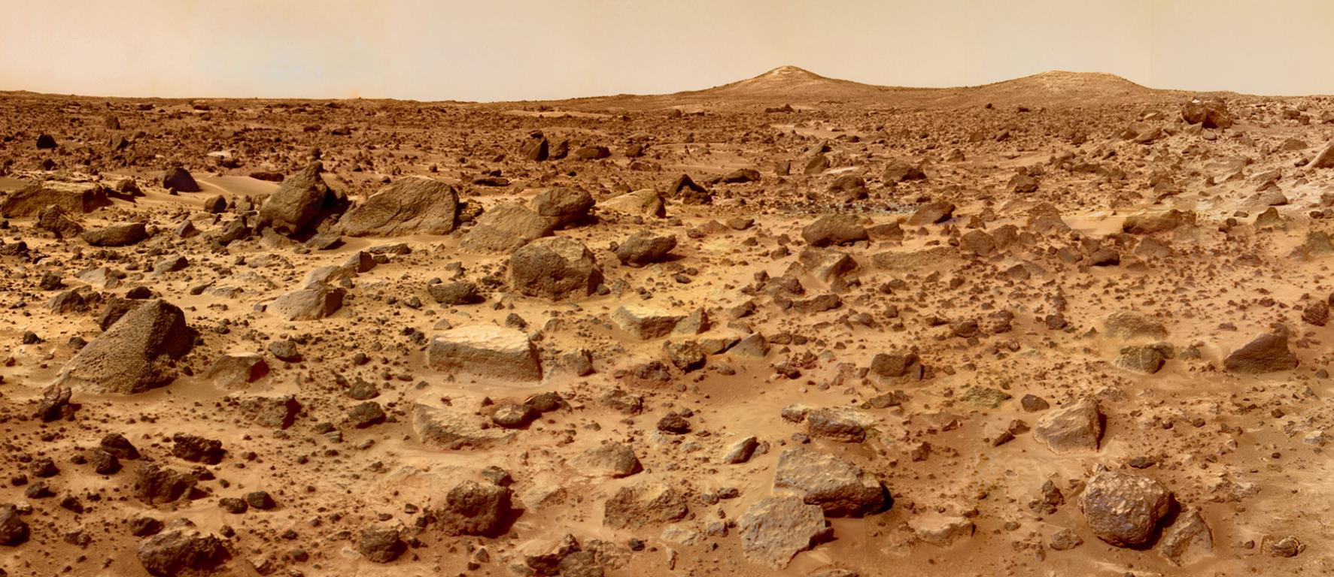
This is a photo of Mars
© NASA

Slide 6
The transition from uni- to multicellularity was one of a few events in the history of life that allowed for the evolution of large and complex organisms we see today
This is a photo of Mars
© NASA
Notes:
The transition from uni- to multicellularity was one of the few events in the history of life that allowed for the evolution of the large and complex organisms we see today.

Slide 7
The transition from uni- to multicellularity was one of a few events in the history of life that allowed for the evolution of large and complex organisms we see today
This transition occurred in the deep past (more than 200 million years ago) and most early multicellular forms have been lost to extinction
This is a photo of Mars
© NASA
Notes:
This transition occurred in the deep past, more than 200 mya, and most early forms of multicellular organisms have been lost to extinction.

Slide 8
The transition from uni- to multicellularity was one of a few events in the history of life that allowed for the evolution of large and complex organisms we see today
This transition occurred in the deep past (more than 200 million years ago) and most early multicellular forms have been lost to extinction
So how on earth do we study it?
This is a photo of Mars
© NASA
Notes:
So how on earth do we study it?

Slide 9
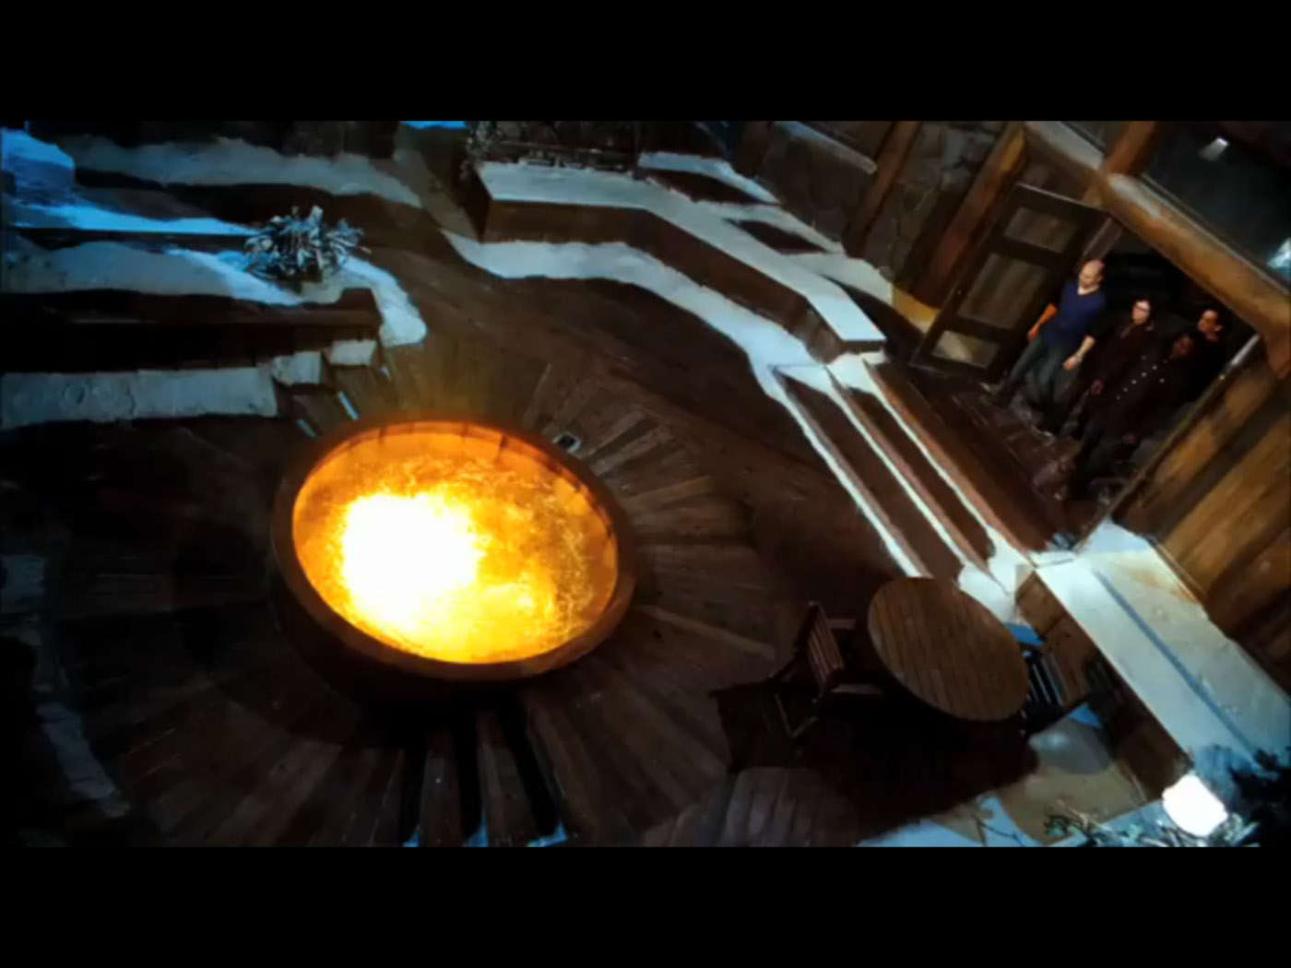
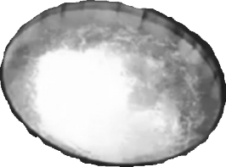
We could invent a time machine and observe this process as it’s happening
…or we could study it in the lab
Notes:
It seems that the best way of understanding this transition would be to invent a time machine, go back 600 million years, and observe this process as it’s happening. But unfortunately, this technology doesn’t exist. Instead, we can try to evolve multicellularity from scratch in the lab so we can observe this process as it happens.

Slide 10
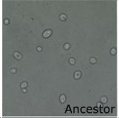
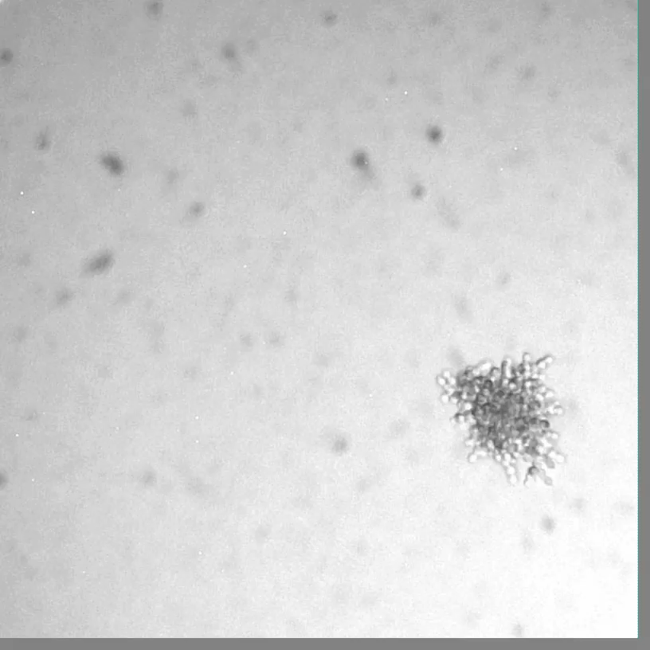
Time travel in a test tube
The left is a picture of the unicellular ancestor and the video is the evolved multicellular ‘snowflake’ yeast.
Notes:
This is exactly what scientists did. They experimentally evolved multicellular ‘snowflake’ yeast from a unicellular ancestor. The picture of the unicellular ancestor is on your left and the video is the evolved multicellular snowflake yeast.

Slide 11
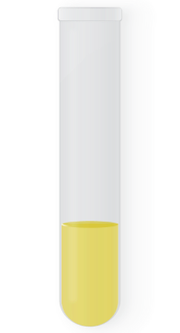

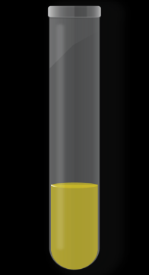
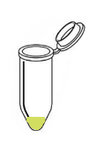


How did they do this?
24 hour, shaking
incubation
centrifuge 100g
for 10 seconds
discard upper
93% of media
transfer to fresh
media
Use gravity to select for clustering genotypes because clusters of cells settle more quickly than single cells.
Notes:
To evolve multicellular yeast, scientists used gravity to select for the clustering genotype that we saw in the previous movie. They did this because clusters of cells settling more quickly than single cells, allowing the scientists to select for groups of cells relatively easily. They started with 10 replicate populations of the unicellular yeast. To select for settling, they took yeast that have been growing for 24h and centrifuged 1.5 mL at 100g for 10 seconds. After this, they discarded the upper 93% of the sample and transferred the bottom to fresh media, allowing only the fastest-settling things to survive.

Slide 12
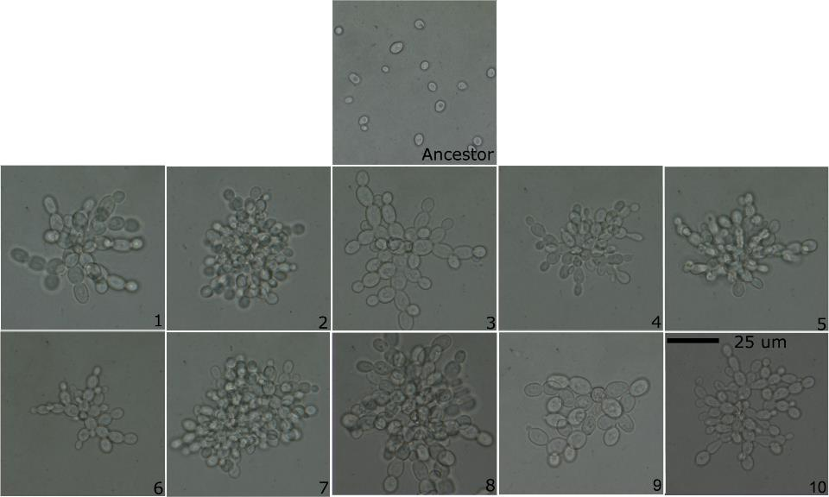
Independent evolution of the ‘snowflake’ yeast in all 10 replicate populations
Notes:
After 60 days, they saw independent evolution of snowflake clusters in all 10 replicate populations!

Slide 13
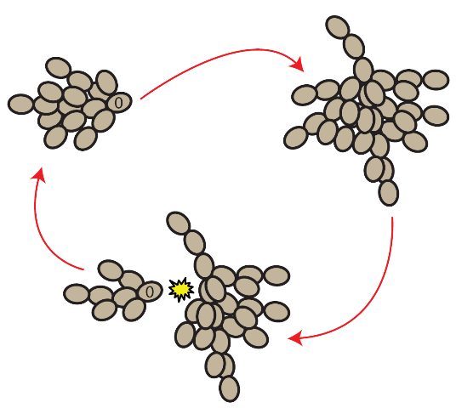
Some cool and important properties of snowflake yeast
A multicellular life cycle evolved. Snowflake yeast reproduce via multicellular propagules.
Notes:
Over the course of the experiment, the scientists observed some really cool and important properties of snowflake yeast. The snowflake yeast evolved a multicellular life cycle. Snowflake yeast reproduced by spitting off multicellular propagules.

Slide 14
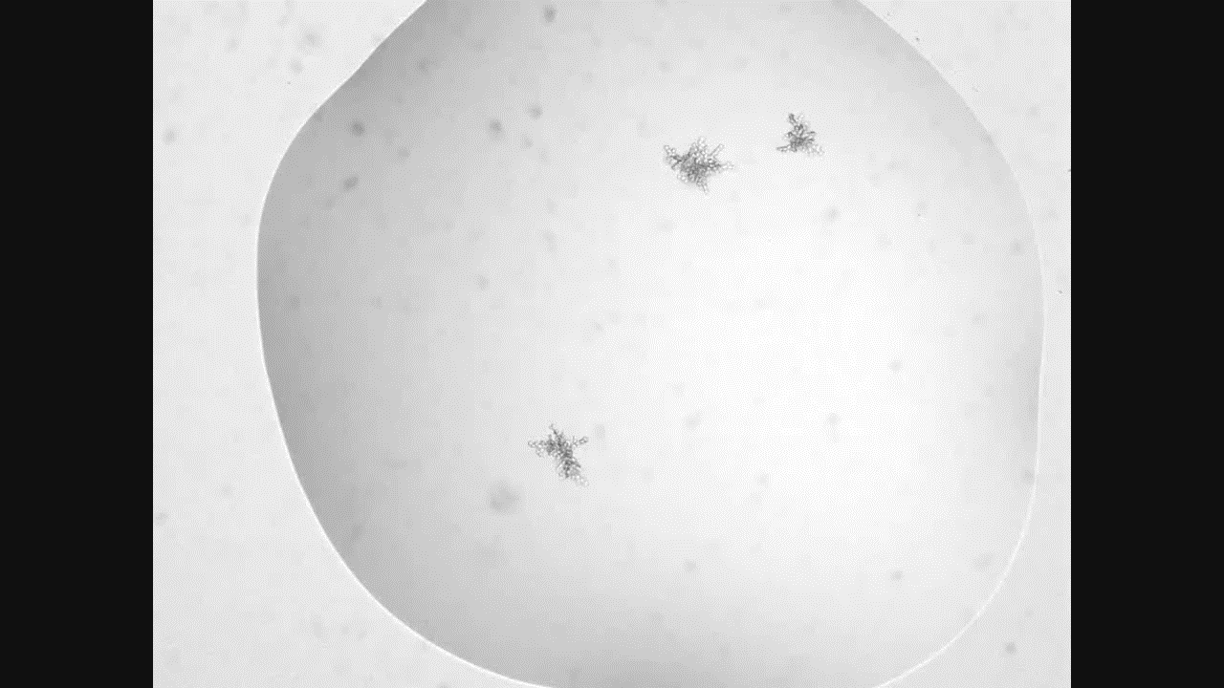
A video of snowflake yeast life cycle
Notes:
Here is a video of the snowflake yeast life cycle. A single parent cluster will be labeled in blue, and the multicellular propagules will be labeled in green. A cool thing to notice is that the propagules are consistently smaller than the parent cluster.

Slide 15
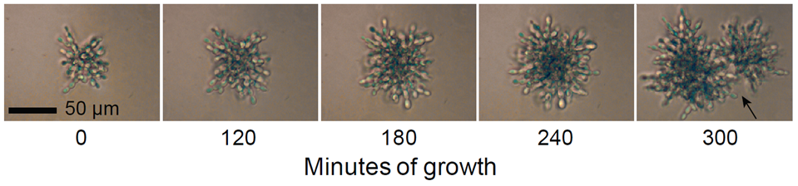
Propagules are functionally juvenile
maturation
reproduction
The multicellular propagules turn out to be functionally juvenile, meaning they have to grow back to their parent size before they can reproduce themselves
Notes:
This turns out to be really important because these propagules turn out to be functionally juvenile, meaning that they have to grow back up to their parent size before they can reproduce themselves. This is displayed in the picture here.

Slide 16
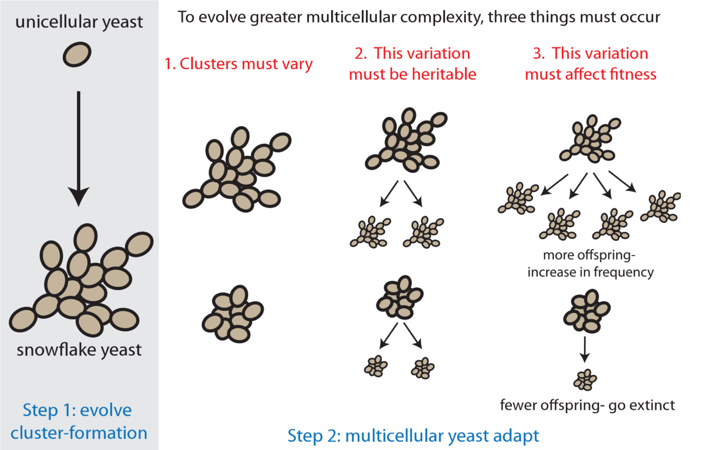
Two steps are required for the transition to multicellularity
Notes:
Let’s talk about the transition from unicellularity to multicellularity for a bit here. Overall, there are two steps required for the transition to multicellularity that I will go over in the next few slides.

Slide 17
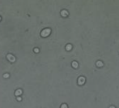
Step 1 – the evolution of clusters
The first step in this transition is the evolution of cluster formation from single-celled ancestors
This could be beneficial for many reason in nature:
  Predator evasion
  Metabolic cooperation
  UV resistance
Y55 - Unicellular Saccharomyces cerevisiae (bakers yeast)
Notes:
The first step in this transition is the evolution of clusters from single-celled ancestors, like ‘snowflake yeast’ evolving from single-celled yeast. In nature, this could be beneficial for many reasons, including evasion from predators that eat unicellular prey, metabolic cooperation, and UV resistance. In the snowflake yeast system, this was beneficial because clusters of cells settled faster than single cells.

Slide 18
Step 2 – multicellular yeast adapt
Three things must be true for multicellular yeast to adapt
Notes:
The second step in this transition is that the early multicellular organism must be able to adapt as a multicellular organism. So once again using snowflake yeast as a model system to think about this transition, snowflake yeast must be able to adapt.

Slide 19
Clusters must vary from one another
Snowflake
Not snowflake (clumpy yeast)
Notes:
First, clusters much vary from one another. Shown are two different ways of forming a cluster in yeast – snowflake and clumping together, which I will call clumpy yeast. You can see that the two look very different from one another.

Slide 20
Cluster variation must be heritable
Snowflake yeast make more snowflake yeast
Clumpy yeast make more clumpy yeast
Notes:
Second, the cluster variation shown in the last slide must be heritable. This means that snowflake yeast make more snowflake yeast, and clumpy yeast make more clumpy yeast.

Slide 21
Cluster variation much affect fitness
The three components of Step 2 are known as evolution via natural selection.
Notes:
Finally, the variation that we’ve been talking about must affect fitness. What I mean by that is that one must be better at surviving than the other. You can see that in this diagram because snowflake yeast make more offspring than clumpy yeast, which will allow the snowflake yeast to increase in frequency and possibly take over the population. The three components of step 2 are known as evolution via natural selection. This is important because over time, this can result in the evolution of multicellular complexity like we see in plants, animals, and fungi.

Slide 22
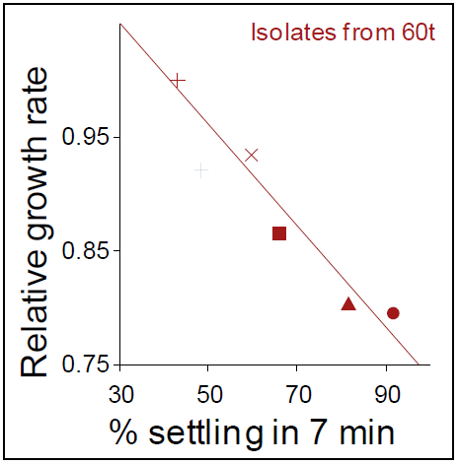
Has Step 2 occurred? Do multicellular yeast adapt?
Large clusters grow slowly, because internal cells don’t get much food.
One possible adaptation for big snowflake yeast: make smaller propagules that grow faster!
Notes:
A big question with snowflake yeast was “has step 2 occurred”? Can the multicellular snowflake yeast adapt? Here is a graph of a couple of properties of snowflake yeast: % settling rate (which is a proxy for how big the cluster is) and the relative growth rate, or how fast the cluster can grow. The relative growth rate is a measure of how much these isolates of yeast increased in biomass during a 4-h growth experiment. As you can see, larger clusters grow slowly because internal cells don’t get much food. One possible adaptation for big snowflake yeast to overcome this problem is to make smaller propagules that grow faster!

Slide 23
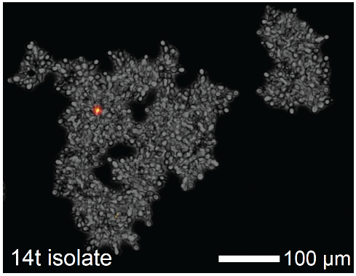
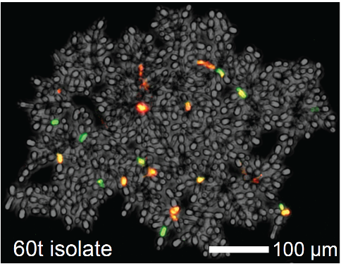
How do you make smaller propagules?
First snowflake yeast to evolve
Transfer 60 yeast
dead apoptotic, but alive apoptotic and dying
Increasing the rate of apoptosis (programmed cell death) allows large clusters to make smaller, faster growing offspring
Notes:
But how do snowflake yeast make smaller propagules? Snowflake yeast increased the frequency of apoptosis, which is programmed cell death, within the cluster that allowed large clusters to do just that. These are pictures of the first snowflake yeast to evolve, which is the 14 transfer isolated on your left, and the 60 transfer isolate yeast (right), after hundreds of generations of evolution, stained with a red viability stain and a green apoptosis stain. This makes yeast that are dead, apoptotic but alive, or apoptotic and dying fluoresce their respective colors. The first snowflake yeast is composed of cells that are all happy and alive. In the transfer 60 snowflake yeast you can see many apoptotic cells as well as many dead cells. Apoptosis has clearly evolved in snowflake yeast.

Slide 24
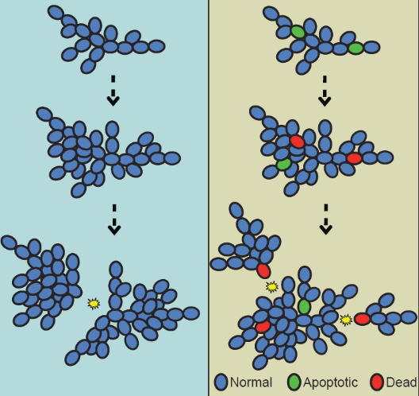
Dead cells act as break-points
Cells that die from apoptosis act as break-points within the cluster, making propagules smaller.
This is a cluster-level trait because increases the fitness of the cluster, not the individual cells undergoing apoptosis (they pay a cost)!
This is evidence that multicellular yeast are adapting. They can be considered multicelled individuals.
Notes:
So how does having high rates of apoptosis allow clusters make smaller propagules? The dead cells in the cluster act as break-points, which then allows the clusters to make a lot of small propagules. Programmed cell death plays a key role in the development of many multicellular organisms, including plants and animals, and we think that it plays a similar, albeit far simpler, role in snowflake yeast. If there is a reasonable chance that these propagules have enough time to get big enough to survive gravitational selection (and remember, because they are small, they grow fast!), then this type of fragmentation would be adaptive and is a cluster-level trait because this increases the fitness of the cluster, not the individual cells that are undergoing apoptosis. This is evidence that multicellular yeast are adapting, which means they can be considered multicelled individuals!!

Slide 25
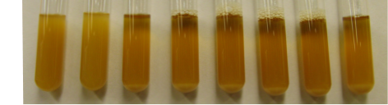
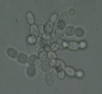
These experiments clearly show that multicellularity can quickly evolve in a test tube
Pictures of populations from every week during the evolution of snowflake yeast
Ancestor
1 week
2 weeks
3 weeks
4 weeks
5 weeks
6 weeks
8 weeks
Unicellular ancestor
Snowflake yeast
300 generations!
0 days of evolution
60 days of evolution
Notes:
So these experiments that I’ve been talking about clearly show that multicellularity can quickly evolve in a test tube. You can see that here, where there is a picture of every week during the evolution of snowflake yeast. This occurred in just 300 generations!

Slide 26
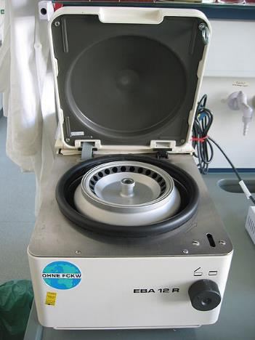
But wait! You might be thinking…centrifuges are not found in nature
but… that does not mean that conditions favoring cluster formation don’t exist in nature!
Notes:
But wait!...you might be thinking…centrifuges don’t exist in nature, so this may not be a very good model for the types of selective pressures that unicellular organisms face in nature. But that does not mean that conditions favoring cluster formation don’t exist in nature!
Image of centrifuge: © CC Magnus Manke

Slide 27
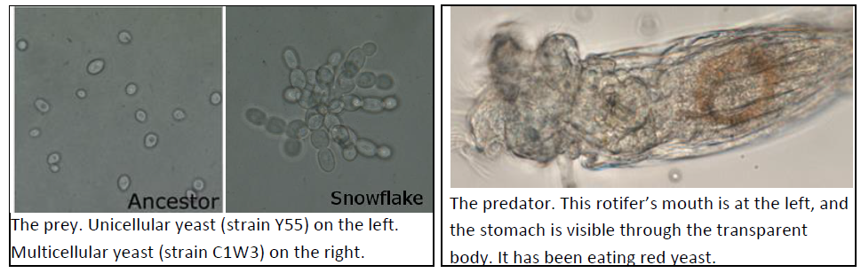
What do you think will happen if we feed yeast to a hungry predator (a rotifer)?
Snowflake yeast are about as big as the rotifer’s head!
Notes:
What do you think will happen if we feed yeast to a hungry predator, such as a rotifer?
**This is great time for a pre-lab exercise! At this point, and at the instructors discretion, students may discuss what they predict will happen with the proposed question. Allow time for students to come up with an experiment to test the hypothesis that “multicellular yeast may avoid predation because they are too big to eat”. After students have come up with an experimental plan, have them write down what they predict will happen if they went forward with the experiment that they proposed. This may be a great pre-lab exercise before moving onto describing the lab to them in slides 28—31.

Slide 28
Multicellular yeast may avoid predation because they are too big to eat
How you will test this hypothesis?
Notes:
Theory predicts that multicelluar yeast may avoid this predation because the are too big to eat, which would give them a huge advantage of single celled yeast. This is what we are going to do to test this this hypothesis…

Slide 29
Multicellular yeast may avoid predation because they are too big to eat
How you will test this hypothesis?
Give hungry rotifers unicellular and multicellular yeast
Notes:
We are going to give hungry rotifers unicellular and multicellular yeast that have been stained so we can tell them apart.

Slide 30
Multicellular yeast may avoid predation because they are too big to eat
How you will test this hypothesis?
Give hungry rotifers unicellular and multicellular yeast
Examine the ability of the rotifers to eat each yeast strain by counting them in rotifer stomachs
Notes:
Then we are going to examine the ability of rotifers to eat each form by counting the number of each type of yeast cell in the rotifers stomach.

Slide 31
Multicellular yeast may avoid predation because they are too big to eat
How you will test this hypothesis?
Give hungry rotifers unicellular and multicellular yeast
Examine the ability of the rotifers to eat each yeast strain by counting them in rotifer stomachs
Analyze these results statistically using a chi-squared test
Notes:
This will allow us to quantify predatory selection by calculating the relative survival of multicellular to unicellular yeast and to determine if the results are statistically robust.

