Slide 1
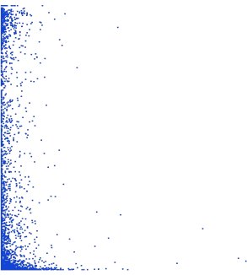
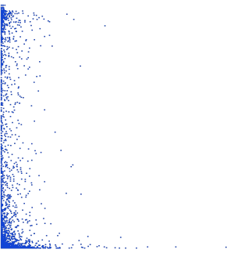
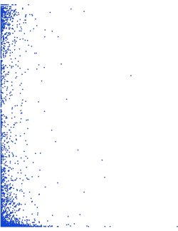
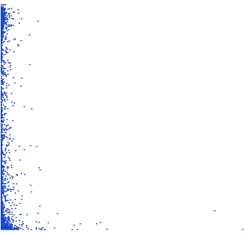
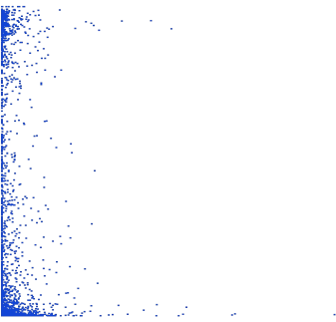

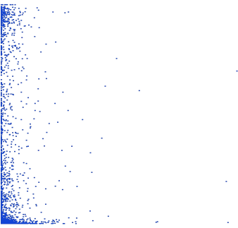
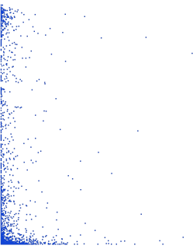
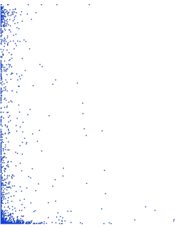
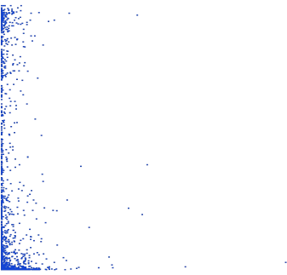
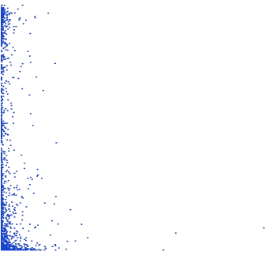
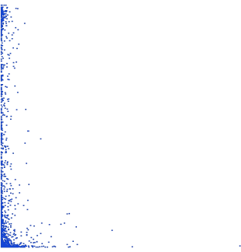
1
Chr 01
1
Chr 02
1
Chr 03
0.75
0.75
0.75
LD (r²)
0.5
LD (r²)
0.5
LD (r²)
0.5
0.25
0.25
0.25
0
0
100
200
300
400
0
0
100
200
300
400
0
0
100
200
300
400
Distance (Kb)
Distance (kb)
Distance (kb)
1
Chr 04
1
Chr 05
1
Chr 06
0.75
0.75
0.75
LD (r²)
0.5
LD (r²)
0.5
LD (r²)
0.5
0.25
0.25
0.25
0
0
250
500
750
1000
0
0
100
200
300
400
0
0
150
300
450
600
Distance (kb)
Distance (Kb)
Distance (Mb)
1
Chr 07
1
Chr 08
1
Chr 09
0.75
0.75
0.75
LD (r²)
0.5
LD (r²)
0.5
LD (r²)
0.5
0.25
0.25
0.25
0
0
100
200
300
400
0
0
100
200
300
400
0
0
100
200
300
400
Distance (Kb)
Distance (Kb)
Distance (Kb)
1
Chr 10
1
Chr 11
1
Chr 12
0.75
0.75
0.75
LD (r²)
0.5
LD (r²)
0.5
LD (r²)
0.5
0.25
0.25
0.25
0
0
125
250
375
500
0
0
200
400
600
800
0
0
250
500
750
1000
Distance (Kb)
Distance (Kb)
Distance (Kb)
Figure S6. Linkage disequilibrium (LD) per chromosome. LD (r²) measure was based on Composite Haplotype Method (CHM).

