Slide 1
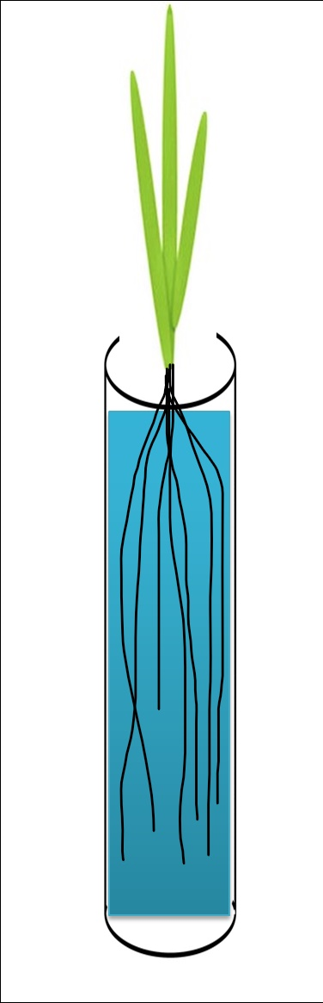
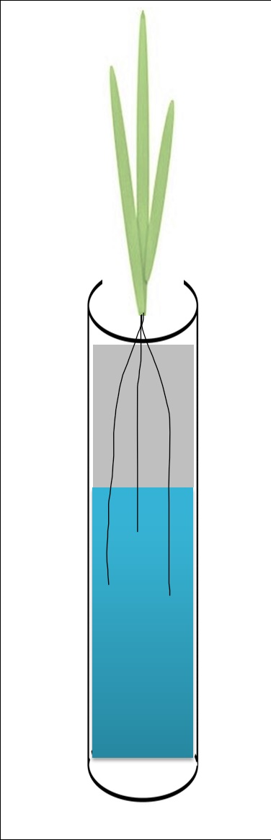
well-watered
drought
humid
dry
0.2533 ≥ θv ≥ 0.2267 cm³/cm³
0.0025 ≥ θv ≥ 0.0011 cm³/cm³
25 cm
25 cm
100 cm
more humid
less humid
0.01455 ≥ θv ≥ 0.0047 cm³/cm³

