Slide 1
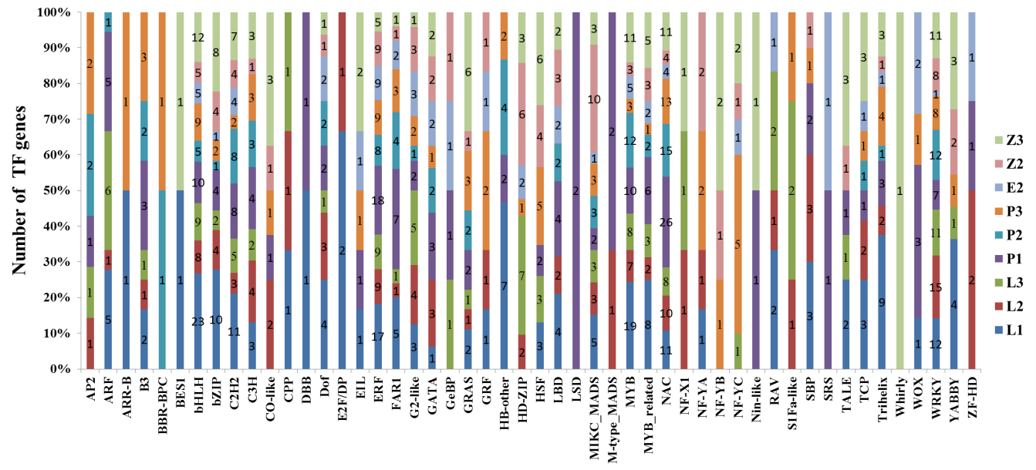
Figure. S6 The number of DEG_{FPU} belonging to different transcription factor families detected in the hybrid and its parents. L1 and P1 represent flag leaves and anthers at meiosis stage, respectively. L2, P2, E2 and Z2 represent flag leaves, anther, embryo sac and leaf sheath at pre-flowering stage, respectively. L3, P3 and Z3 represent flag leaves, grain and leaf sheath at three days after flowering, respectively.

