Slide 1
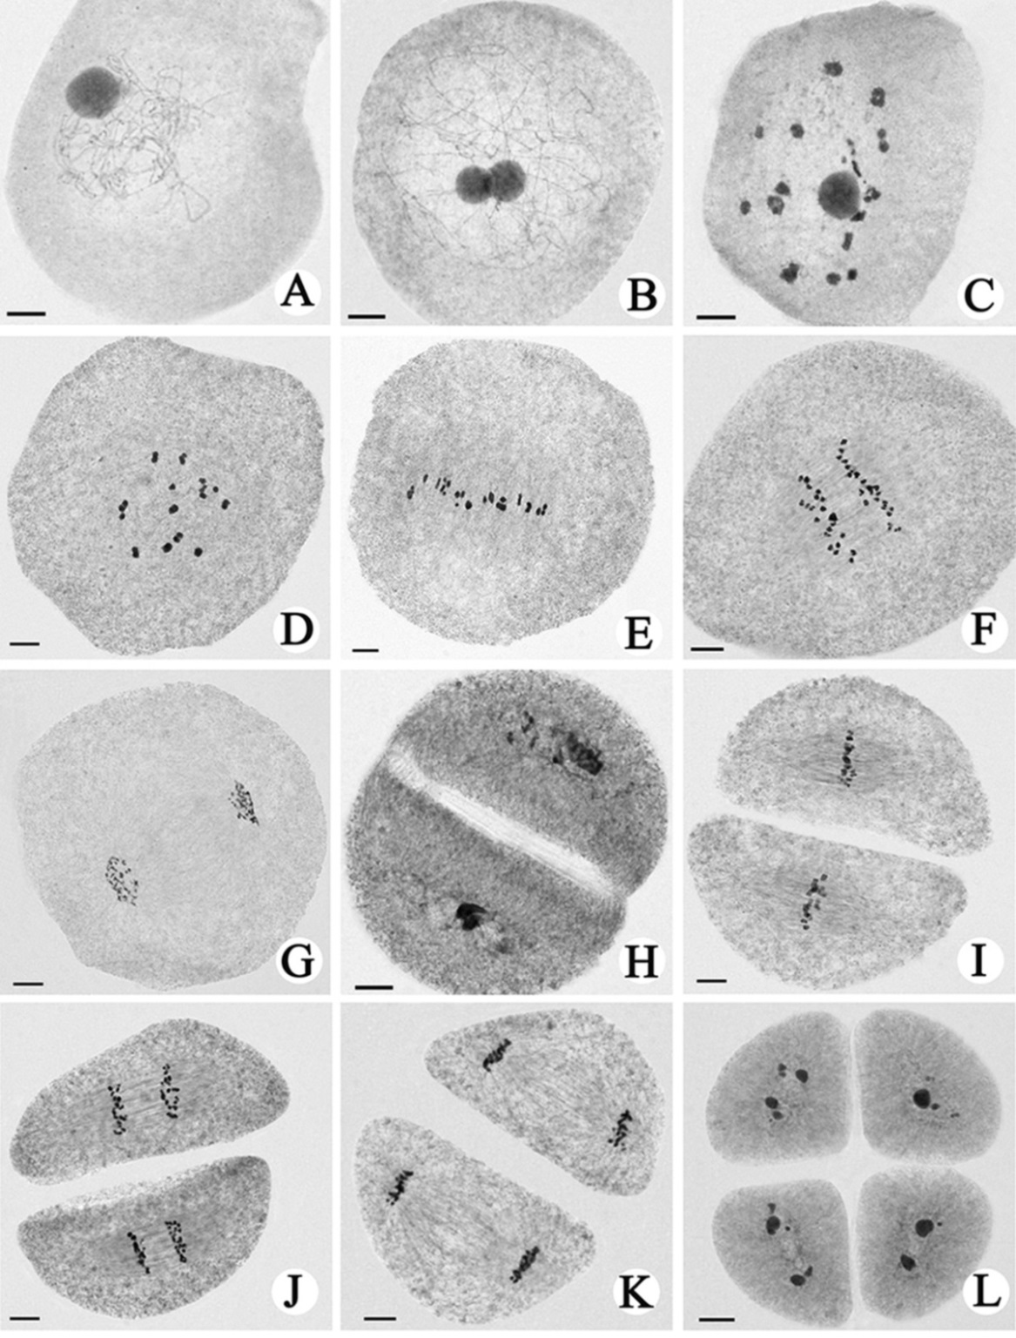
Figure. S1 Chromosome behavior of hybrid. A and B pachytene, C and D diakinesis, E metaphase I, F anaphase I, G telophase I, H prophase II, I metaphase II, J anaphase II, K telophase II, L tetrad stage. Bar=10μm.

