Slide 1
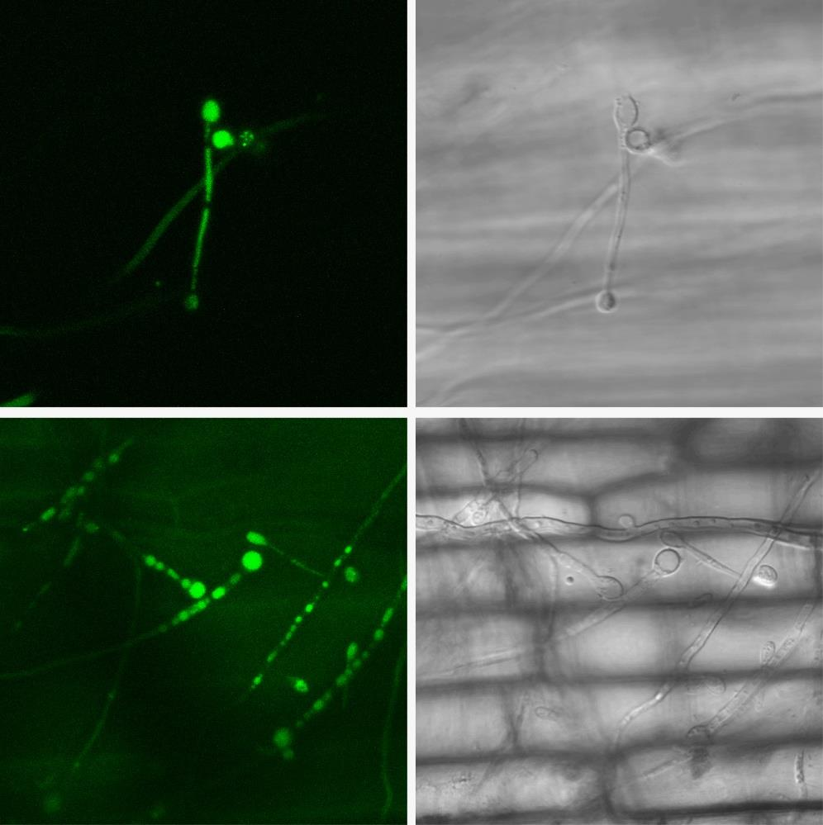
Fig. S1
GFP-Atg8
Bright field
Fig. S1 The GFP-UvAtg8 was highly expressed during the secondary spore formation stage on rice. The images were obtained using a confocal laser scanning microscope. Scale bar= 5 μm.

