Slide 1
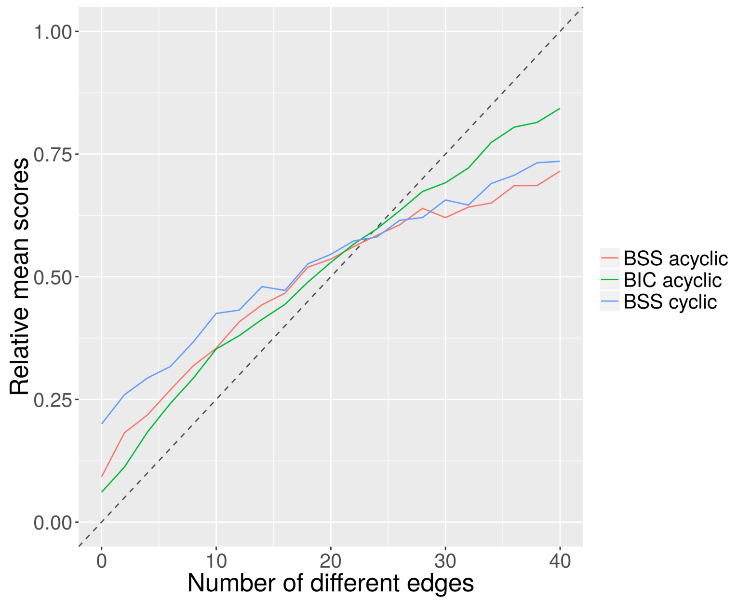

Slide 2
Supplementary Fig 3
Mean scores have been calculated across all networks (five acyclic networks and five cyclic networks) for BIC and BSS scoring functions calculated using non zero-inflated synthetic expression data. All scores have been standardised for comparison purpose, such that the scores range from 0 to 1.
Note that while the results in this figure is similar with Figure 3, the results in this figure are generated using non zero-inflated synthetic expression data, in contrast to Figure 3 which uses zero-inflated synthetic expression data. Difference can be seen in the results of BSS scoring function.

