Slide 1
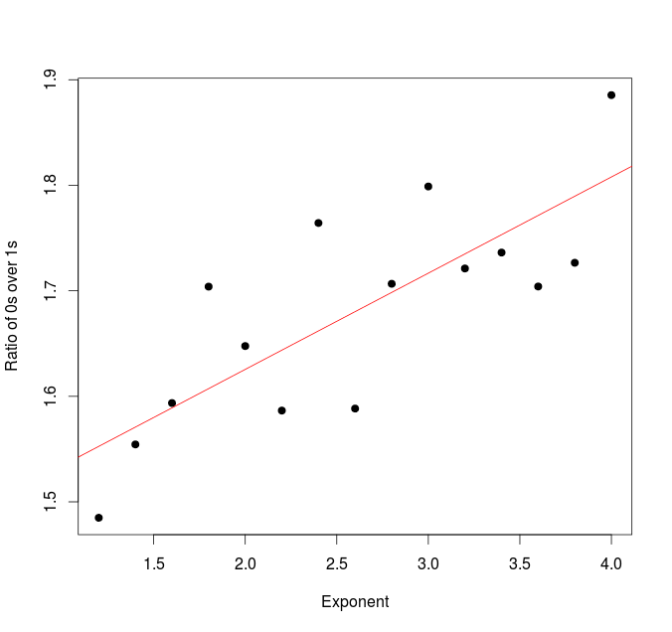
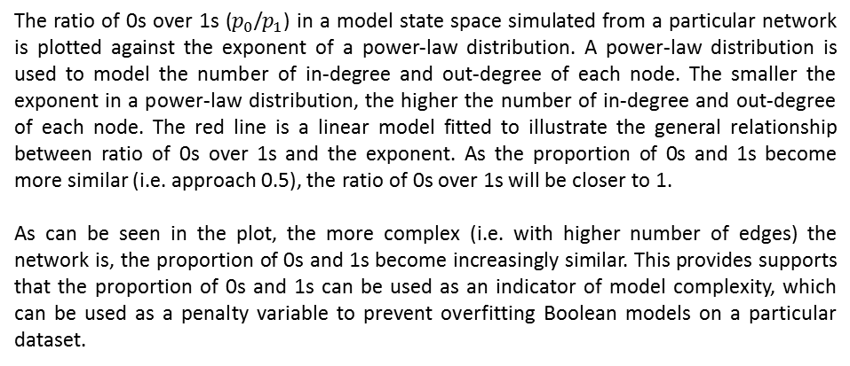
The ratio of 0s over 1s ($p_{0}$/$p_{1}$) in a model state space simulated from a particular network is plotted against the exponent of a power-law distribution. A power-law distribution is used to model the number of in-degree and out-degree of each node. The smaller the exponent in a power-law distribution, the higher the number of in-degree and out-degree of each node. The red line is a linear model fitted to illustrate the general relationship between ratio of 0s over 1s and the exponent. As the proportion of 0s and 1s become more similar (i.e. approach 0.5), the ratio of 0s over 1s will be closer to 1.
As can be seen in the plot, the more complex (i.e. with higher number of edges) the network is, the proportion of 0s and 1s become increasingly similar. This provides supports that the proportion of 0s and 1s can be used as an indicator of model complexity, which can be used as a penalty variable to prevent overfitting Boolean models on a particular dataset.

