Slide 1
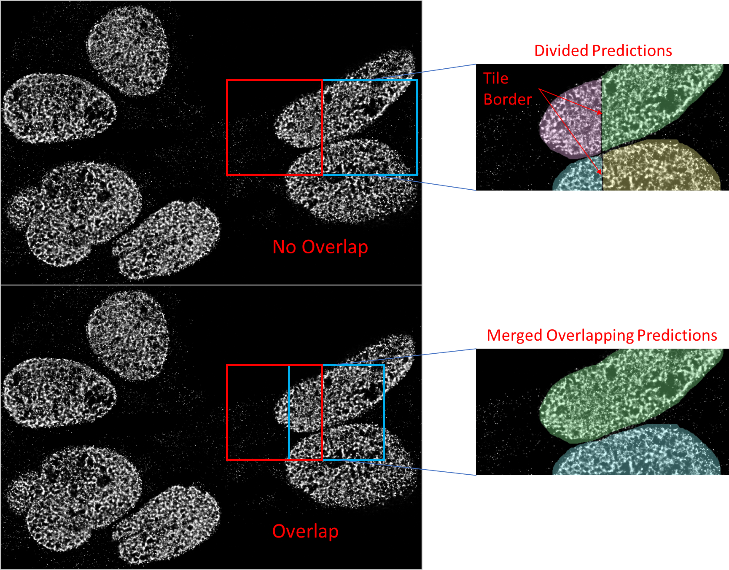
Supplementary Figure 9. Tiling method example with and without tile overlaps. When the test image is divided into non-overlapping squares, or tiles, for segmentation, the borders where independently evaluated tiles meet will act as artificial demarcations between labeled detected instances upon image reconstruction. This creates divided predictions (upper diagram). Overlapping allows for a post-segmentation algorithm to sample the overlapping region between adjacent tiles and merge divided instances when they overlap during reconstruction (lower diagram).

