Slide 1
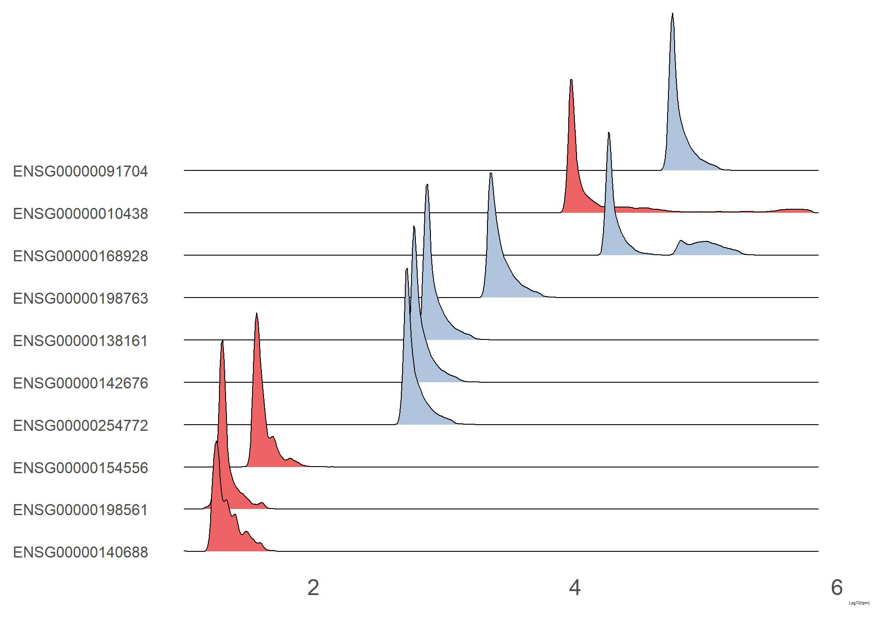
Log10(TPM)
Figure S5
Notes:
Figure S5

