Slide 1
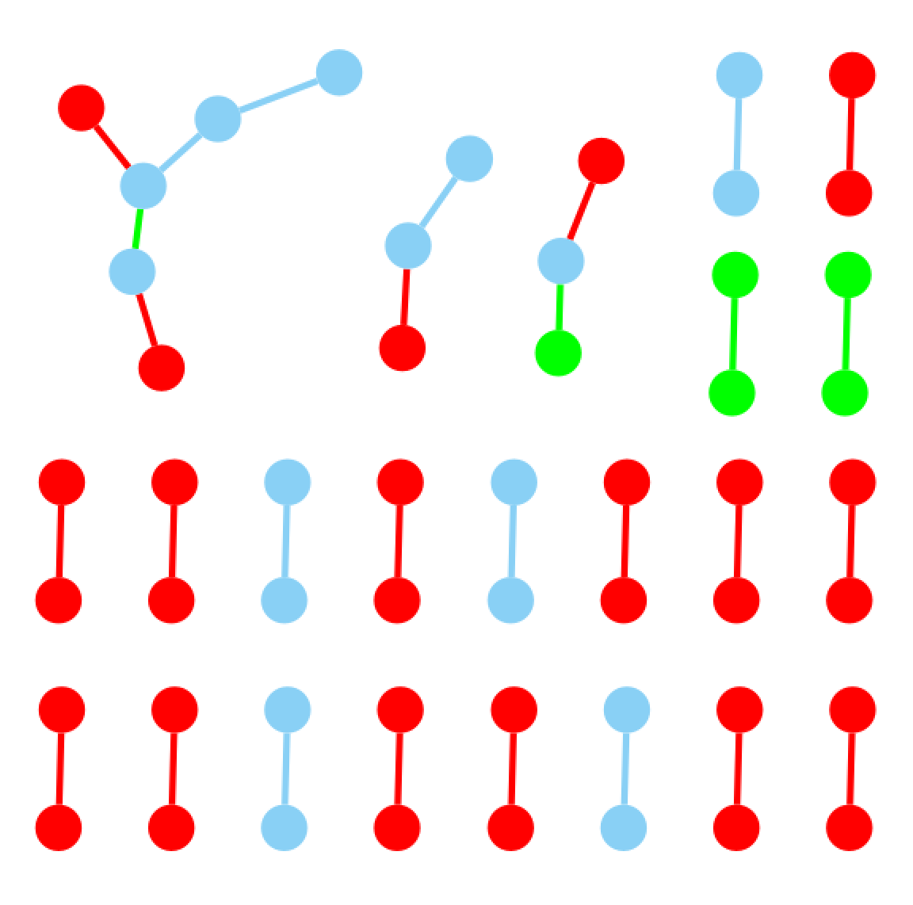
Fig. S1A BRCA0000 CoDM PMI and PCC survival factors network
Overlap Node/Edge
PCC-only Node/Edge
PMI-only Node/Edge

Slide 2
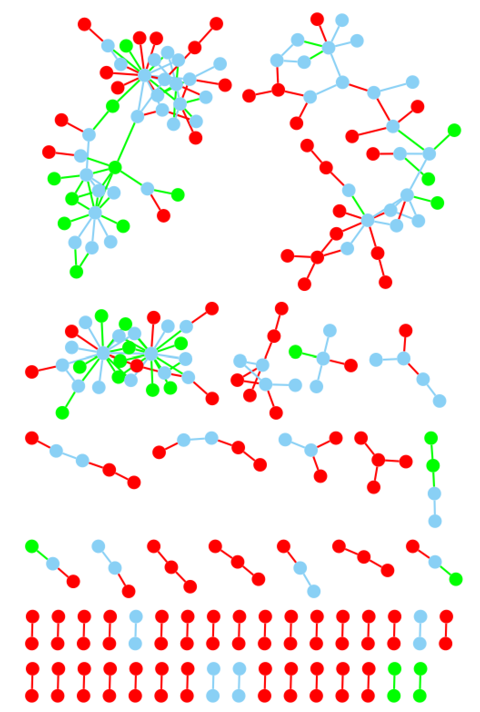
Fig. S1B BRCA0112 CoDM PMI and PCC survival factors network
BRCA0112
Overlap Node/Edge
PCC-only Node/Edge
PMI-only Node/Edge

Slide 3
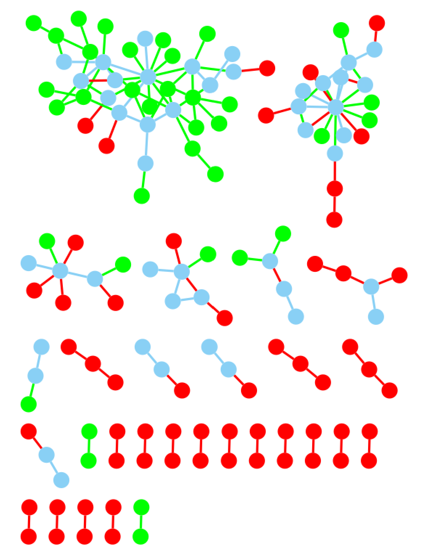
Fig. S1C LUSC00 CoDM PMI and PCC survival factors network
LUSC00
Overlap Node/Edge
PCC-only Node/Edge
PMI-only Node/Edge

Slide 4
Fig. S2 The workflow of omics comparison and survival analysis
Database
Cancer Data
PMI network and Comparable PCC network
Use the same data
Xena
Browser
TCGA
mRNA
PMI Calculation
PMI network
Use similar
PCC network
PCC threshold
Survival analysis
Survival
PMI has better/higher recall with fewer total edges
Convert to gene-pair
relationships
PMI recalled
CoCNV/CoDM
CNV
Omics defined gene-pair relationships
TR, CoTR, PPI, CoCNV, CoDM…
Convert to gene-pair
relationships
DM
Convert to gene-pair
relationships
Significant survival factors
Reg
Network
TR
Directly use
HINT
PPI
Directly use
Survival score

