Slide 1
Figure S2: Schematic representation of a part of the genome of 25 bacteria, Genomes are annotated manually in order to obtain genomic information around the genes encoding a potential DIRL. With the NCBI number of the bacteria genomes in the table 1, the fasta sequence of the genome is obtain and zoomed on the DPL region. Softberry server is used to predict the -10 and -30 regulation zone before the ATG of each predicted gene. For the other DPL, or the DPL genes is not well positioned on the contigue or not found (the sequenced genome for these bacteria is not complete or in not operonique structure.

Slide 2
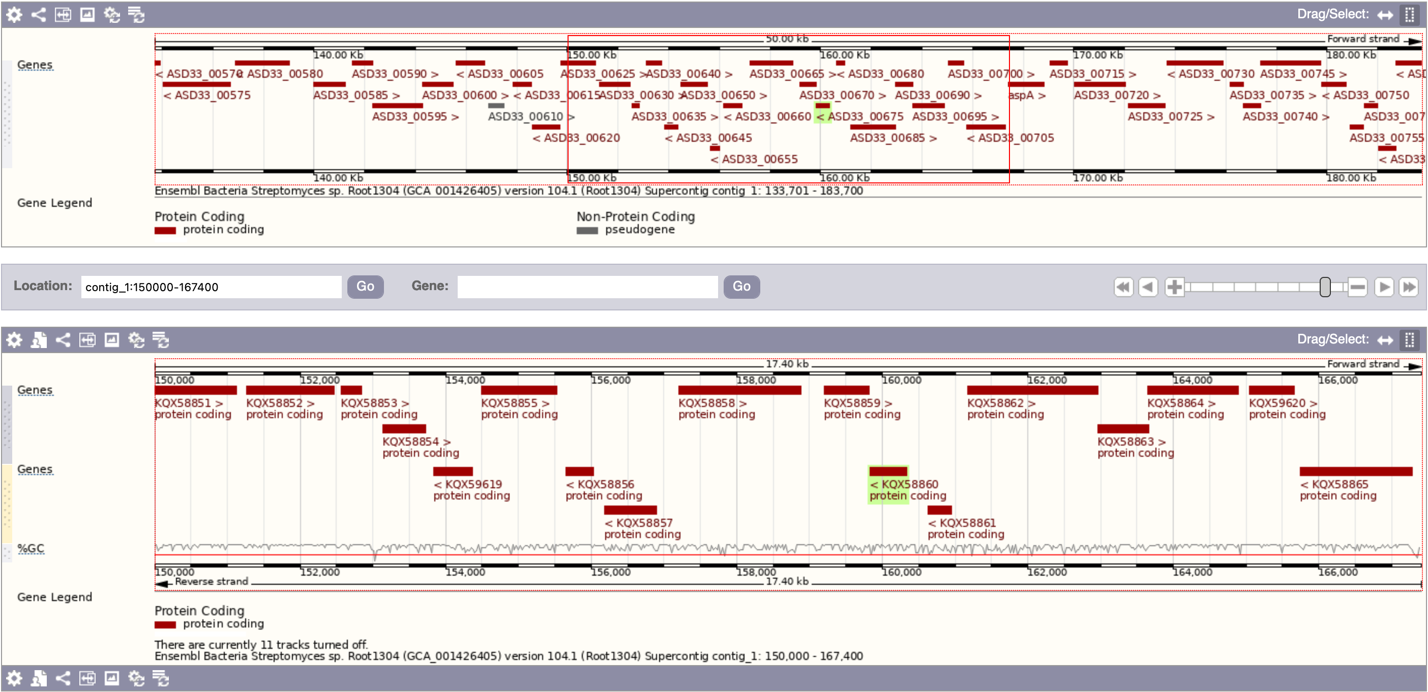
Fructose-1,6-biphosphatase
Fumarate hydratase class I
Hydrolase
Uncharacterized
FtsX domain (permease)
Uncharacterized
Malonic semialdehyde reductase
ABC transporteur domain
Uncharacterized
Transcriptional regulator WhiB
DP-like
Ricin B-type lectin domain
DUF domain
Uncharacterized
Genomic zone of Streptomyces sp.root1304 DPL
The cluster predictions shed-light : Fumarate hydratase class I , hydrolase, Transcriptional regulator WhiB (4Fe-4S) , DUF domain coding genes
Gene involved in compound biosynthesis
Regulation gene
Promotor predicted by Softberry server
Gene involved in compound transport
Uncharacterized protein coding gene
DPL gene
Notes:
https://bacteria.ensembl.org/Streptomyces_sp_root1304_gca_001426405/Location/View?db=core;g=ASD33_00675;r=contig_1:150000-167400;t=KQX58860

Slide 3
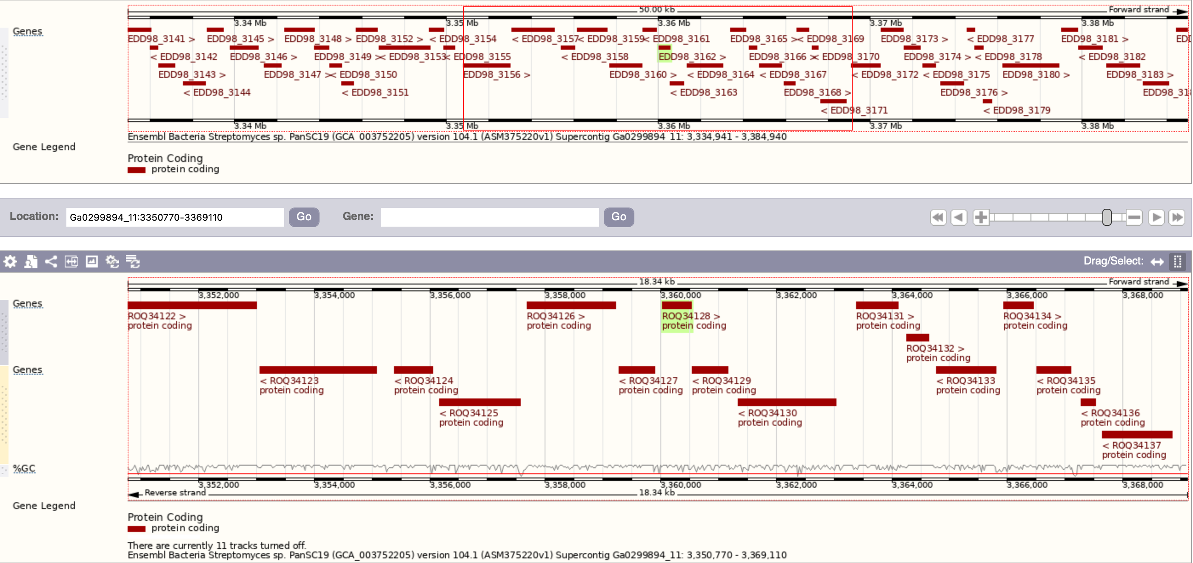
Genomic zone of Streptomyces PanSC19 DPL
Gene involved in compound biosynthesis
Regulation gene
Promotor predicted by Softberry server
Gene involved in compound transport
Uncharacterized protein coding gene
DPL gene
Notes:
https://bacteria.ensembl.org/Streptomyces_sp_pansc19_gca_003752205/Location/View?db=core;g=EDD98_3162;r=Ga0299894_11:3350770-3369110;t=ROQ34128

Slide 4
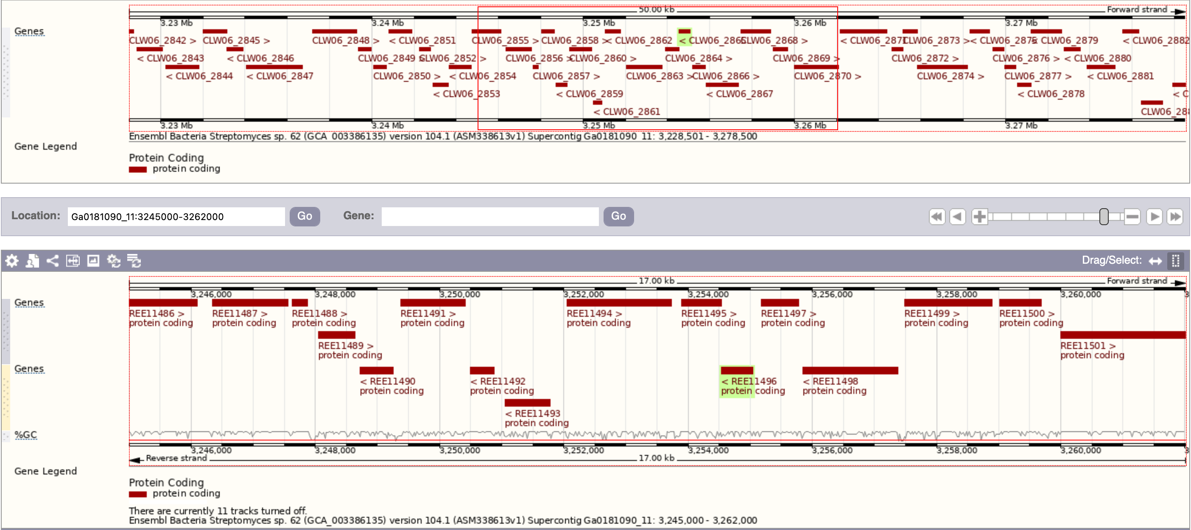
Genomic zone of Streptomyces sp.62 DPL
Gene involved in compound biosynthesis
Regulation gene
Promotor predicted by Softberry server
Gene involved in compound transport
Uncharacterized protein coding gene
DPL gene
Notes:
https://bacteria.ensembl.org/Streptomyces_sp_62_gca_003386135/Location/View?db=core;g=CLW06_2865;r=Ga0181090_11:3245000-3262000;t=REE11496

Slide 5
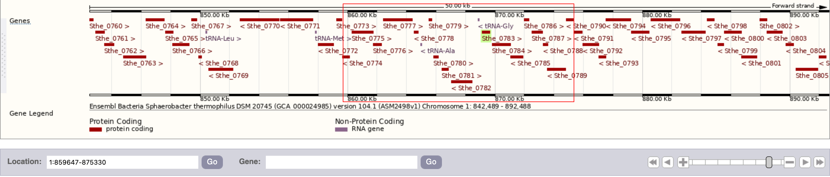
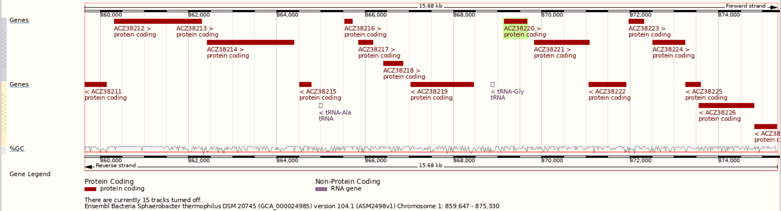
Genomic zone of Spherobacter thermophilus DSM 20745 DPL
Gene involved in compound biosynthesis
Regulation gene
Promotor predicted by Softberry server
Gene involved in compound transport
Uncharacterized protein coding gene
DPL gene
Notes:
https://bacteria.ensembl.org/Sphaerobacter_thermophilus_dsm_20745_gca_000024985/Location/View?db=core;g=Sthe_0783;r=1:859647-875330;t=ACZ38220

Slide 6
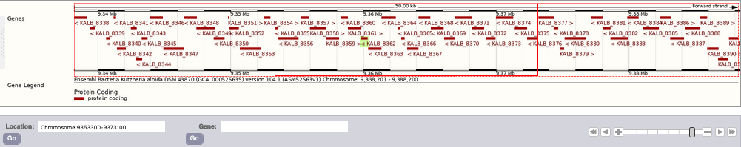
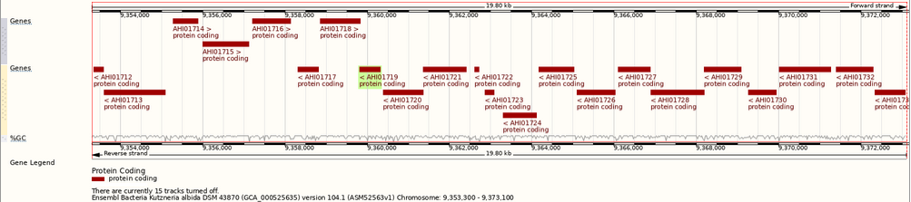
Oxidase
UPF045 protein
DP-like
Epimerase domain
DUF domain
Uncharacterized
AP_endonuc_2 domain
Ppx GppA domain
Histidine kinase
(sensor)
Aldo_ket_red dom.
PlsC domani (transferase)
HTH 17 domain
Proline dehydrogenase
Uncharacterized
Phosphorelay
signal transduction
system
Pyrroline 5 carboxylate reductase
Genomic zone of Kutzneria albida dsm43870 DPL
Remark: Predictions shed-light an oxydase coding gene (AH0171) close by the DPL
Gene involved in compound biosynthesis
Regulation gene
Promotor predicted by Softberry server
Gene involved in compound transport
Uncharacterized protein coding gene
DPL gene
Notes:
https://bacteria.ensembl.org/Kutzneria_albida_dsm_43870_gca_000525635/Location/View?db=core;g=KALB_8362;r=Chromosome:9353300-9373100;t=AHI01719

Slide 7
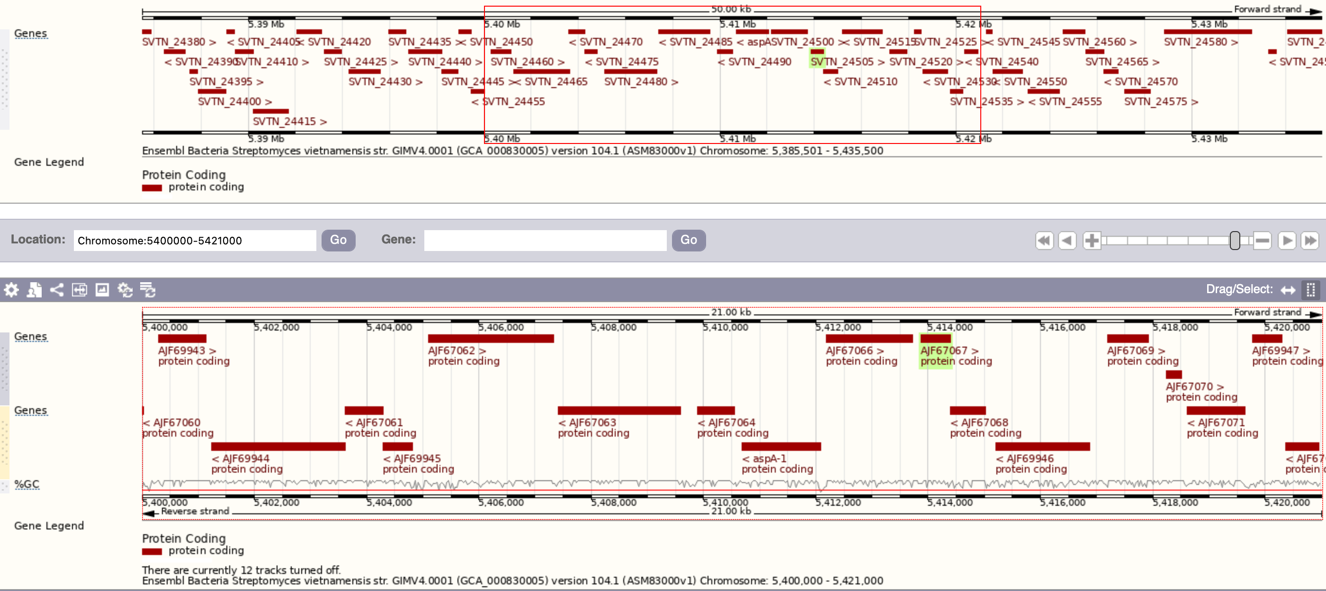
Ricin B lectin
DP-like
DUF domain
Transcriptional regulator WhiB
Penicillin-binding protein
DUF domain
Hydrolase
Fumarate hydratase class II
Fumarate hydratase class I
Genomic zone of Streptomyces vietnamensis DPL
Remark: the cluster predictions shed-light the Fumarate hydratase class I et II coding gene, the hydrolase coding gene, a Transcriptional regulator coding gene, WhiB (4Fe-4S) coding gene, DUF domain coding gene and a penicillin-binding coding gene
Gene involved in compound biosynthesis
Regulation gene
Promotor predicted by Softberry server
Gene involved in compound transport
Uncharacterized protein coding gene
DPL gene
Notes:
https://bacteria.ensembl.org/Streptomyces_vietnamensis_gca_000830005/Location/View?db=core;g=SVTN_24505;r=Chromosome:5400000-5421000;t=AJF67067

Slide 8
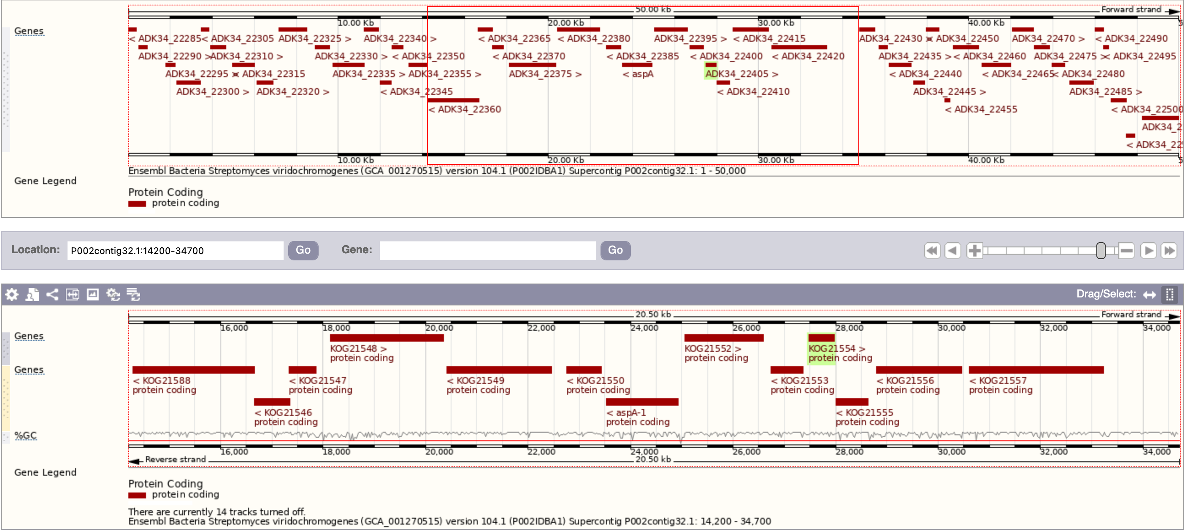
Penicillin insensitive transglycosylase
Ricin B lectin
DP-like
Sérine/Threonine
Protein phosphatase
DUF domain
Uncharacterized
Fumarate hydratase
class I
Tripeptidyl-peptidase II
Fumarate hydratase class II
Hydrolase
Genomic zone of Streptomyces viridochromogenes DPL
Remark: the cluster predictions shed-light the Fumarate hydratase class II coding gene, the hydrolase coding gene, a DUF domain coding gene and a penicillin insensitive transglycolase coding gene
Gene involved in compound biosynthesis
Regulation gene
Promotor predicted by Softberry server
Gene involved in compound transport
Uncharacterized protein coding gene
DPL gene
Notes:
https://bacteria.ensembl.org/Streptomyces_viridochromogenes_gca_001270515/Location/View?db=core;g=ADK34_22405;r=P002contig32.1:14200-34700;t=KOG21554

Slide 9
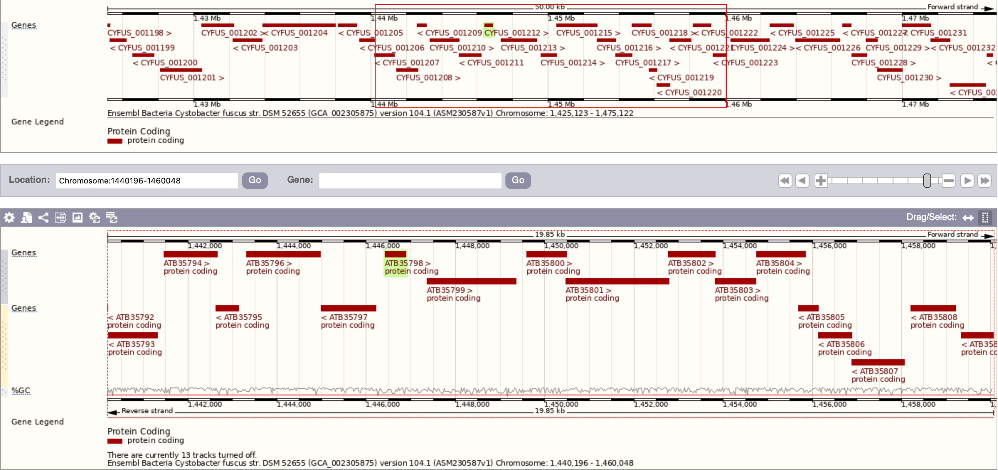
Genomic zone of Cytstobacter fucus DPL
Gene involved in compound biosynthesis
Regulation gene
Promotor predicted by Softberry server
Gene involved in compound transport
Uncharacterized protein coding gene
DPL gene
Notes:
https://bacteria.ensembl.org/Cystobacter_fuscus_gca_002305875/Location/View?db=core;g=CYFUS_001212;r=Chromosome:1440196-1460048;t=ATB35798

Slide 10
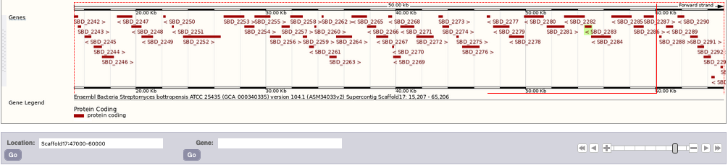
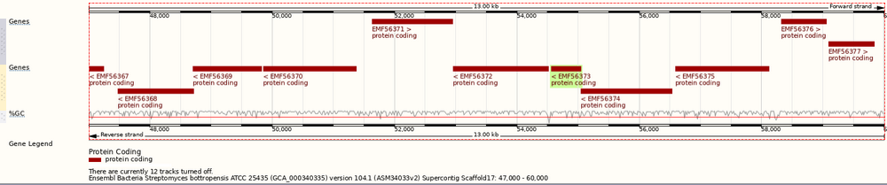
Aminotransferase
Regulatory protein GntR
Cache domain
Transcriptional regulator
Glutaryl-CoA
dehydrogenase
Oxidoreductase
Purine catabolism PurC doamin
DP-like
Transmembranaire transporter
Transferase (CoA)
Oxidoreductase
Genomic zone of Streptomyces bottropensis DPL
Gene involved in compound biosynthesis
Regulation gene
Promotor predicted by Softberry server
Gene involved in compound transport
Uncharacterized protein coding gene
DPL gene
Notes:
https://bacteria.ensembl.org/Streptomyces_bottropensis_atcc_25435_gca_000340335/Location/View?db=core;g=SBD_2283;r=Scaffold17:47000-60000;t=EMF56373

Slide 11
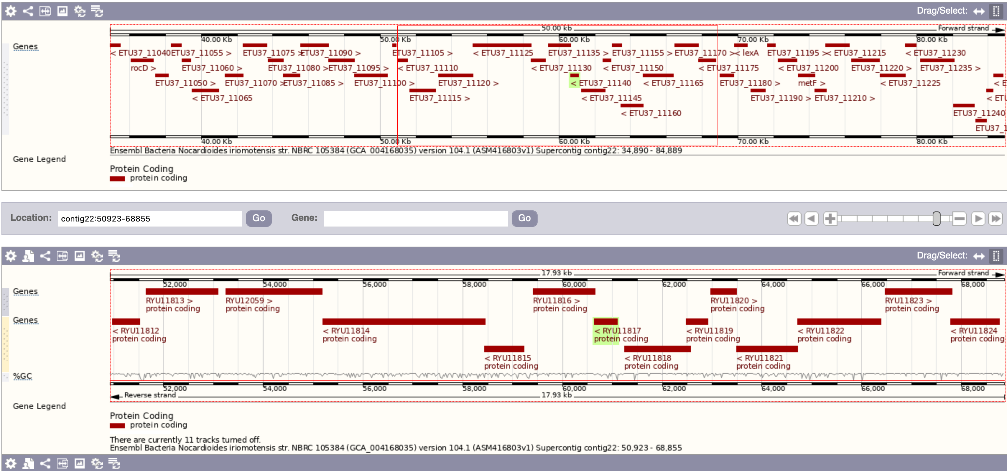
MSF transporter
ATP-dependent DNA helicase
Oxidoreductase
Pyridoamine 5’
-phosphate oxidase
Tet/AcrR family transcriptional regulator
Cytochrome P450
DP-like
NUDIX domain
Alkaline phosphatase
Uncharacterized
Glycosyltransferase
Sulfatase-like hydrolase/transferase
Genomic zone of Norcadioides iriomotensis DPL
The cluster predictions shed-light : an Tet/AcrB family transcriptional regulator, A MSF transporter, A Cytochrome P450, an oxydoreductase etc… coding genes
Gene involved in compound biosynthesis
Regulation gene
Promotor predicted by Softberry server
Gene involved in compound transport
Uncharacterized protein coding gene
DPL gene
Notes:
SoftBerry pour predir les -10 -30 avant ATG de chaque gènes : via # NCBI du genome (table des 52 DIRs) récupération en fasta de tout le génome puis zoom sur la zone 50923-68855 dans softBerry pour avoir les -10 et -30
http://bacteria.ensembl.org/Nocardioides_iriomotensis_gca_004168035/Location/View?db=core;g=ETU37_11140;r=contig22:50923-68855;t=RYU11817

Slide 12
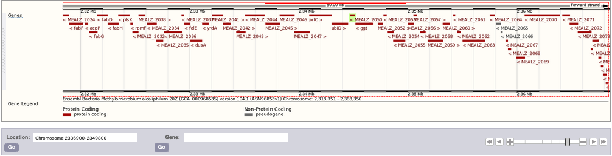
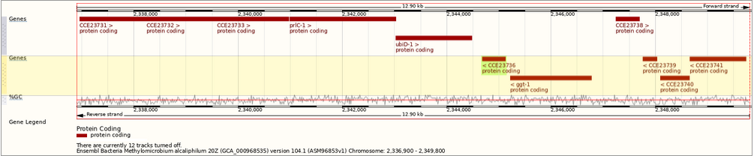
Genomic zone of Methylomicrobium alcaliphilum DPL
Gene involved in compound biosynthesis
Regulation gene
Promotor predicted by Softberry server
Gene involved in compound transport
Uncharacterized protein coding gene
DPL gene
Notes:
https://bacteria.ensembl.org/Methylomicrobium_alcaliphilum_20z_gca_000968535/Location/View?db=core;g=MEALZ_2050;r=Chromosome:2336900-2349800;t=CCE23736

Slide 13
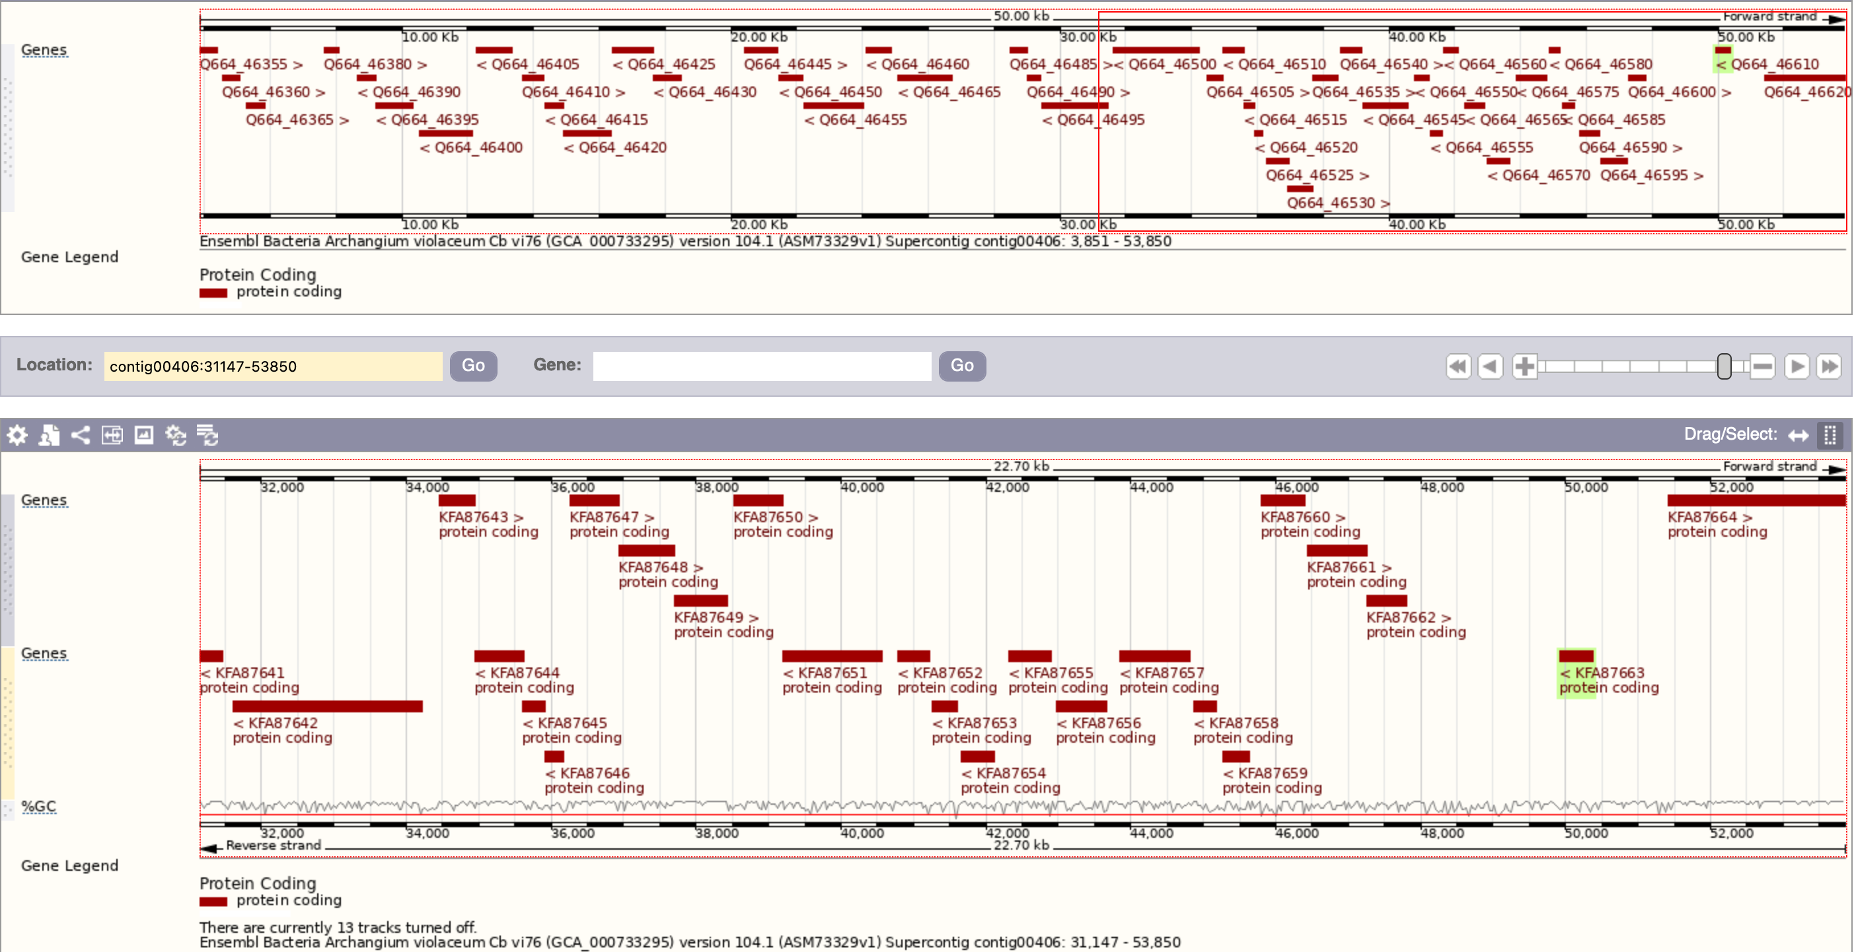
Genomic zone of Archangium volaceum DPL
Gene involved in compound biosynthesis
Regulation gene
Promotor predicted by Softberry server
Gene involved in compound transport
Uncharacterized protein coding gene
DPL gene
Notes:
https://bacteria.ensembl.org/Archangium_violaceum_cb_vi76_gca_000733295/Location/View?db=core;g=Q664_46610;r=contig00406:31147-53850;t=KFA87663

Slide 14
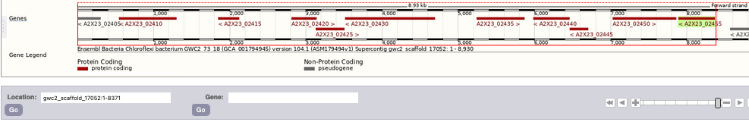
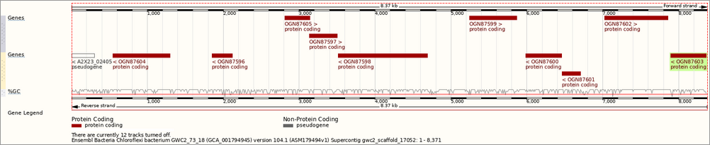
Genomic zone of Chloroflexi DPL
Gene involved in compound biosynthesis
Regulation gene
Promotor predicted by Softberry server
Gene involved in compound transport
Uncharacterized protein coding gene
DPL gene
Notes:
https://bacteria.ensembl.org/Chloroflexi_bacterium_gwc2_73_18_gca_001794945/Location/View?db=core;g=A2X23_02455;r=gwc2_scaffold_17052:1-8371;t=OGN87603

Slide 15
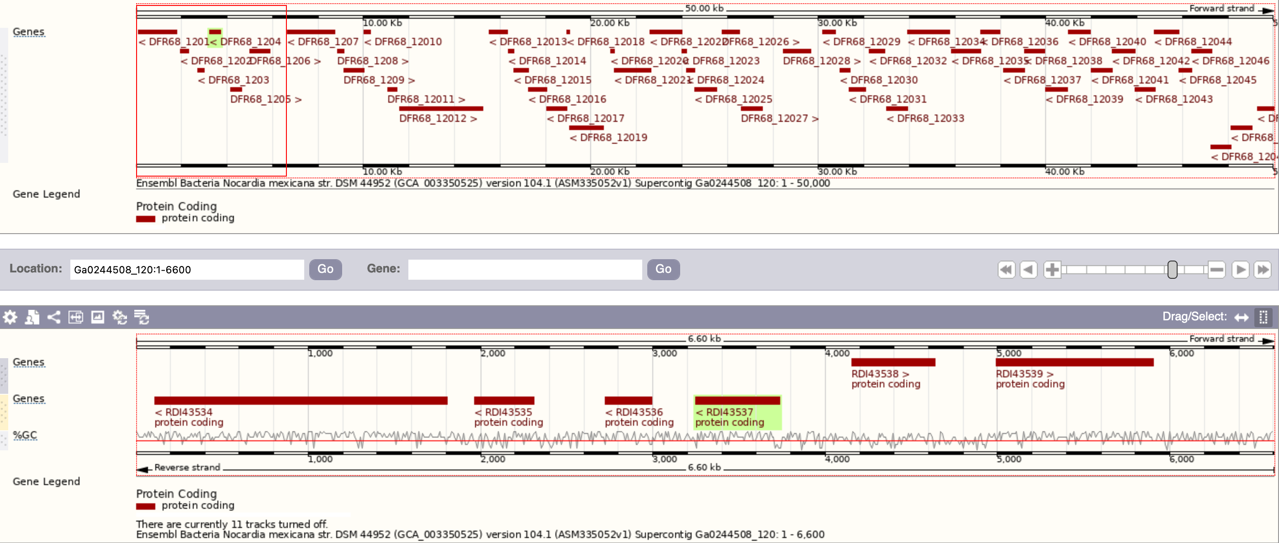
Genomic zone of Norcadia Mexicana DPL
Gene involved in compound biosynthesis
Regulation gene
Promotor predicted by Softberry server
Gene involved in compound transport
Uncharacterized protein coding gene
DPL gene
Notes:
https://bacteria.ensembl.org/Nocardia_mexicana_gca_003350525/Location/View?db=core;g=DFR68_1204;r=Ga0244508_120:0-6600;t=RDI43537

Slide 16
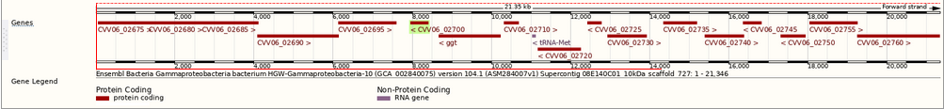
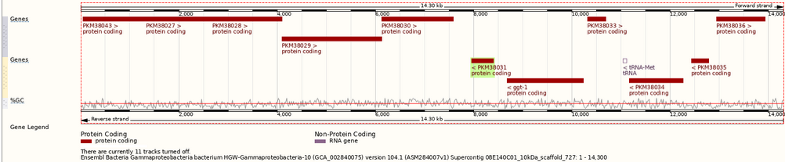
Genomic zone of Gammaproteobacteria DPL
Gene involved in compound biosynthesis
Regulation gene
Promotor predicted by Softberry server
Gene involved in compound transport
Uncharacterized protein coding gene
DPL gene

Slide 17
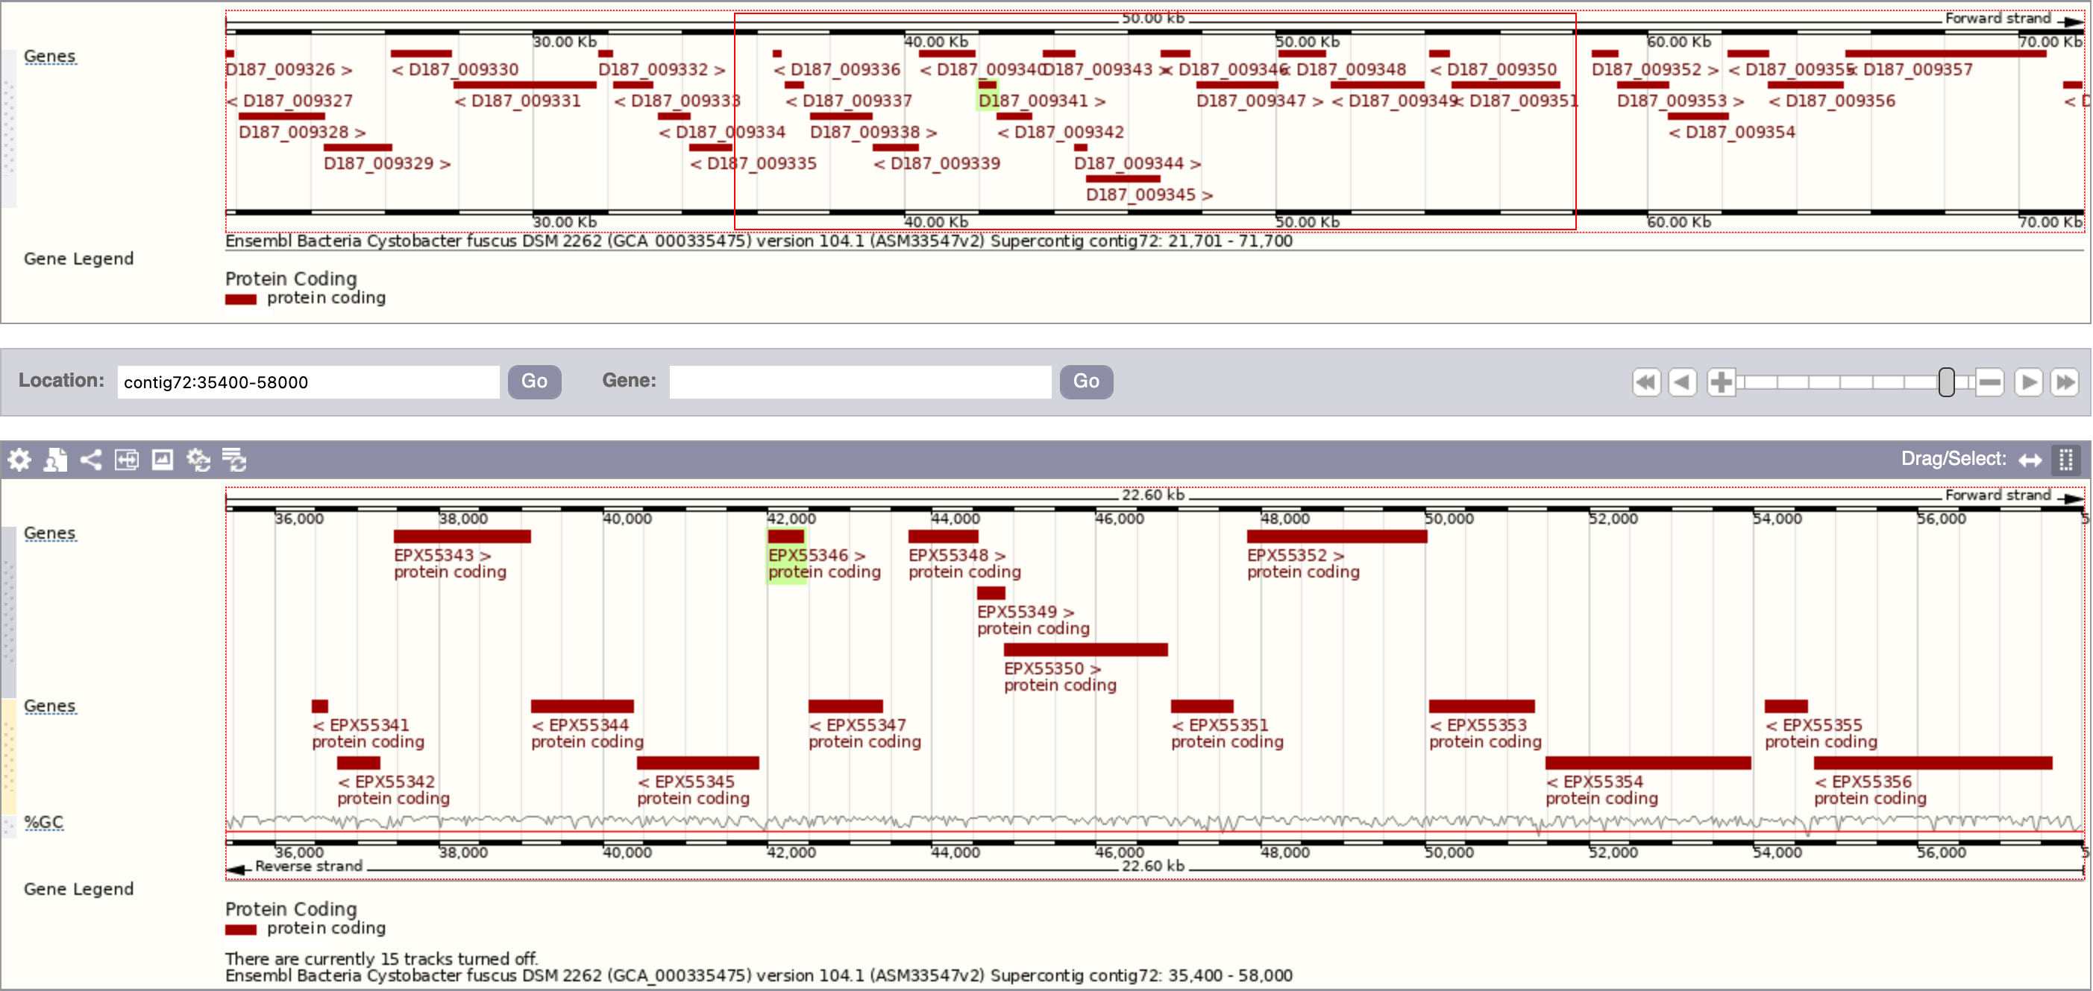
Acetyl-CoA synthétase
DP-like
Acetyl-CoA dehydrogénase
Prolyl endopeptidase
Oxidoreductase
Histidine kinase sensor
Uncharacterized
Uracil permease
Putative hydrolase
Transcriptional regulator MerR
Transmembranaire protein
Carboxylic ester hydrolase
Genomic zone of Cystobacter fuscus DPL
Gene involved in compound biosynthesis
Regulation gene
Promotor predicted by Softberry server
Gene involved in compound transport
Uncharacterized protein coding gene
DPL gene
Notes:
https://bacteria.ensembl.org/Cystobacter_fuscus_dsm_2262_gca_000335475/Location/View?db=core;g=D187_009341;r=contig72:35400-58000;t=EPX55346

Slide 18
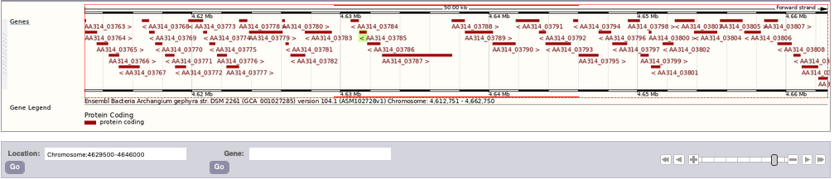
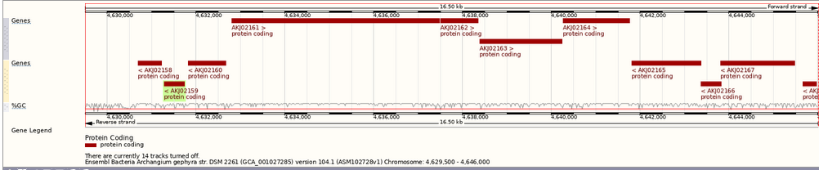
Plectin 1 isoform 8
Diaminopimelate epimerase
Response regulator receiver domain
Diguanylate cyclase
(GGDEF)-like protein
DifB protein
Uncharacterized
Histidine kinase
Histidine kinase
DP-like
Response regulator
Genomic zone of Archangium gephyra DPL
The cluster predictions shed-light : a DifB protein, two Histidine kinase, two response regulator etc… coding genes
Gene involved in compound biosynthesis
Regulation gene
Promotor predicted by Softberry server
Gene involved in compound transport
Uncharacterized protein coding gene
DPL gene
Notes:
https://bacteria.ensembl.org/Archangium_gephyra_gca_001027285/Location/View?db=core;g=AA314_03785;r=Chromosome:4629500-4646000;t=AKJ02159

Slide 19
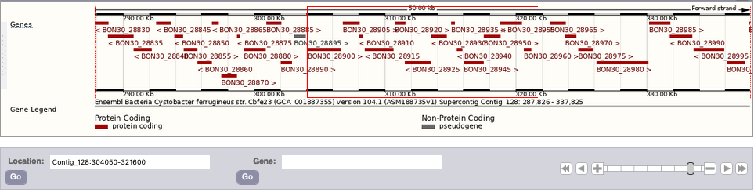
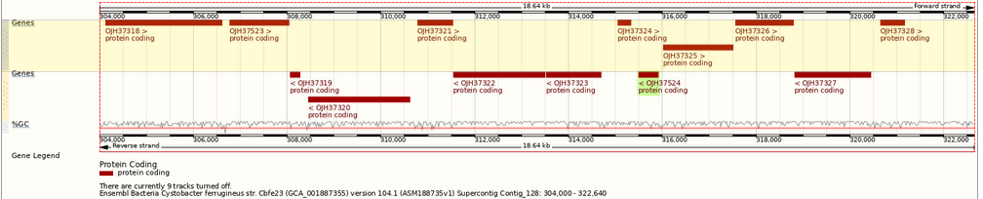
Serine protease
MerR family transcriptional regulator
Hydrolase
Uracil permease
Carboxylic ester hydrolase
Uncharacterized
Histidine kinase
Acyl-CoA dehydrogenase
DP-like
Uncharacterized
Genomic zone of Cystobacter ferrugineus DPL
The cluster predictions shed-light : a Acyl-CoA deshydrogenase, a Histidine kinase, a serine protease, a uracil permease etc… coding genes
Gene involved in compound biosynthesis
Regulation gene
Promotor predicted by Softberry server
Gene involved in compound transport
Uncharacterized protein coding gene
DPL gene
Notes:
https://bacteria.ensembl.org/Cystobacter_ferrugineus_gca_001887355/Location/View?db=;g=BON30_28940;r=Contig_128:304050-321600;t=OJH37524

Slide 20
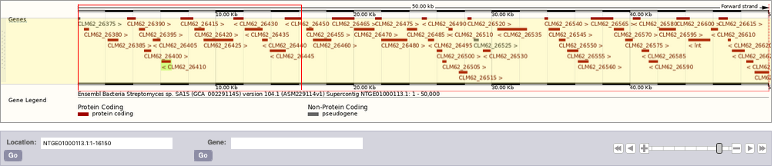
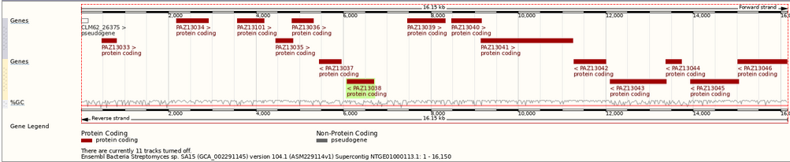
Genomic zone of Streptomyces sp SA 15 DPL
Gene involved in compound biosynthesis
Regulation gene
Promotor predicted by Softberry server
Gene involved in compound transport
Uncharacterized protein coding gene
DPL gene
Notes:
https://bacteria.ensembl.org/Streptomyces_sp_sa15_gca_002291145/Location/View?db=core;g=CLM62_26410;r=NTGE01000113.1:1-16150;t=PAZ13038

Slide 21
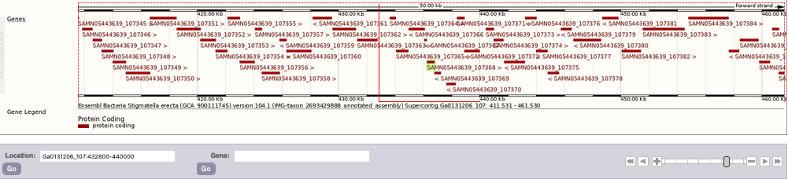
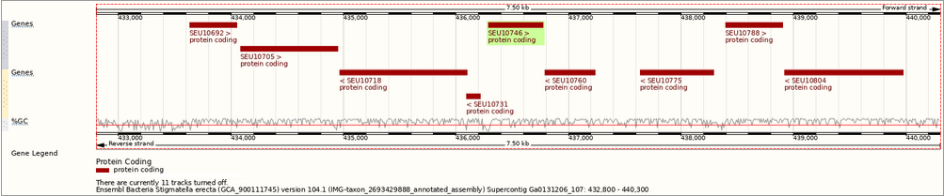
Methyltransferase
DP-like
Transcriptional regulator, HxlR family
Nucleoside-diphosphate-sugar epimerase
Glycosyltransferase (cell wall)
Regulator of nucleoside
diphosphate kinase
Glutathione S-transferase
Type II/IV secretion system protein
Uncharacterized
Genomic zone of stigmatella erecta DPL
The cluster predictions shed-light : a glycosyl transferase, a type II/type IV secretion system protein, few regulators etc… coding genes
Gene involved in compound biosynthesis
Regulation gene
Promotor predicted by Softberry server
Gene involved in compound transport
Uncharacterized protein coding gene
DPL gene
Notes:
https://bacteria.ensembl.org/Stigmatella_erecta_gca_900111745/Location/View?db=core;g=SAMN05443639_107368;r=Ga0131206_107:436277-436783;t=SEU10746

Slide 22
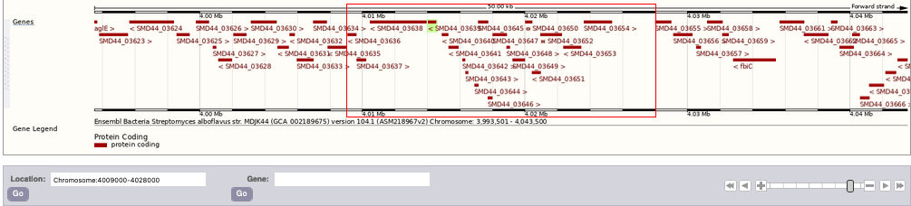
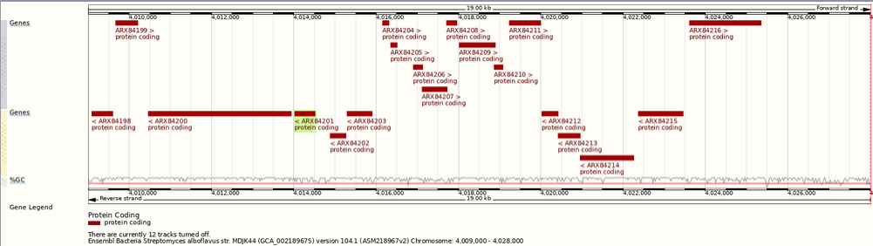
Genomic zone of Streptomyces alboflavus DPL
Gene involved in compound biosynthesis
Regulation gene
Promotor predicted by Softberry server
Gene involved in compound transport
Uncharacterized protein coding gene
DPL gene
Notes:
https://bacteria.ensembl.org/Streptomyces_alboflavus_gca_002189675/Location/View?db=core;g=SMD44_03639;r=Chromosome:4009000-4028000;t=ARX84201

Slide 23
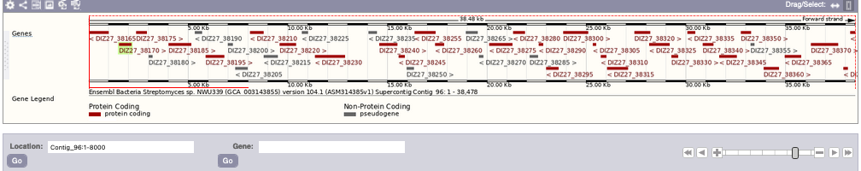
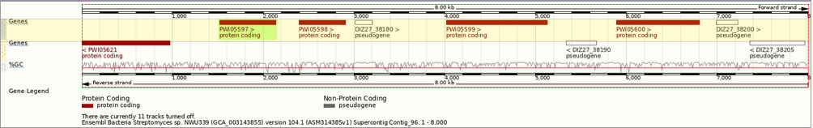
Genomic zone of Streptomyces sp nwu339 DPL
Gene involved in compound biosynthesis
Regulation gene
Promotor predicted by Softberry server
Gene involved in compound transport
Uncharacterized protein coding gene
DPL gene
Notes:
https://bacteria.ensembl.org/Streptomyces_sp_nwu339_gca_003143855/Location/View?db=core;g=DIZ27_38170;r=Contig_96:1511-2152;t=PWI05597

Slide 24
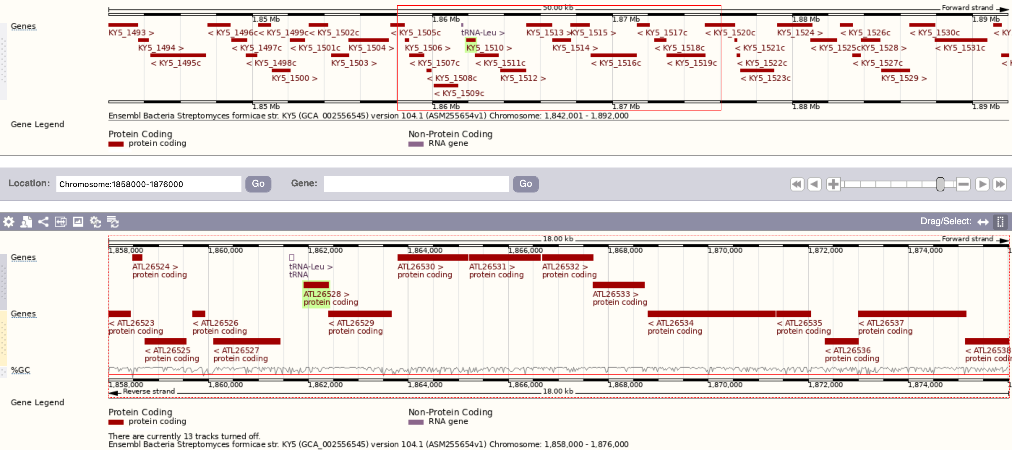
Cytochrome P450
Glutamate-1-
semialdehyde
aminotransferase
Terpène synthase
Osmosensitive K+
Channel histidine
Kinase KdpD
DP-like
Octaprenyl diphosphate synthase
UDP-glucose stérol
glucosyltransferase
Histidine kinase
Potassium transporting ATPase
Potassium transporting ATPase
Genomic zone of Streptomyces formicae DPL
The cluster predictions shed-light : a cytochrome P450, two K transporting ATPase; a channel histidine kinase, a histidine kinase, a terpene synthase, a octaprenyl diphosphate synthase etc… coding genes
Gene involved in compound biosynthesis
Regulation gene
Promotor predicted by Softberry server
Gene involved in compound transport
Uncharacterized protein coding gene
DPL gene
Notes:
https://bacteria.ensembl.org/Streptomyces_formicae_gca_002556545/Location/View?db=core;g=KY5_1510;r=Chromosome:1858000-1876000;t=ATL26528

Slide 25
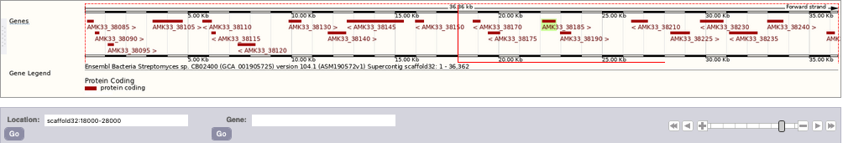
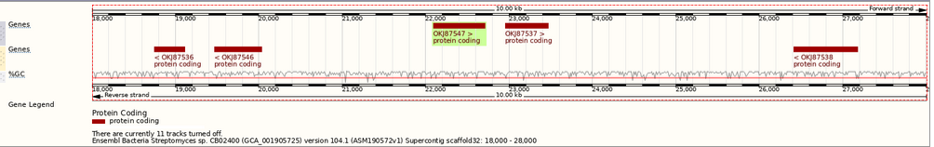
Genomic zone of Streptomyces sp cb02400 DPL
Gene involved in compound biosynthesis
Regulation gene
Promotor predicted by Softberry server
Gene involved in compound transport
Uncharacterized protein coding gene
DPL gene
Notes:
https://bacteria.ensembl.org/Streptomyces_sp_cb02400_gca_001905725/Location/View?db=core;g=AMK33_38185;r=scaffold32:18000-28000;t=OKJ87547

Slide 26
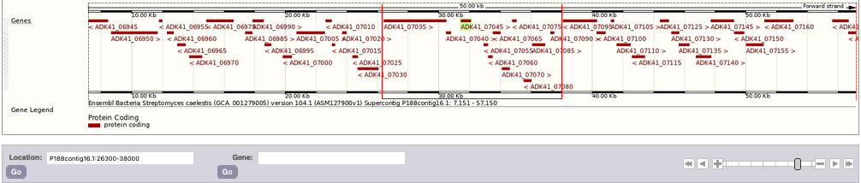
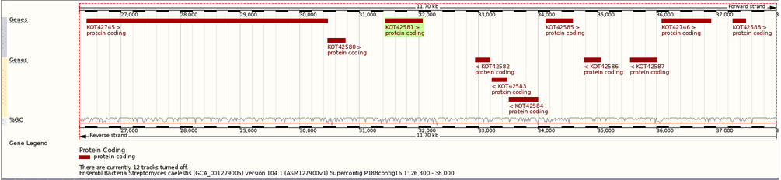
Genomic zone of Streptomyces caelestisDPL
Gene involved in compound biosynthesis
Regulation gene
Promotor predicted by Softberry server
Gene involved in compound transport
Uncharacterized protein coding gene
DPL gene
Notes:
https://bacteria.ensembl.org/Streptomyces_caelestis_gca_001279005/Location/View?db=core;g=ADK41_07045;r=P188contig16.1:26300-38000;t=KOT42581

