Slide 1
Figure S1
Notes:
Figure S1: Flow chart of the analysis
The pre-cDC, cDC1 and cDC2 single cells were mixed and sequenced in 3 batches with different combinations using Fludigm C1 system. After mapping the reads to human reference genome, reads counts for each gene were obtained to measure gene expression level. Multidimensional scaling was used to infer cell type and remove outliers. Highly biological variable genes in pre-cDC population can separate cDC1 and cDC2, which indicates the heterogeneity of pre-cDCs. Master regulators that are differentially expressed between bulk cDC1 and cDC2 (indicated in red and blue) or have enriched targets (indicated in olive) can reveal the trajectory of pre-cDC differentiation into DCs.

Slide 2
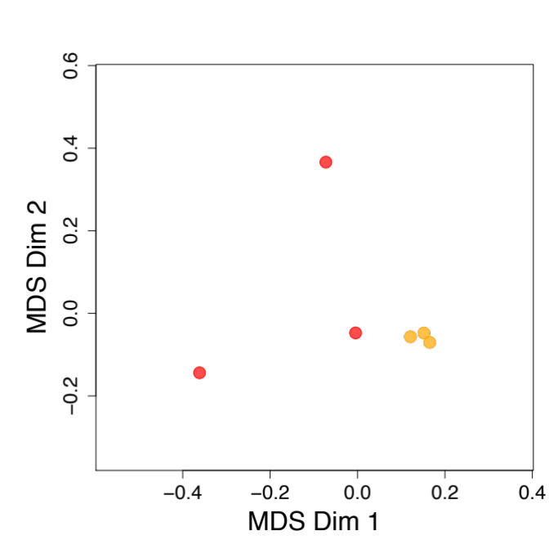
Figure S2
A
pDC
pre-cDC
B
Paper | Phenotype* | Finding | VS. Ma et al 2017 | Fraction
See et al 2017 | flow sort markers: Lin-HLA-DR+CD34-CD45+CD33+ CD123+CD303(BDCA2)+ CD135(FLT3)+ | Identified early uncommitted CD123high pre-DC subset, two CD45RA+CD123low lineage-committed subsets | The pre-cDCs are CD303+(pDC marker), phenotypically different. Did not carry out master regulator analysis. | ~0.02% (range of 0.01- 0.03)of CD45+ blood populations(Fig.2c)
Villani et al 2017 | flow sort markers: Lin-HLA-DR+CD45RA+CD100^{hi} CD34^{int} CD11C- CD123- mRNA expression: CD135(FLT3)- | Identified a new progenitor population can produce CLEC9A+ and CD1c+ DCs but lack FLT3/CD135 expression | Did not perform heterogeneity and pre-commitment analysis of cDC progenitors. Did not carry out master regulator analysis. | ~0.02% of the LIN-HLA-DR+ fraction of PBMCs
Ma et al 2018 | flow sort markers: Lin-CD34-CD66b- CD45RA+CD117+CD116+CD115-SSClo CD303(BDCA2)-CD135(FLT3)+ CD1c/CD141- mRNA expression: HLA-DR+CD123^{lo #} | Heterogeneity and pre-commitment of pre-cDCs; Master regulator analysis and suggest that transcription factor dosage combination determine the terminal differentiation | NA | 0.001% (range of 0.001– 0.002%) of CD45+ blood
*: the phenotype here is defined based on markers used to isolate the single cells. For the study that does not use a specific marker, we use their mRNA expression level. Markers in red are those key ones to distinguish the datasets of the 3 studies.
#:CD123 also shows low protein expression in pre-DC compared with DC1, DC2 and pDCs (Fig.2f, Breton and Lee et al., 2015)
Notes:
Figure S2: Comparison of 3 studies: See et al., 2017, Villani et al., 2017 and Ma et al., 2018
MDS plot of the pDC and pre-cDC bulk RNA-Seq samples identified with our set of markers.
Compare the three studies from the aspects of pre-cDC phenotype, finding and pre-cDC fraction in blood.

Slide 3
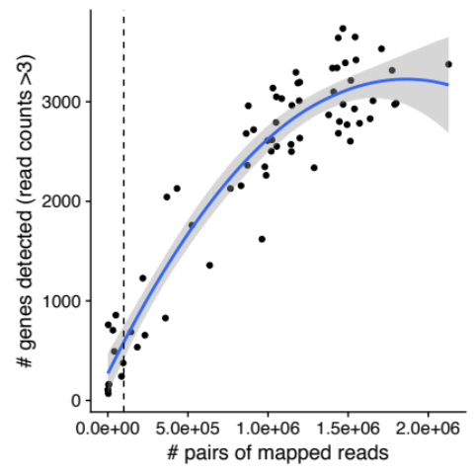
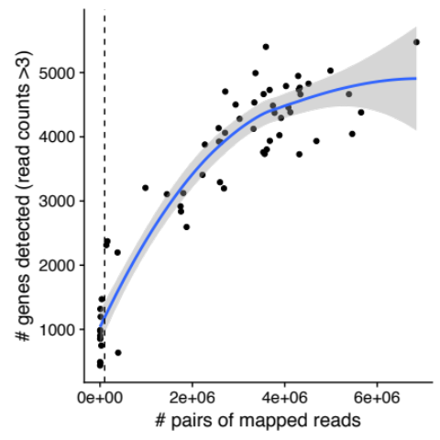
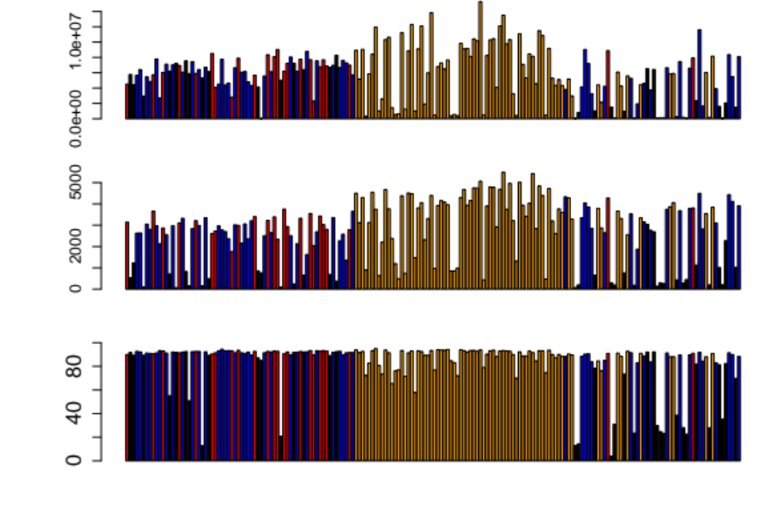
Figure S3
A
B
Total # of reads
Detected # of genes
pre-cDC
cDC1
cDC2
outliers
Mapping rate(%)
Notes:
Figure S3: Quality control of single cell sequencing data.
(A) Sequencing saturation analysis for the 3 batches. In each panel, the dashed vertical line represents the cutoff we used to filter cells with too few genes detected. The blue curve represents the local regression curve and the grey region represents the 95% confidence interval. (B) Bar plot of total number of reads uniquely mapped, detected number of genes (mapped reads number > 0), mapping rate (uniquely mapped reads / total reads) for all the single cells, with identities inferred from the clustering analysis represented by different colors as indicated. (C) Boxplot of mapped reads number for single cells belonging to the two dense clusters (group1 and group 2) and those deemed as outliers (group 3) in Fig.2A. (D) The same MDS plot with Fig2.A, with cells color coded by inferred cell identities, pre-cDC in orange, DC1 in red, DC2 in blue and outliers in grey.

Slide 4
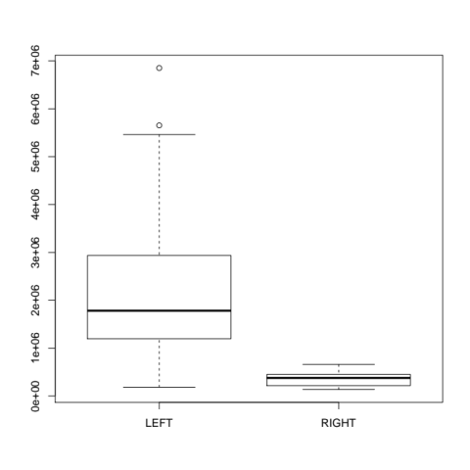
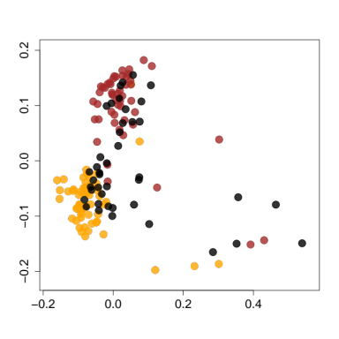
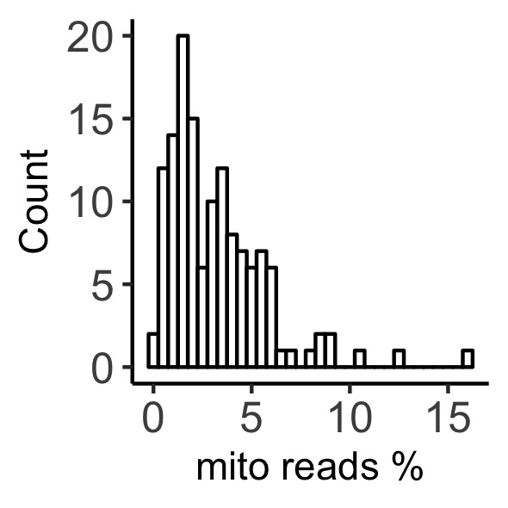
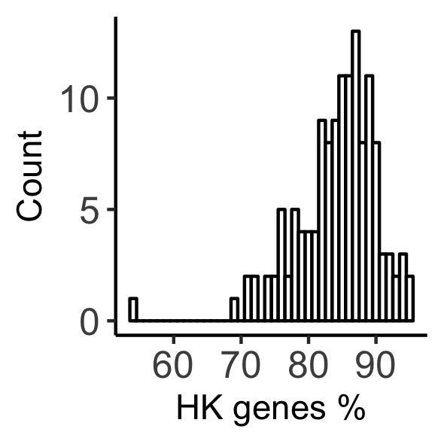
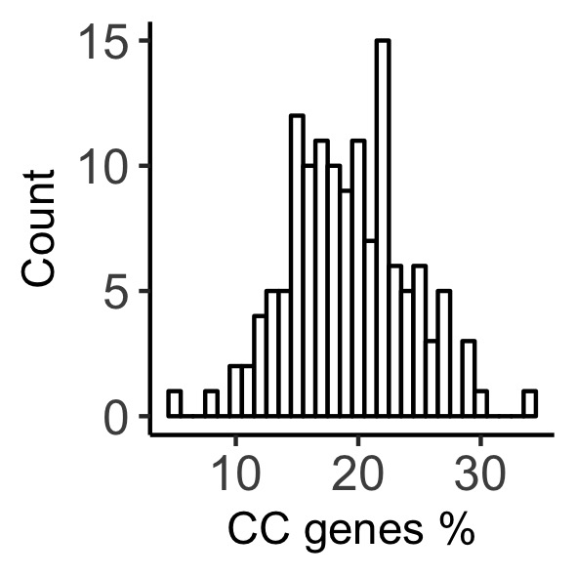
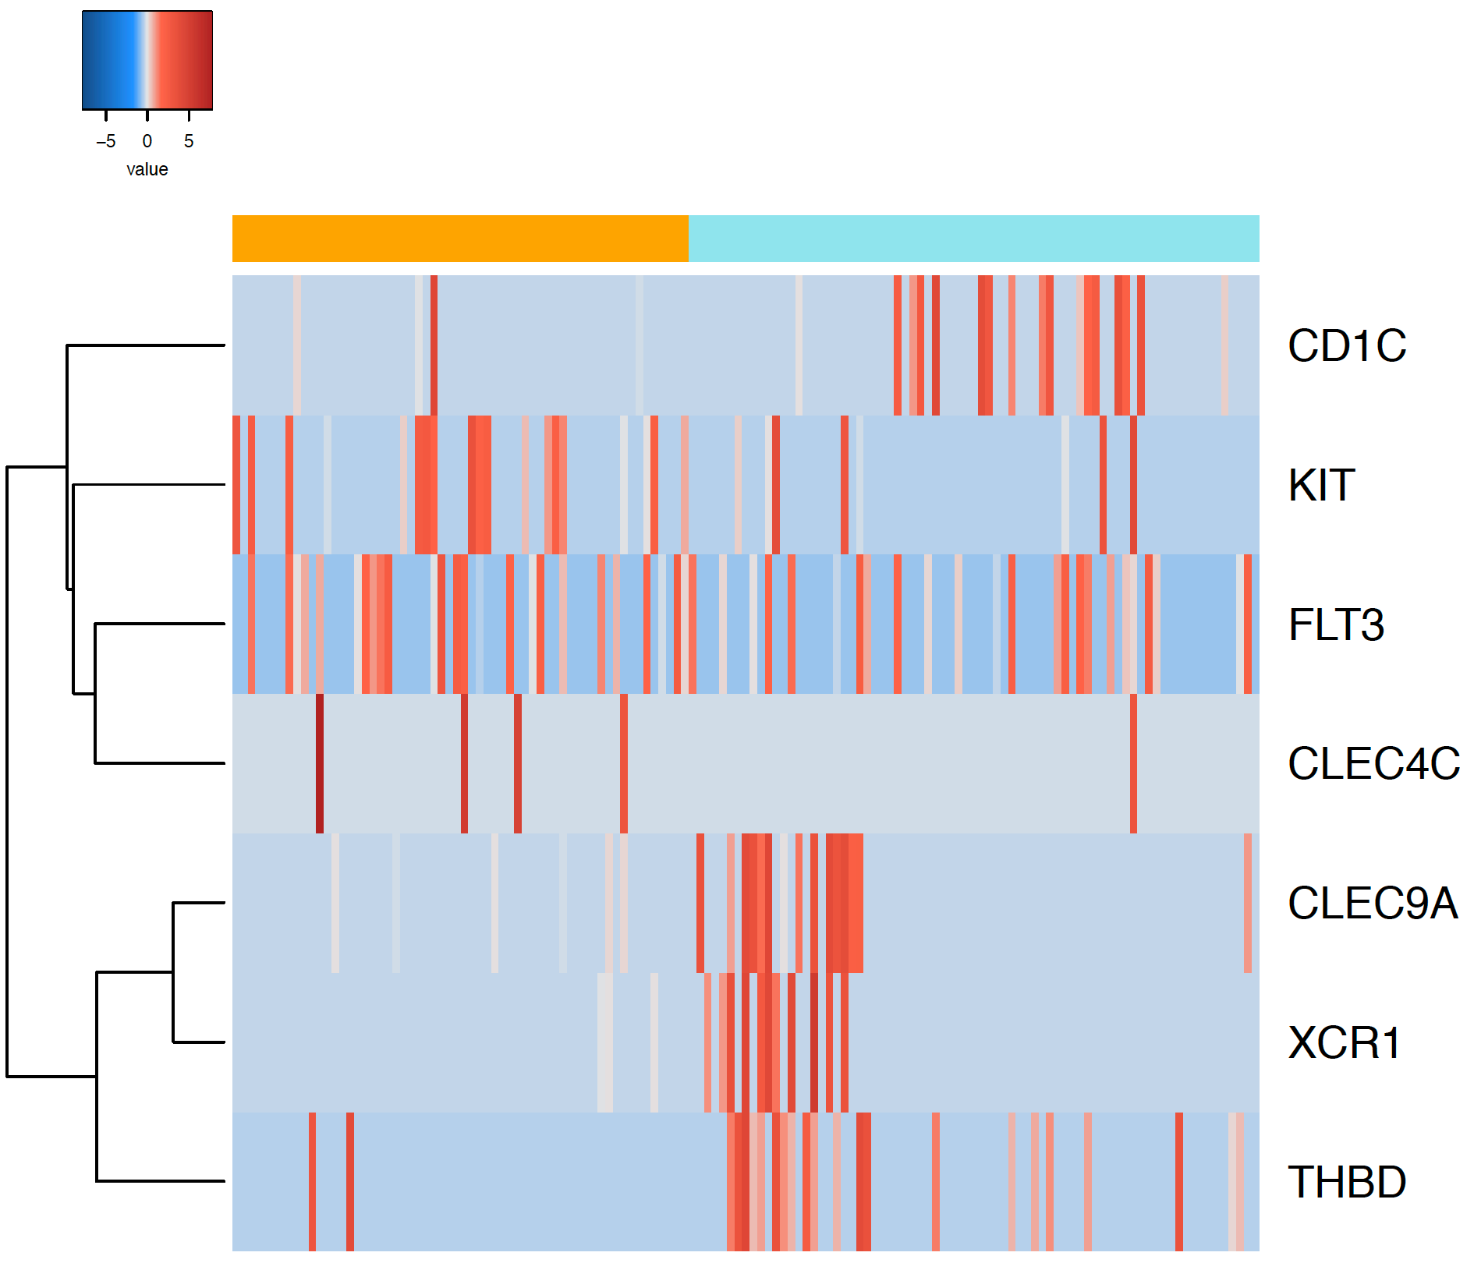
Figure S4
A
B
Group 2
Batch1
MDS Dim 2
Group 3
Batch2
Total number of reads
Batch3
Group 1
MDS Dim 1
Group 1 and 2
Group 3
C
D
pre-cDC
cDCs
+ for DC2
+ for pre-cDC
+ for pre-cDC
- for pre-cDC
+ for cDC1
+ for cDC1
+ for cDC1
Notes:
Figure S4. Outlier analysis.
(A) Multidimensional scaling (MDS) plot for all the cells of the three batches that pass the depth filter 100, 000 mapped reads to gene region, batch1 (yellow, cDCs), batch2 (brown, pre-DCs) and batch3 (black, mixture of cDCs and pre-DCs), where the input distance was adjusted for dropout rate with SCDE. The cells can be separated into 3 groups by k-means clustering: group1 for cDCs, group 2 for pre-cDCs and group 3 for outliers(outside of the dashed ovals ). (B) Boxplot of mapped reads number for single cells belonging to the two dense clusters (group1 and group 2) and those deemed as outliers (group 3) in Panel A. (C) Histogram of the percentage of mitochondrial reads, the percentage of genes detected out of 100 housekeeping genes and 496 cell cycle genes. (D) Heatmap of cell-specific markers for pre-cDC and cDCs.

Slide 5
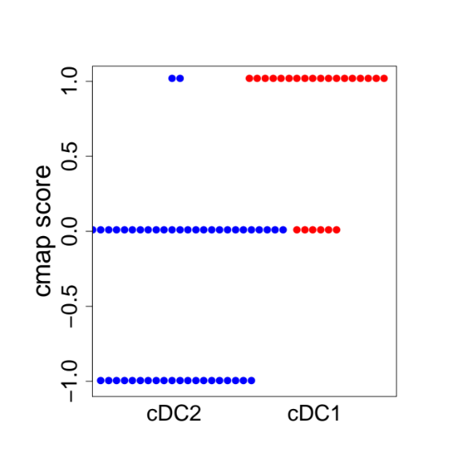
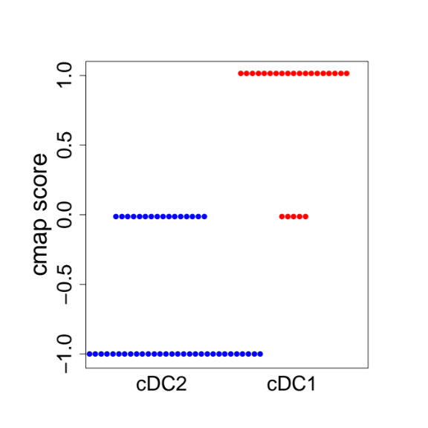
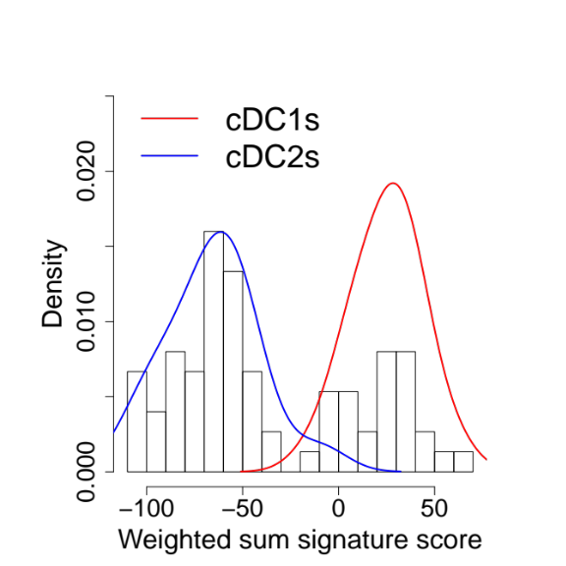
Figure S5
A
B
cDC2
cDC2
cDC1
cDC1
C
Notes:
Figure S4. Assessment of the purity of the two DC clusters.
Cmap score for each single cell using DC signature genes from Villani et al(A) and signature genes from our bulk RNA-Seq data(B). Cmap score ranges from -1 to 1, here -1 indicates a single cell is close to cDC2 and 1 indicates a single cell is close to cDC1.
(C) histogram of weighted sum score with the signature genes from our bulk RNA-Seq data, where weight is the expression fold change between bulk cDC1 and cDC2 samples. The two lines represent the density of weighted sum score for cDC1 group (red) and cDC2 group (blue), respectively.

Slide 6
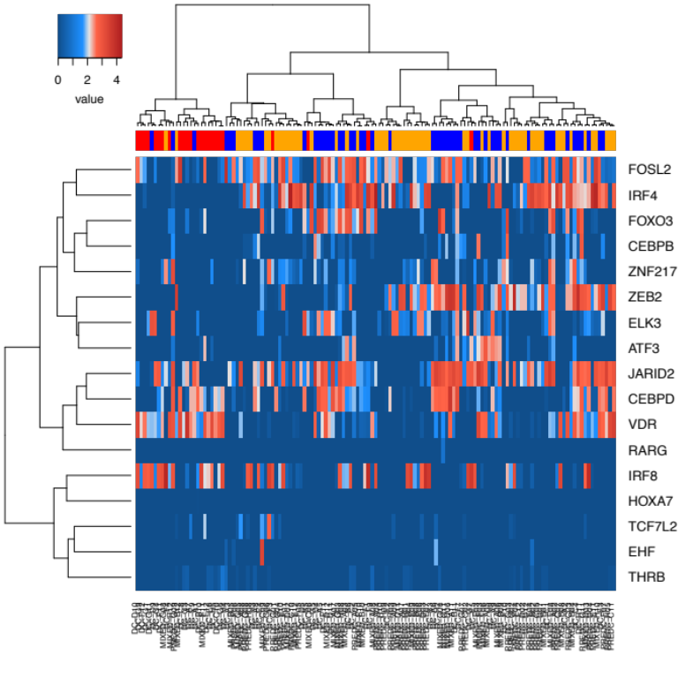

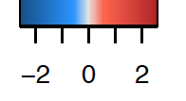
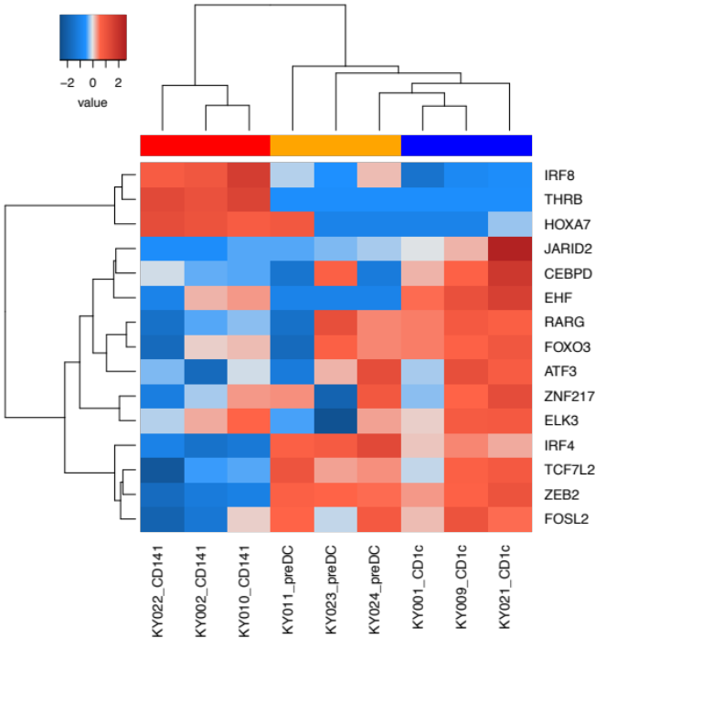
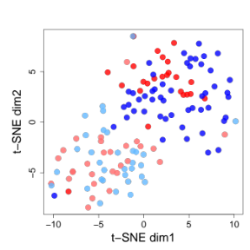
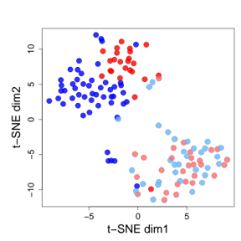
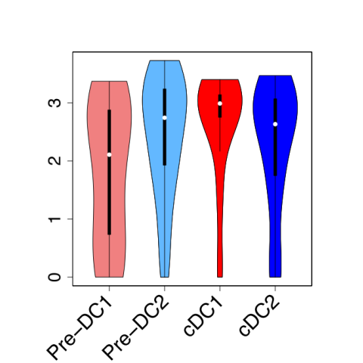
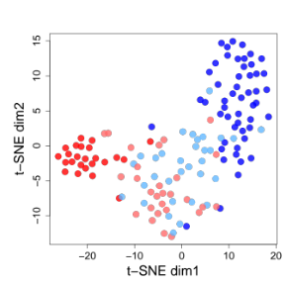
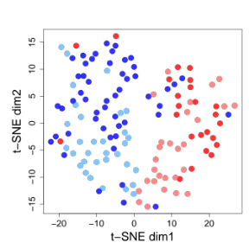
Figure S6
A
B
Log₁₀ expression
Row Z score
pre-cDC
cDC1
cDC2
C
D
Global transcriptome
Variable genes
GABARAP
Log 10 normalized expression
DE genes
MR TFs
pre-DC1
pre-DC2
cDC2
cDC1
Notes:
Figure S5: More details about “MR” TFs between bulk cDC1 and cDC2 that potentially drive the pre-commitment of pre-cDC.
(A-B) Heatmap of “MR” TFs in bulk data (A) and single cell data(B). (C) t-SNE plot of all the single cells with global transcriptome, biological variable genes in pre-cDCs, DE genes between bulk cDC1 and cDC2 and the “MR” TFs, with pre-committed pre-cDC subsets marked. (D) Violin plot of the housing keep gene GABARAP in single cell populations: pre-cDC1, pre-cDC2, cDC1 and cDC2.

Slide 7
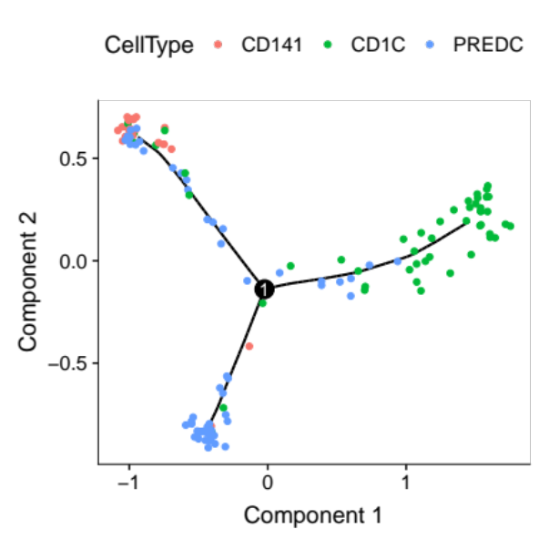
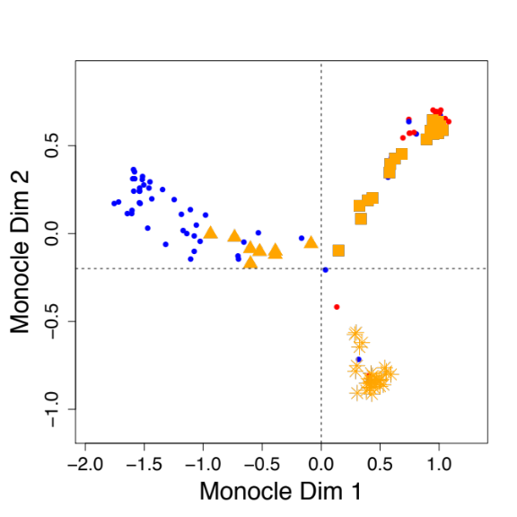

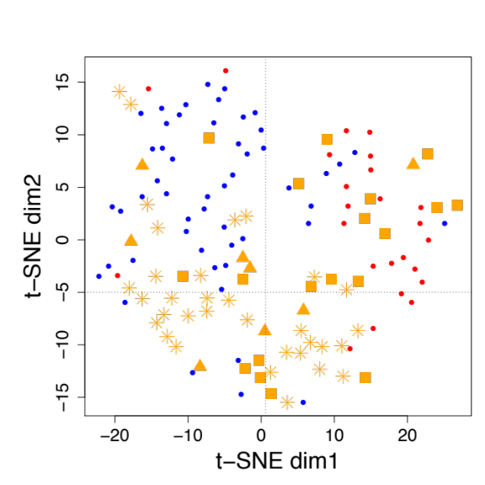
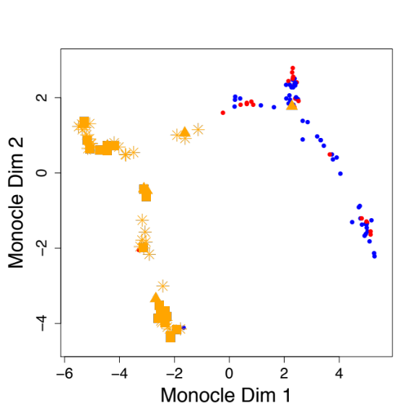
Figure S7
A
B
cDC2
cDC1
M_unknown
M_preDC1
M_preDC2
C
D
cDC2
cDC1
M_unknown
M_preDC1
M_preDC2
Notes:
Figure S7. Trajectory analysis with Monocle2.
(A) Trajectory inferred by Monocle with the list of candidate “MR” TFs. (B) Panel A left and right flipped for the sake of easy comparing with t-SNE (Panel C). The pre-cDCs in Monocle map were classified into 3 categories according to their coordinates: M_preDC1(box), M_preDC2(triangle) and M_unknown (asterisks) (D) Trajectory inferred by Monocle2 based on the 842 variable genes in pre-cDCs. The shapes of pre-cDCs were encoded the same as that of Panel B.

Slide 8
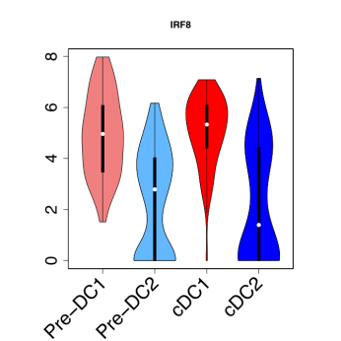
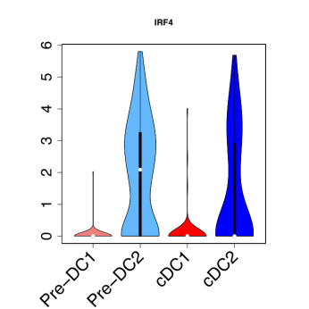
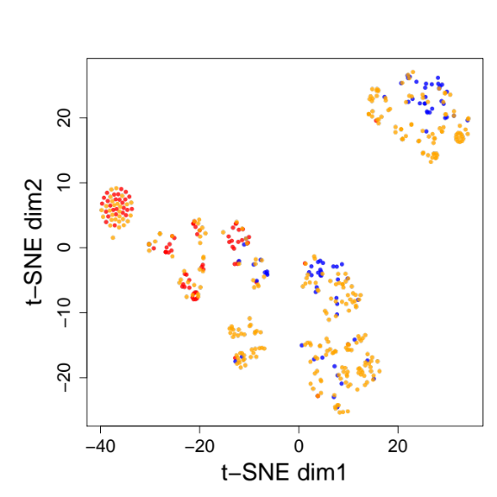
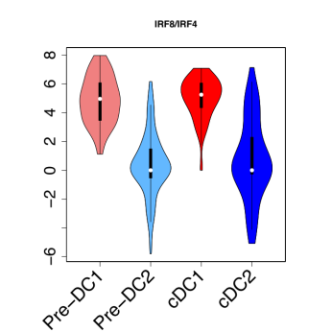
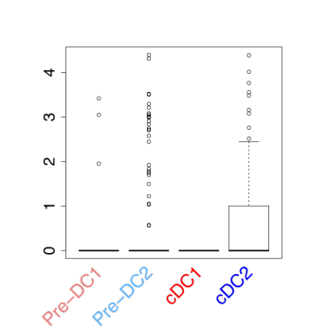
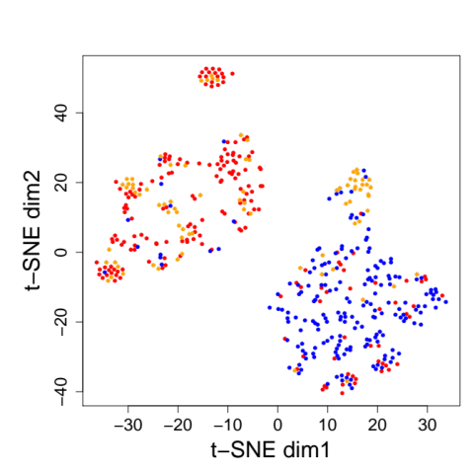
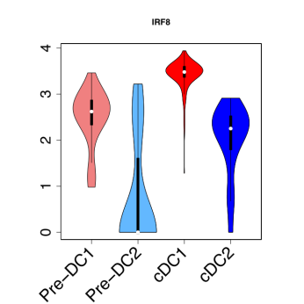
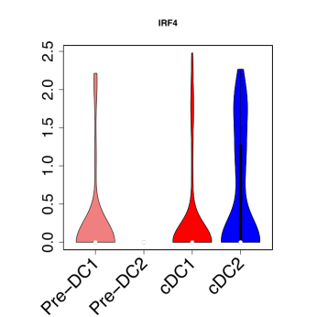
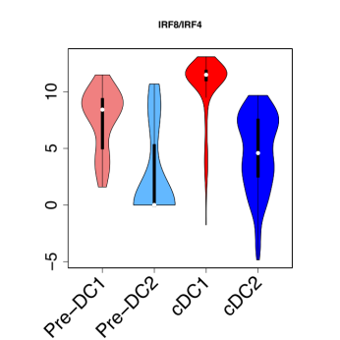
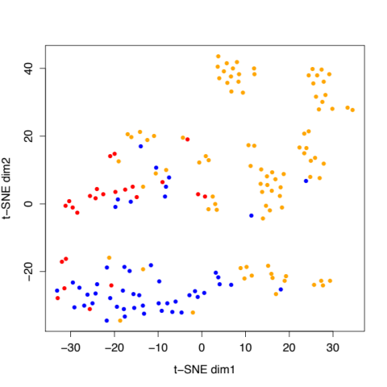
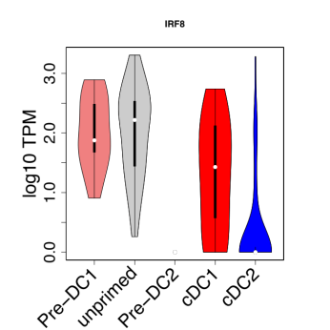
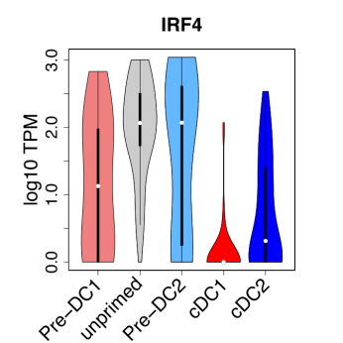
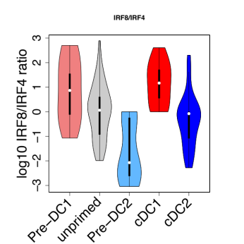
Figure S8
A
II
IRF8
III
IRF4
I
pre-cDC
cDC2
Log TPM
cDC1
C3
C1
IV
IRF8/IRF4
V
SIRPA
C2
Log10 IRF8/ IRF4 ratio
Log TPM
B
I
II
III
IV
C1
IRF8
IRF4
IRF8/IRF4
C2
Log 10 normalized expression
Log10 IRF8/ IRF4 ratio
Log 10 normalized expression
pre-cDC
cDC2
cDC1
C
I
II
III
IV
pre-cDC
IRF8
IRF4
IRF8/IRF4
cDC2
C3
cDC1
C1
T-SNE dim2
C2
t-SNE dim1
Notes:
Figure S7. Test our hypothesis on the published data sets.
(A) Test our hypothesis on the dataset of Breton et al., 2016. We used 16 candidate MR TFs to do t-SNE on the cells filtered by procedures in Breton et al., 2016 and performed K-means to do clustering on the t-SNE map. DC progenitors in cluster C3 are referred to as pre-DC1 and DC progenitors in clusters in C1 and C2 are referred to as pre-DC2 (I) in the following violin plots which show the expression of IRF8, IRF4 and the ratio thereof (II-IV). (V) Boxplot showing expression level of SIPRA, a verified surface marker that can distinguish pre-DC1 and pre-DC2, for pre-DC1, pre-DC2, cDC1 and cDC2, respectively.
(B) Test our hypothesis on the dataset of Villani et al., 2017. We use 16 candidate MR TFs to do t-SNE on the cells filtered by procedures from Villani et al., 2017. and performed K-means to do clustering on the t-SNE map. DC progenitors here have phenotype of CD100hiCD34int. DC progenitors in cluster C1 are referred to as pre-DC1 and DC progenitors in cluster C2 are referred to as pre-DC2 (I) in the following violin plots which show the expression of IRF8, IRF4 and the ratio thereof (II-IV).
(C) Test our hypothesis on the dataset of See et al., 2017. We used 16 candidate MR TFs to do t-SNE on the 92 cells of pre-cDC combined with our cDC cells. Then we performed K-means to do clustering on the t-SNE map, which result in 3 clusters C1-3. Pre-cDCs in cluster C1 are referred to as pre-DC1, pre-cDCs in cluster C2 are referred to as pre-DC2 and pre-cDCs in cluster C3 are referred to as unprimed (I) in the following violin plots which show the expression of IRF8, IRF4 and the ratio thereof (II-IV).

