Slide 1
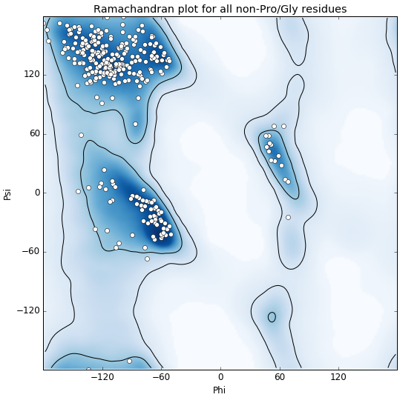
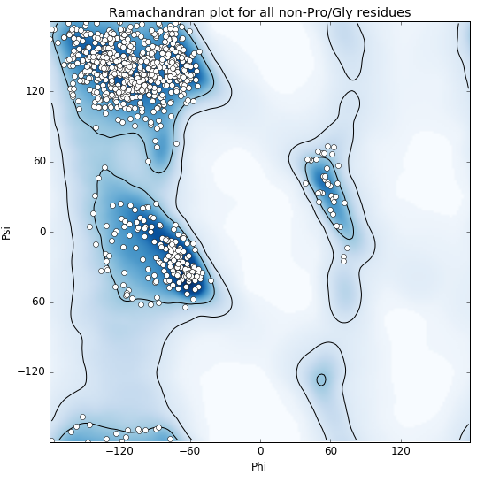
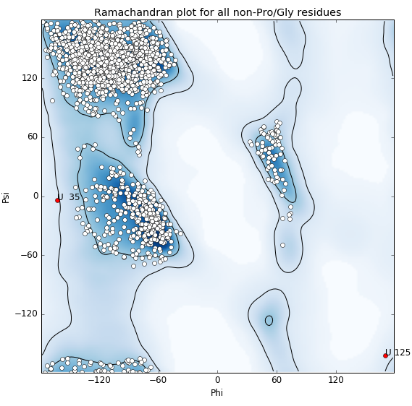
a
b
c
ABBV-323 Fab alone
Outliers:
ABBV-323 Fab complexed to CD40
Outliers:
FAB516 complexed to CD40
Outliers:
Chain | Residue
H | P152
Chain | Residue
A | P152
H | P152
Chain | Residue
C | V153, P152
E | P152
U | S35

