Slide 1
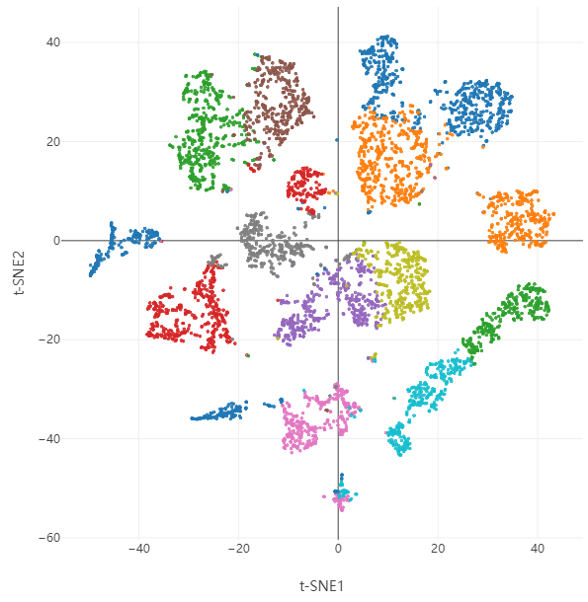
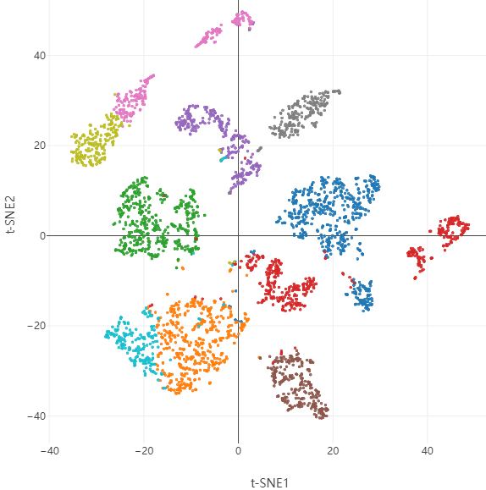
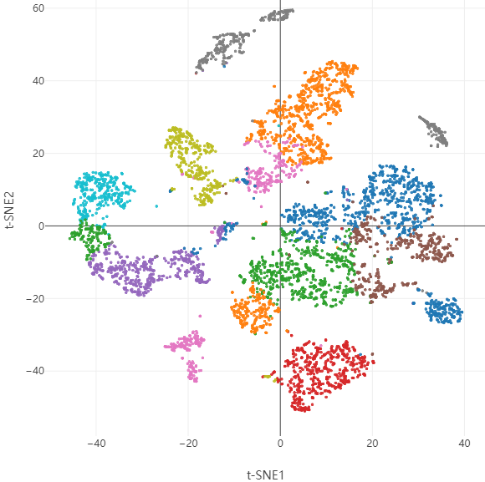
Supplementary Figure 1. T-SNE Plots of Human Degenerative Nucleus Pulposus.
Sample 1
Sample 2
Sample 3
③
⑥
①
⑨
⑦
⑧
⑧
⑪
⑭
②
⑫
⑤
⑨
②
④
⑧
⑨
③
①
⑩
①
⑤
⑬
④
④
⑬
⑤
③
⑥
⑪
⑪
⑦
⑩
⑩
②
⑥
⑦
⑫
④
Supplementary Figure 1. T-SNE plots showing cells distribution from each sample of human degenerative nucleus pulposus. Different cell subsets were indicated with different numbers.

Slide 2
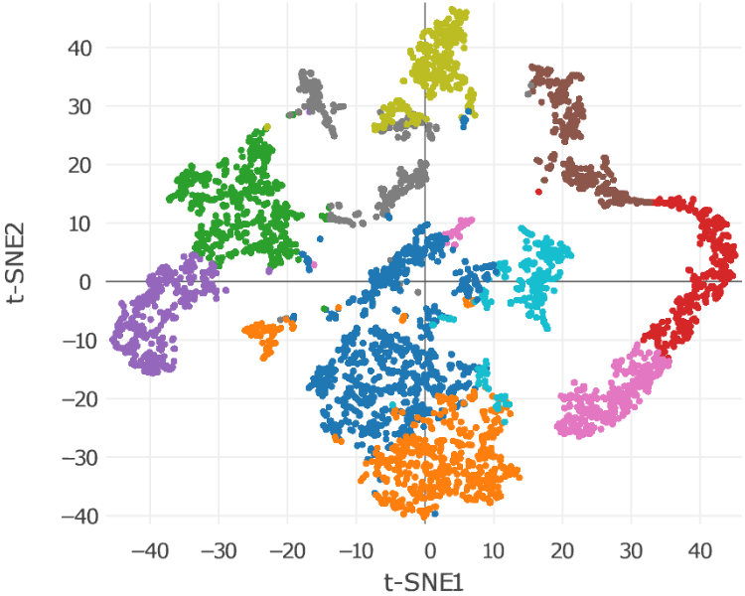
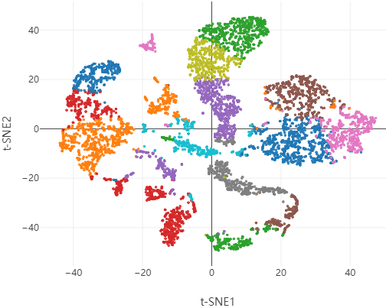
Supplementary Figure 2. T-SNE Plots of Human Ossified Posterior Longitudinal Ligament.
Sample 1
Sample 2
⑧
⑨
⑪
⑰
⑨
③
⑥
⑭
⑫
⑤
⑥
③
④
②
⑩
①
⑦
⑤
⑪
①
⑩
⑮
⑧
⑦
④
⑯
②
⑬
Supplementary Figure 2. T-SNE plots showing cells distribution from each sample of human ossified posterior longitudinal ligament. Different cell subsets were indicated with different numbers.

