Slide 1
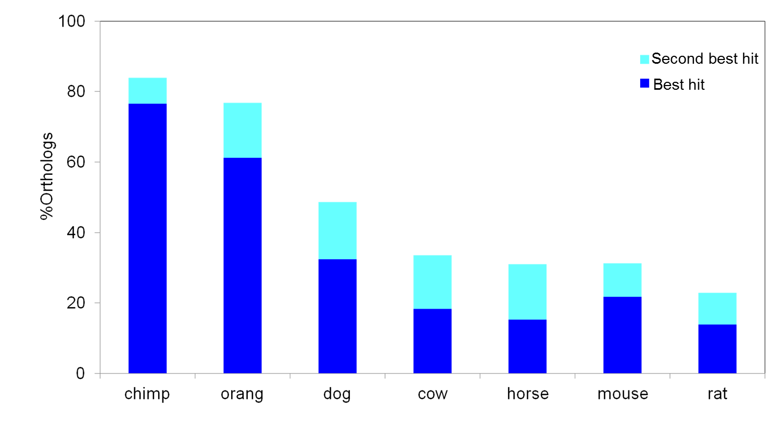
Fig S1

Slide 2
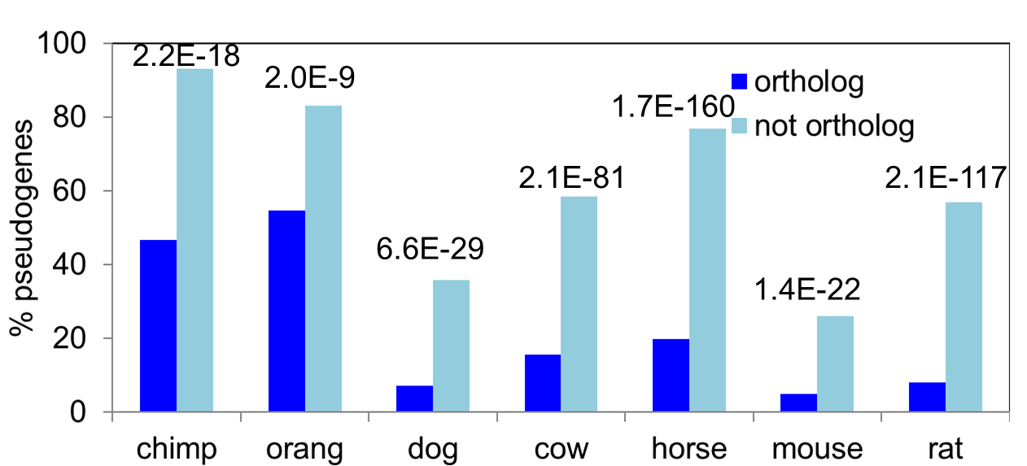
Fig S2

Slide 3
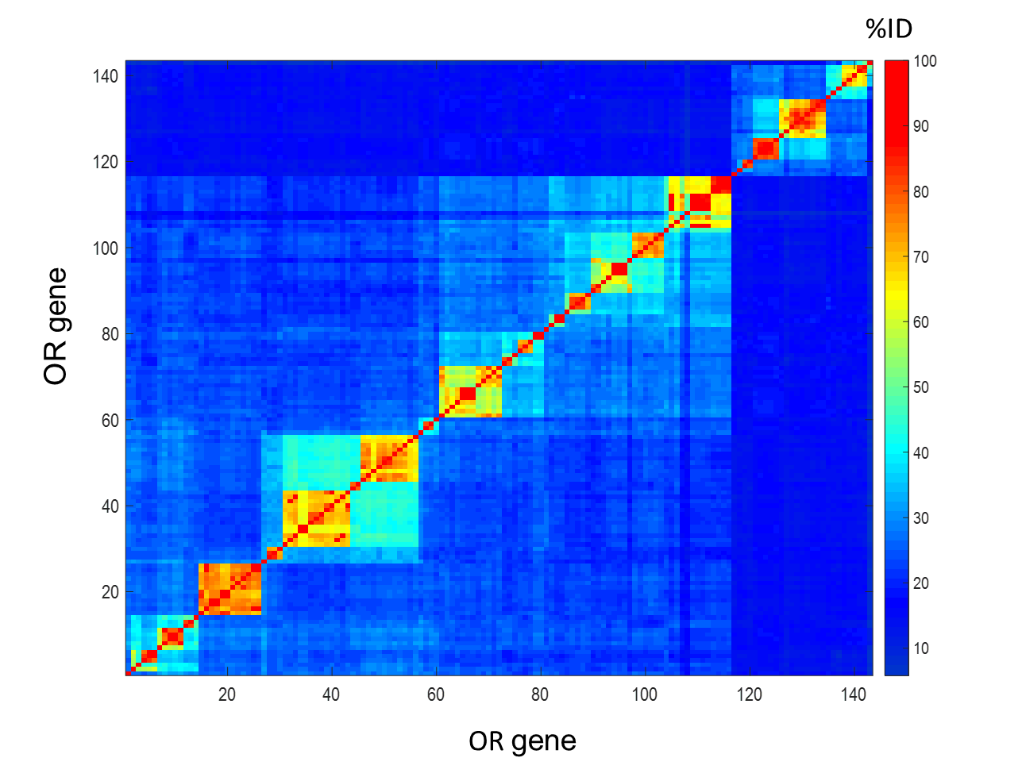
Figure S3

Slide 4
Table S2:
Family numbers of the zebrafish OR repertoire
class | OR family number
A | 52-56
B | 1-14
C | 30-39
D | 40-49
E | 60-69
F | 70-79
G | 80-89
H | 90-100
Classes are from Alioto TS et al.

