Slide 1
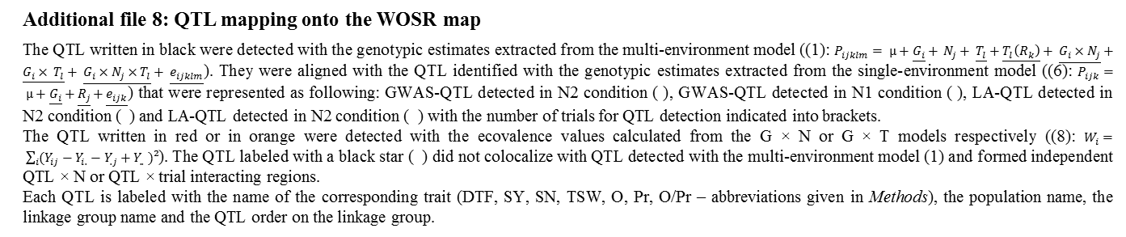
Additional file 8: QTL mapping onto the WOSR map
The QTL written in black were detected with the genotypic estimates extracted from the multi-environment model ((1): $P_{ijklm}= µ+\underline{G_{i}}+ N_{j}+ \underline{T_{l}}+\underline{T_{l}\left(R_{k}\right)}+ \underline{G_{i}×N_{j}}+\underline{G_{i}× T_{l}}+ \underline{G_{i}×N_{j}×T_{l}}+ \underline{e_{ijklm}}$). They were aligned with the QTL identified with the genotypic estimates extracted from the single-environment model ((6): $P_{ijk}= µ+\underline{G_{i}}+\underline{R_{j}}+\underline{e_{ijk}}$) that were represented as following: GWAS-QTL detected in N2 condition ( ), GWAS-QTL detected in N1 condition ( ), LA-QTL detected in N2 condition ( ) and LA-QTL detected in N2 condition ( ) with the number of trials for QTL detection indicated into brackets.
The QTL written in red or in orange were detected with the ecovalence values calculated from the G × N or G × T models respectively ((8): $W_{i}= \sum_{i}{(Y_{ij}−Y_{i.}−Y_{.j}+Y_{..} })²$). The QTL labeled with a black star ( ) did not colocalize with QTL detected with the multi-environment model (1) and formed independent QTL × N or QTL × trial interacting regions.
Each QTL is labeled with the name of the corresponding trait (DTF, SY, SN, TSW, O, Pr, O/Pr – abbreviations given in Methods), the population name, the linkage group name and the QTL order on the linkage group.
Genetic basis of nitrogen use efficiency and yield stability across environments in winter rapeseed
Bouchet et al.

Slide 2
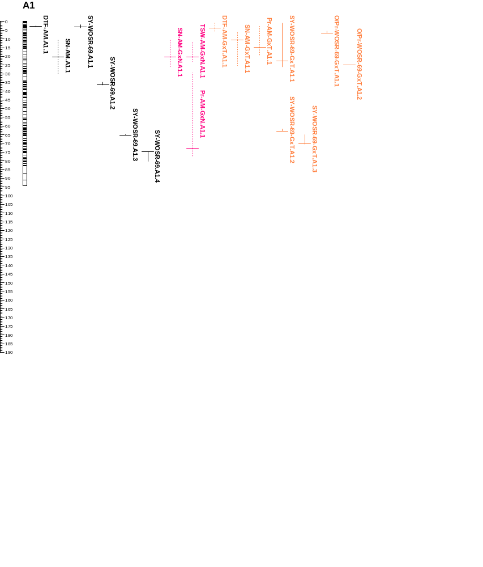
(2)
SY-WOSR.A1.1
SY-WOSR-GxT.A1.1
O/Pr-WOSR-GxT.A1.1
(2)
(2)
O/Pr-WOSR-GxT.A1.2
(4)
(4)
(2)
(2)
SY-WOSR.A1.2
(4)
SY-WOSR-GxT.A1.2
SY-WOSR.A1.3
SY-WOSR-GxT.A1.3
(2)
SY-WOSR.A1.4
(1)
(1)

Slide 3
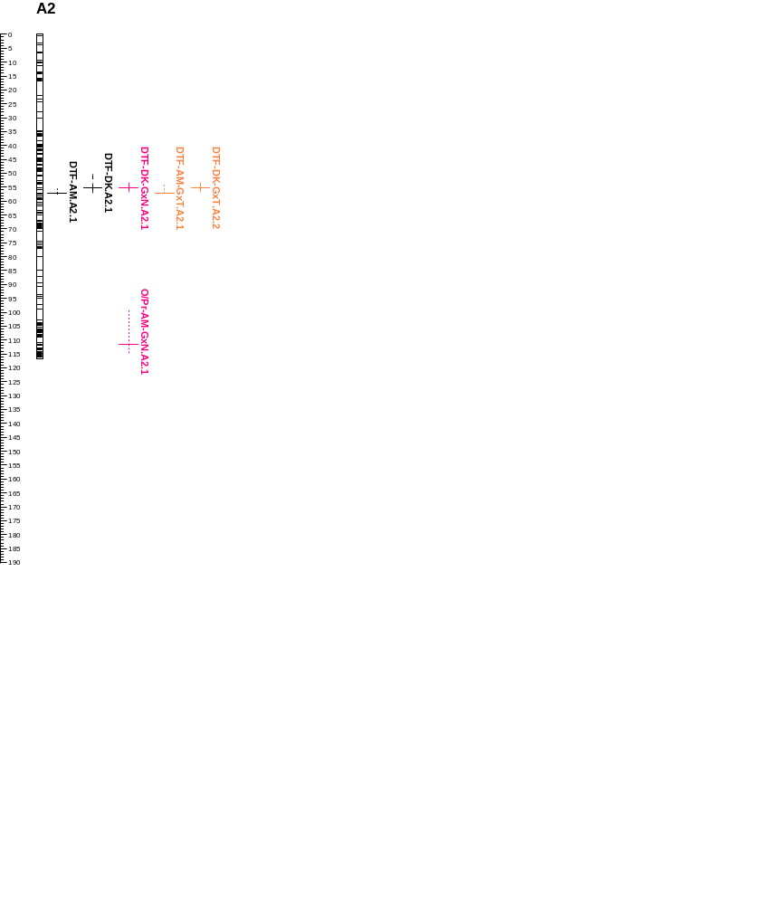
(6)
(6)
(6)
(6)

Slide 4
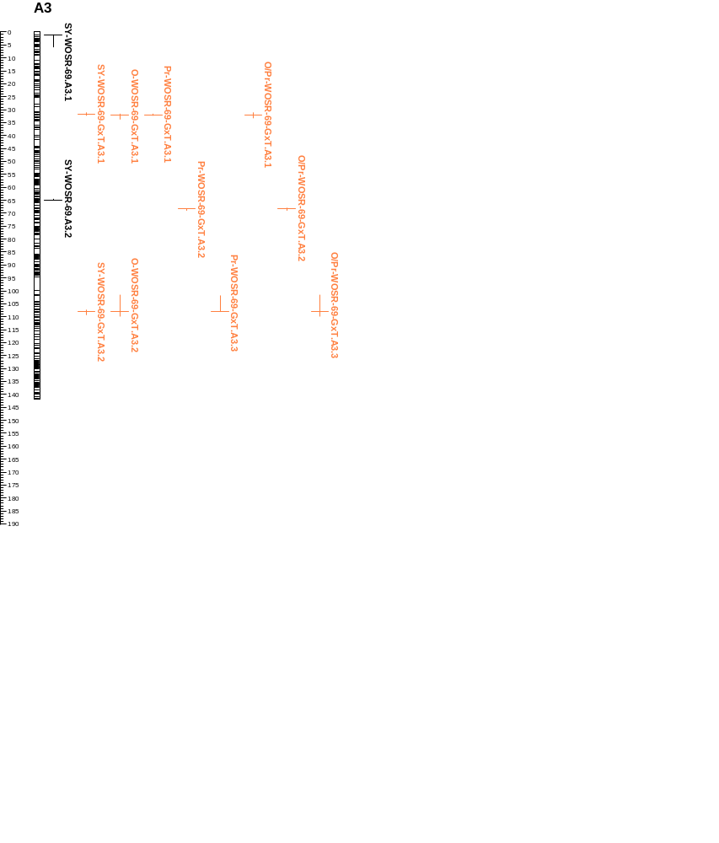
SY-WOSR.A3.1
(4)
SY-WOSR-GxT.A3.1
O-WOSR-GxT.A3.1
Pr-WOSR-GxT.A3.1
O/Pr-WOSR-GxT.A3.1
SY-WOSR.A3.2
Pr-WOSR-GxT.A3.2
O/Pr-WOSR-GxT.A3.2
(4)
SY-WOSR-GxT.A3.2
O-WOSR-GxT.A3.2
Pr-WOSR-GxT.A3.3
O/Pr-WOSR-GxT.A3.3

Slide 5
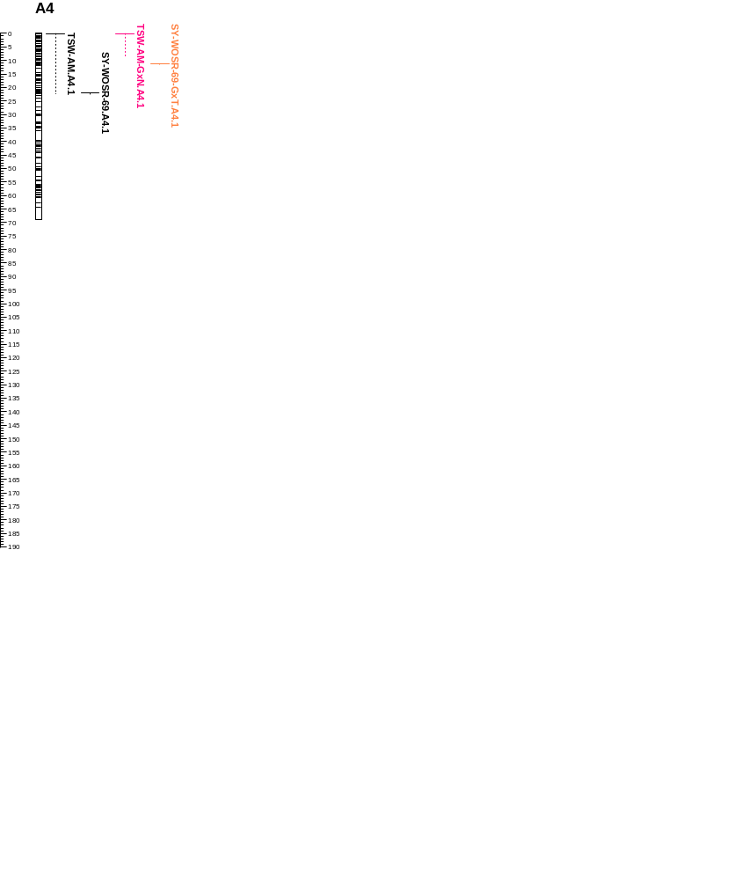
SY-WOSR-GxT.A4.1
(2)
SY-WOSR.A4.1
(3)
(4)
(3)

Slide 6
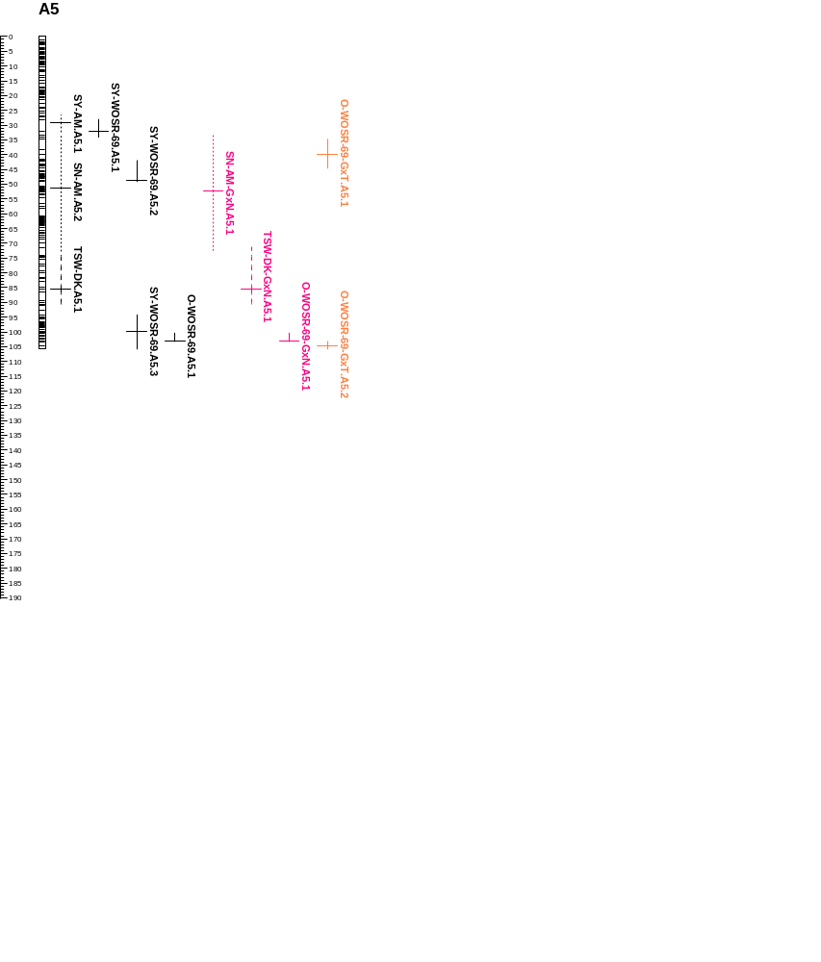
SY-WOSR.A5.1
O-WOSR-GxT.A5.1
(3)
(3)
(1)
(1)
(1)
(1)
SY-WOSR.A5.2
(2)
(2)
(3)
(2)
(1)
(2)
(1)
(2)
SY-WOSR.A5.3
O-WOSR-GxN.A5.2
O-WOSR-GxT.A5.2
(1)
O-WOSR.A5.1
(5)
(4)
(1)
(4)

Slide 7
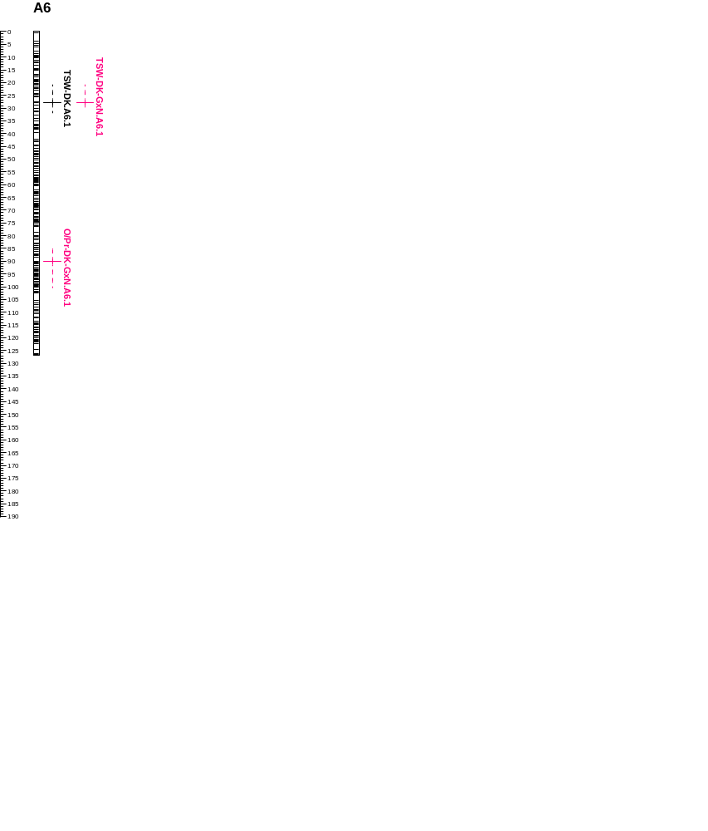
(1)
(1)

Slide 8
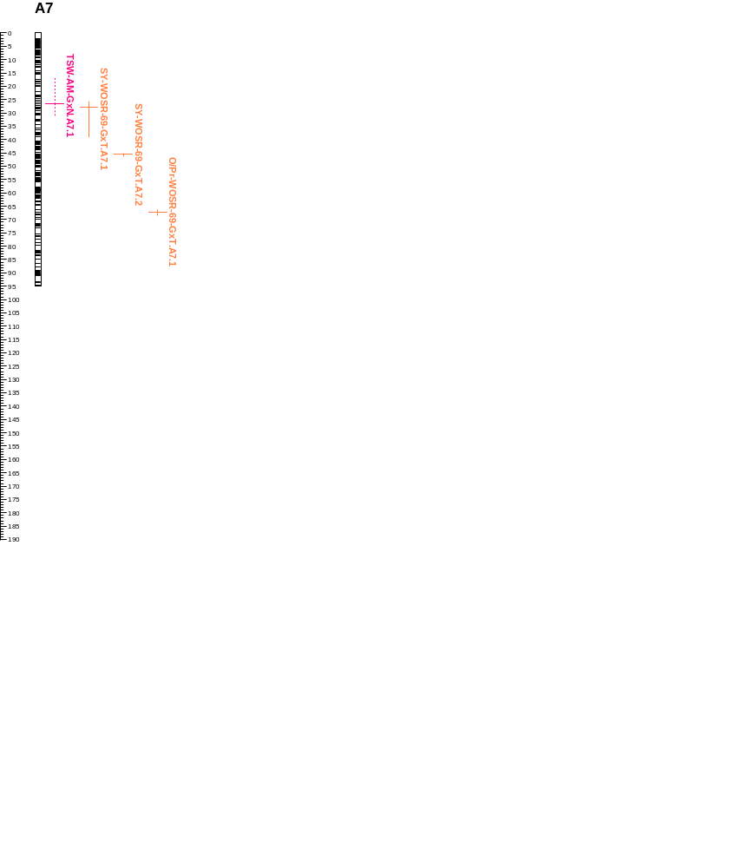
SY-WOSR-GxT.A7.1
SY-WOSR-GxT.A7.2
O/Pr-WOSR-GxT.A7.1

Slide 9
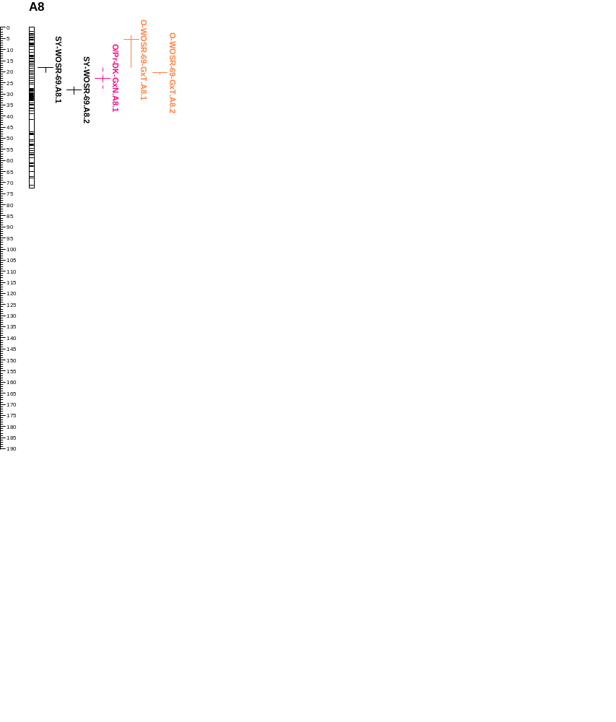
O-WOSR-GxT.A8.1
SY-WOSR.A8.1
O-WOSR-GxT.A8.2
(2)
SY-WOSR.A8.2
(2)

Slide 10
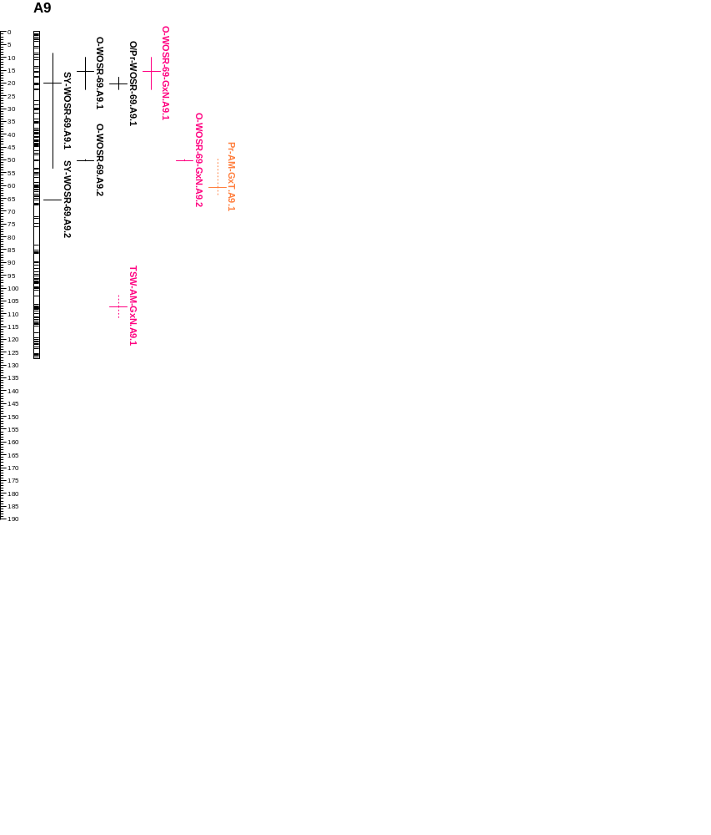
O-WOSR-GxN.A9.1
O-WOSR.A9.1
O/Pr-WOSR.A9.1
SY-WOSR.A9.1
(4)
(3)
(4)
(5)
(4)
(2)
O-WOSR-GxN.A9.2
O-WOSR.A9.2
(2)
SY-WOSR.A9.2
(1)
(1)
(2)

Slide 11
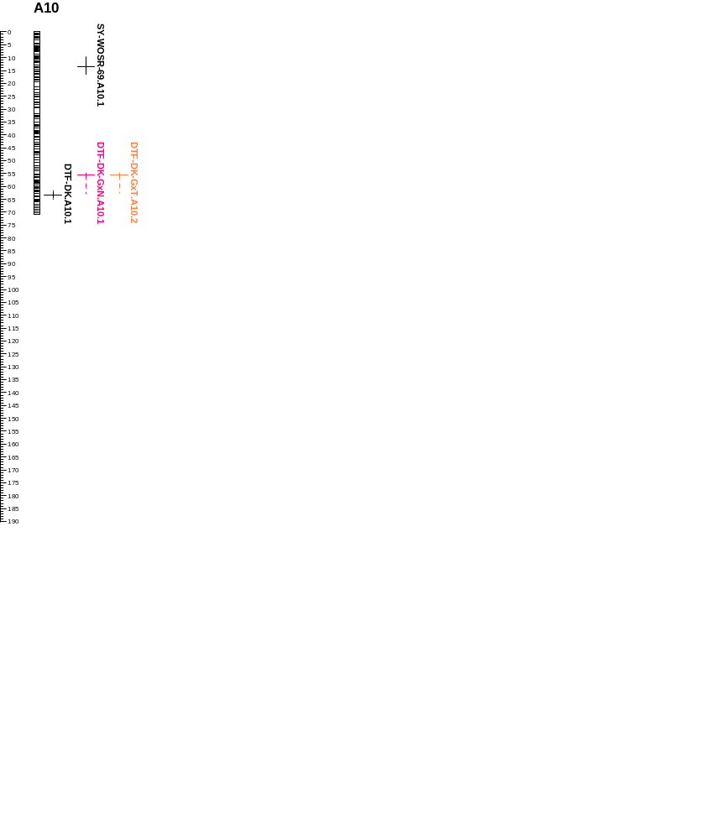
SY-WOSR.A10.1
(3)
(1)
(2)
(2)
(1)
(1)

Slide 12
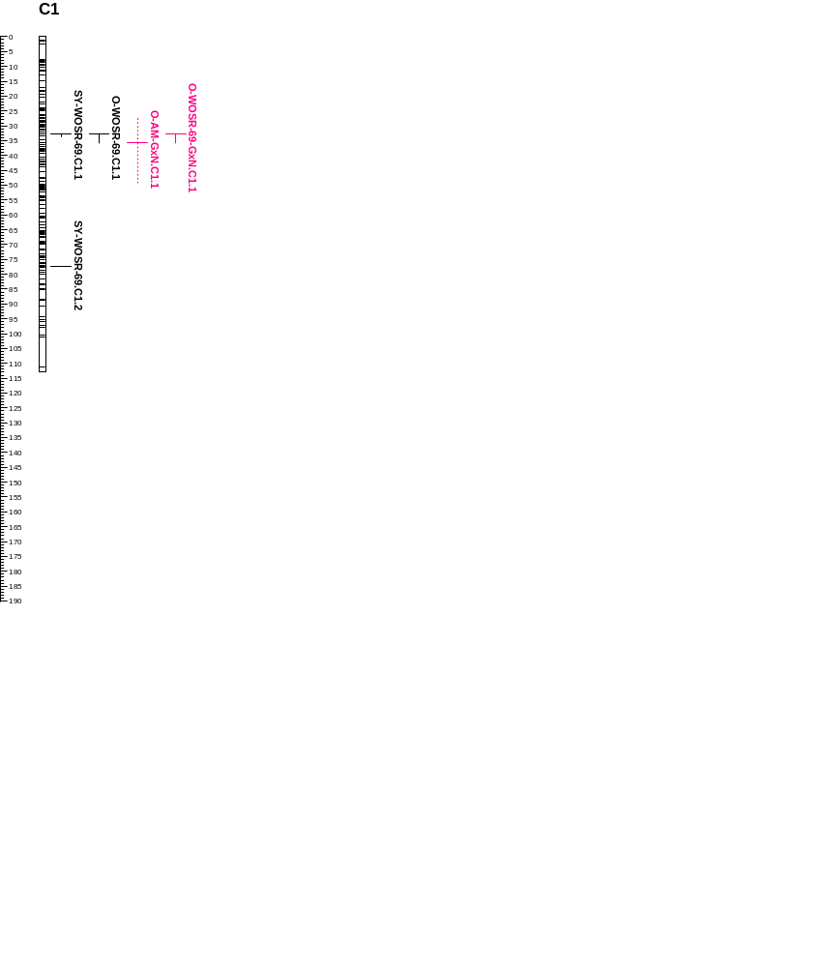
O-WOSR-GxN.C1.1
(4)
(4)
(3)
(4)
(2)

Slide 13
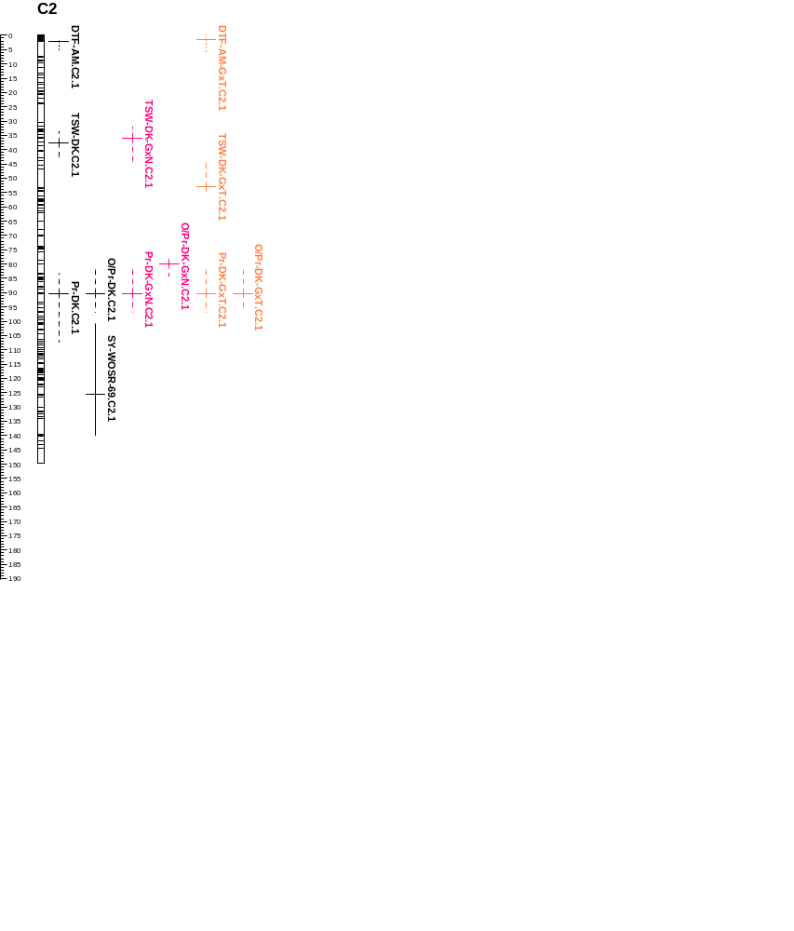
(1)
(5)
(5)
(1)
(1)
(2)
(1)
SY-WOSR.C2.1
(3)
(1)
(1)

Slide 14
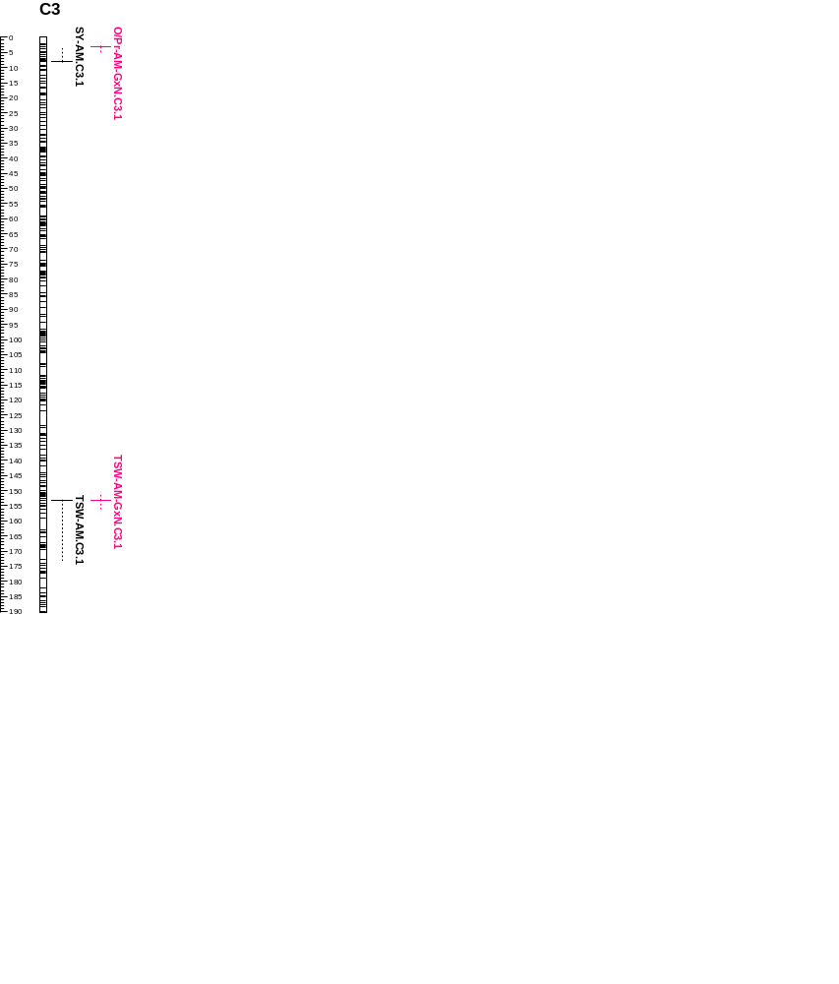
(2)
(1)
(1)

Slide 15
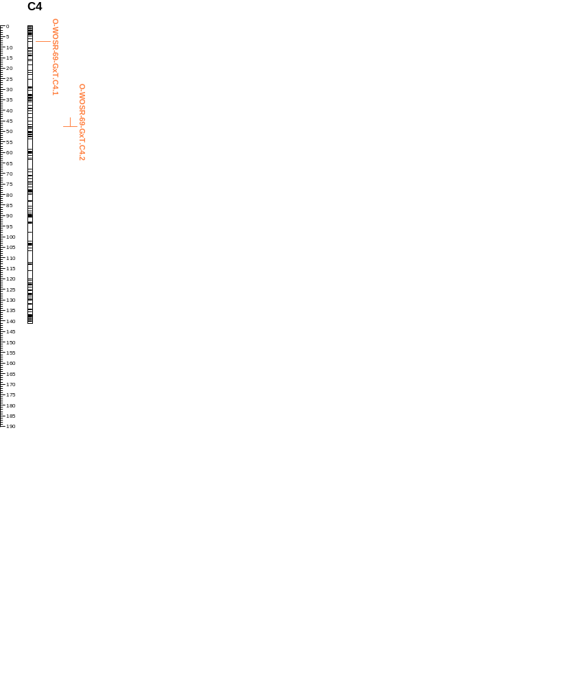
O-WOSR-GxT.C4.1
O-WOSR-GxT.C4.2

Slide 16
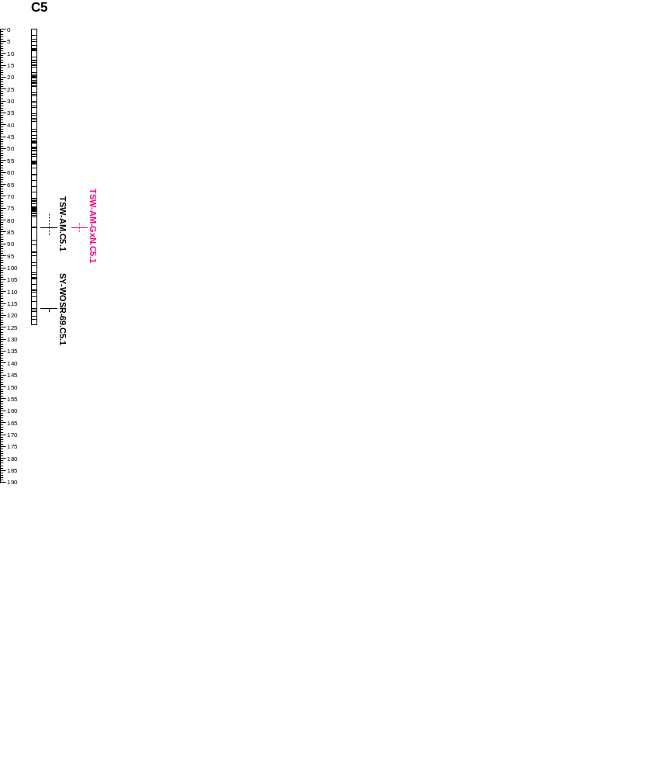
(2)
SY-WOSR.C5.1
(2)
(1)

Slide 17
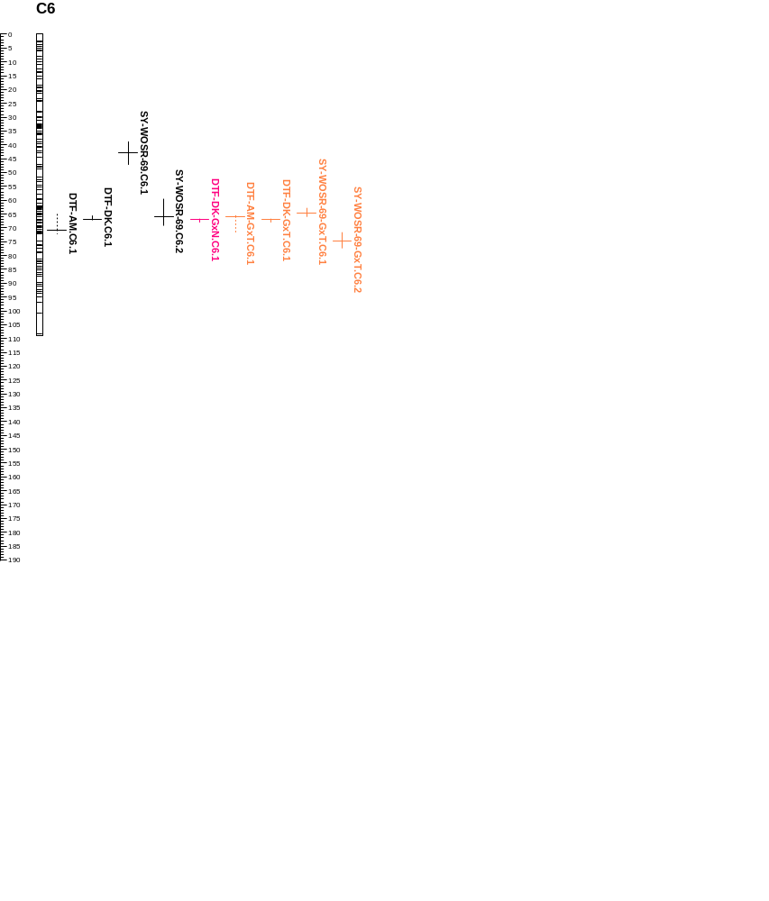
SY-WOSR.C6.1
(3)
(1)
SY-WOSR-GxT.C6.1
SY-WOSR.C6.2
(1)
SY-WOSR-GxT.C6.2
(1)
(7)
(1)
(7)
(7)
(7)

Slide 18
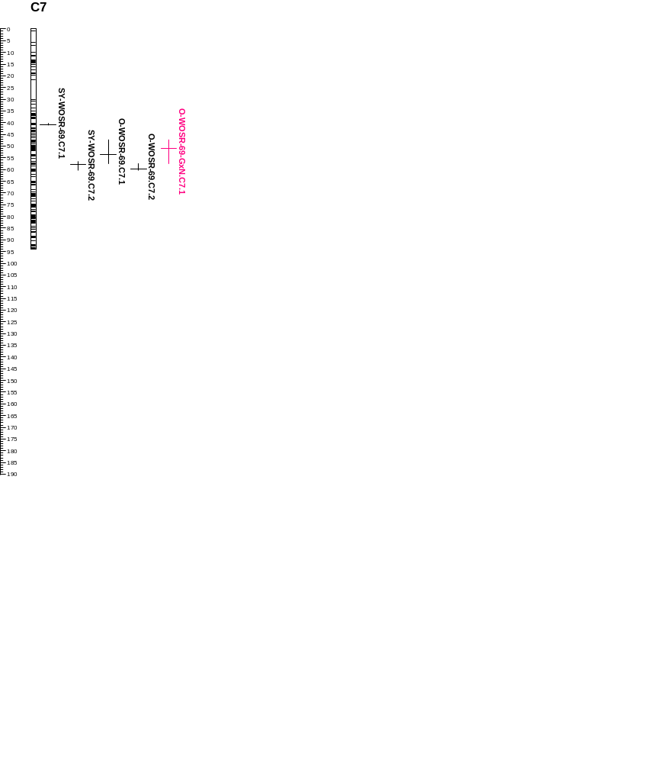
SY-WOSR.C7.1
(4)
O-WOSR-GxN.C7.1
(1)
SY-WOSR.C7.2
O-WOSR.C7.1
(1)
(3)
O-WOSR.C7.2
(4)
(3)
(3)
(1)
(3)
(1)

Slide 19
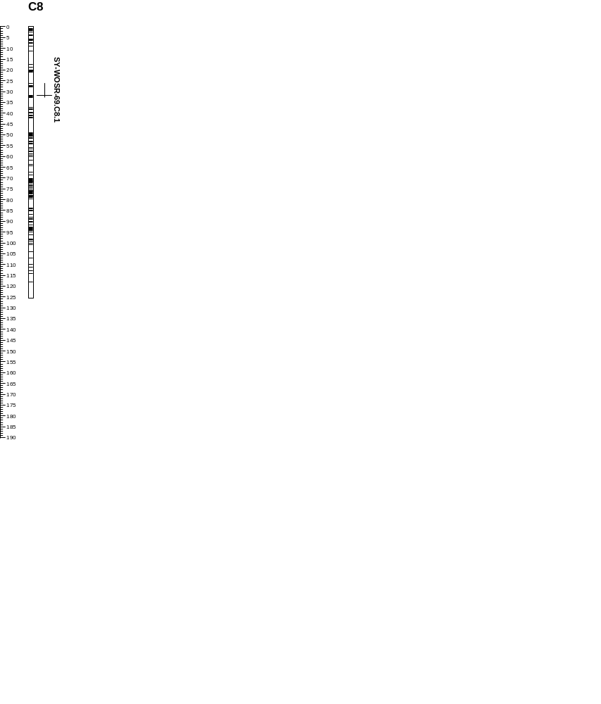
SY-WOSR.C8.1
(1)

Slide 20
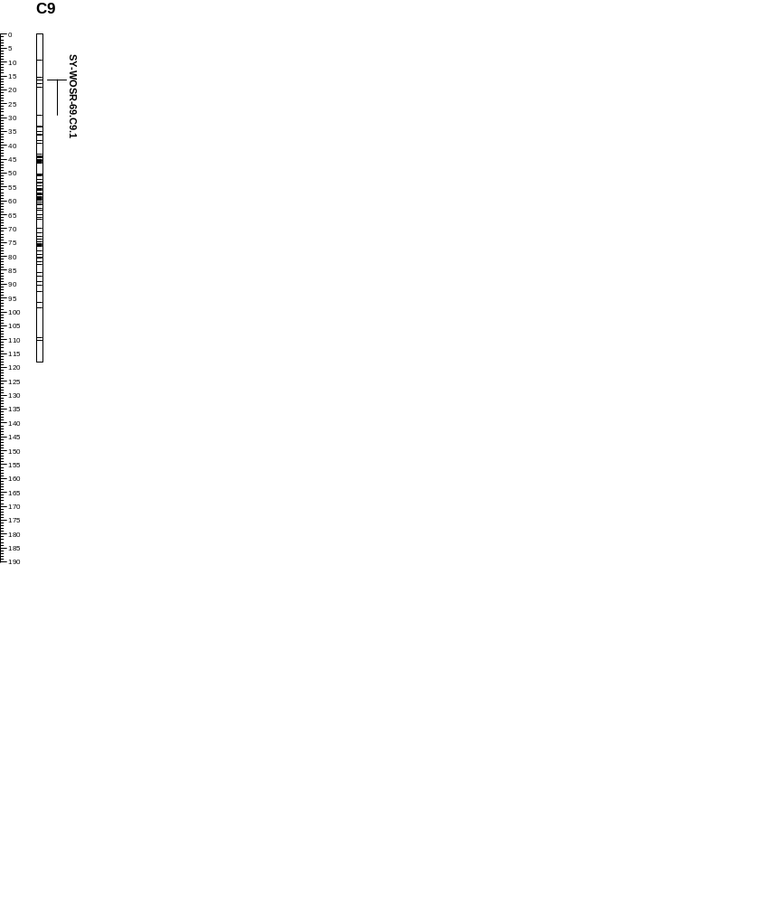
SY-WOSR.C9.1
(5)
(1)
(1)

